Slide 1
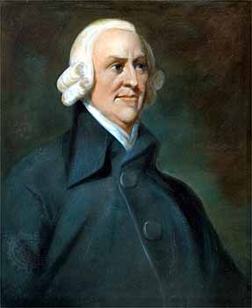
Adam Smith’s Specialization Theory
By Valerie Jensen
“All money is a matter of belief.”

Slide 2
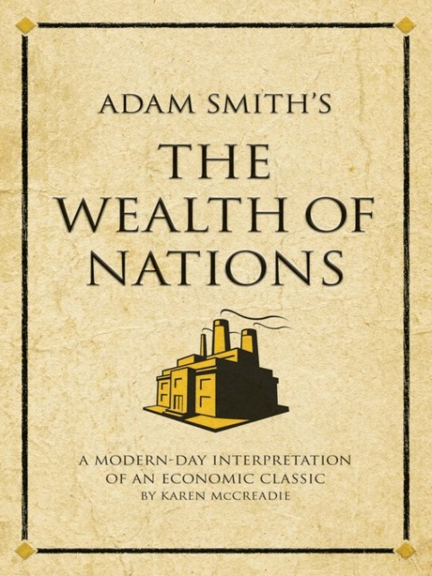
About the Specialization Theory
The specialization theory was devised by Adam Smith.
Broke large jobs into smaller jobs then would assign jobs to workers.
First recognized in Adam’s Smiths book "Wealth of Nations," published in 1776.
The specialization theory is better known as division of labor.
Devised during the Age of Enlightment.

Slide 3
Why was theory was created?
To create specialized knowledge of a particular trade or task, also known as self interest.
Save labor time.
Division of labor involved in the production of a particular product leads to increased productivity.
To create a market between other countries.

Slide 4
Key Points
Helped develop mass assembly lines and mass production later on.
Became a technique used in modern economics.
“Mercantile System” to describe the system of political economy that sought to enrich the country by restraining imports and encouraging exports or production (LaHaye).
Mercantilism-colonies that would supply materials and markets and relieve home nations of dependence on other nations.
Notes:
Lead to a system call the

Slide 5
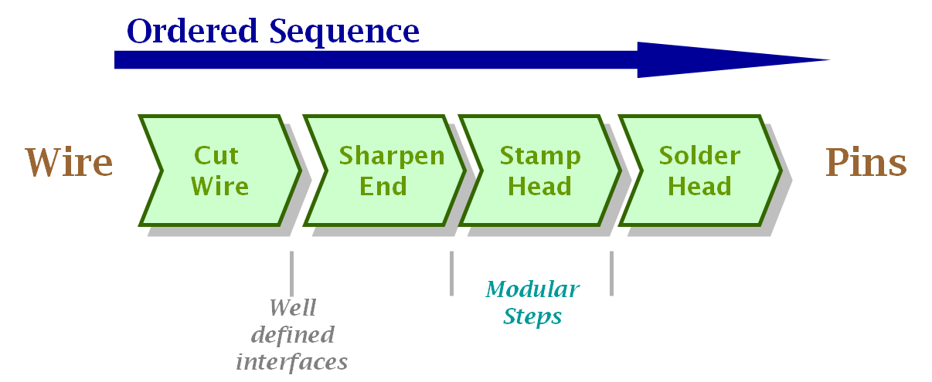
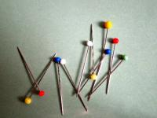
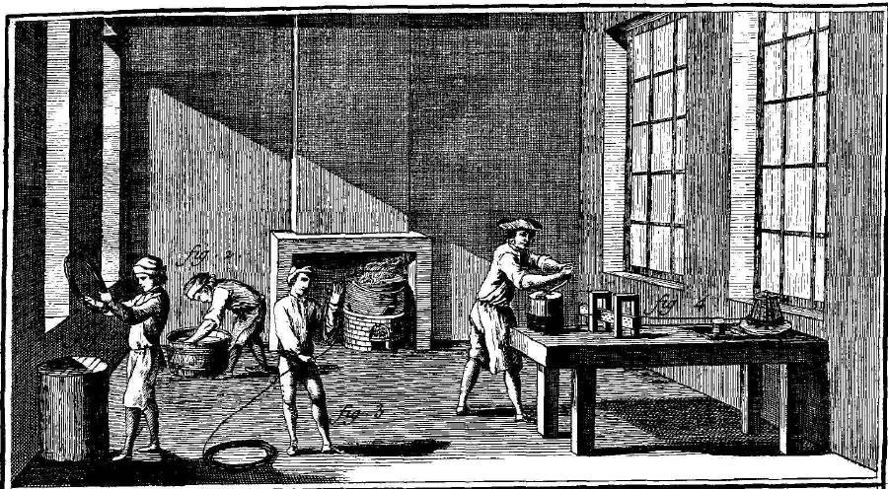
How does theory work?
Adam Smith used pins in his book as an example of how division of labor works.

Slide 6
What economic basics are involved in the theory?
Productivity-measure of the amount of output produced with a given amount of productive factors; normally refers to labor, but can apply to all factors of production.
Capitol-Money made off production.
Opportunity Cost- the highest valued alternative given up when a choice is made.

Slide 7
Are their flaws in the theory?
Workers would hate repetition.
Based on market if you over produced during bad times you will have over production.
-Farm crisis
Specialization theory led to long working hours, child labor, low wages, and unsafe conditions.
Loss of skill
Cost of training workers
Machinery eventually replaced by human labor.

Slide 8
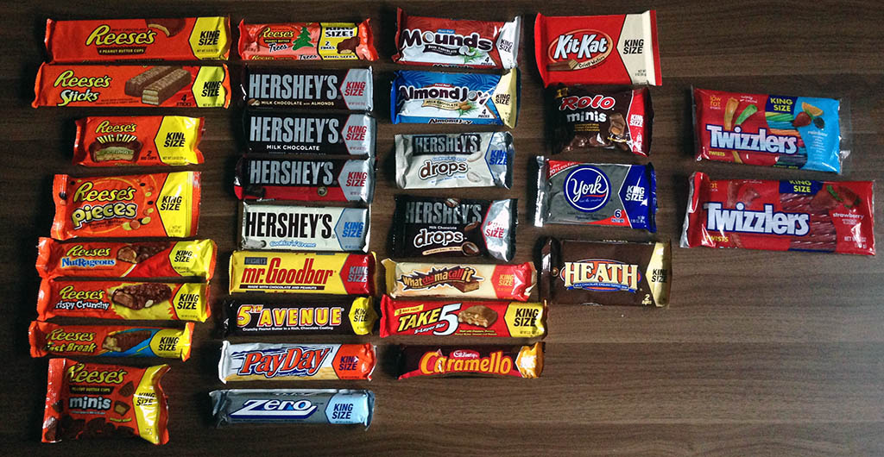
Current leaders in this field
Today specialization can be seen in companies and businesses.
Kellogg specializes in cereals.
Coca-Cola specializes in soft drinks.
Hershey’s specializes in candy.
Apple specializes technology.

Slide 9
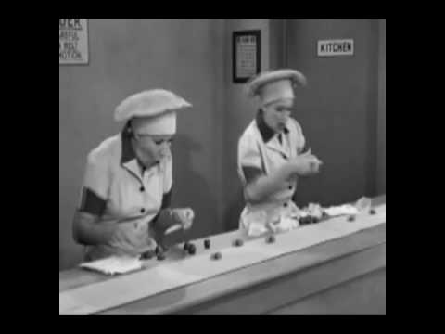
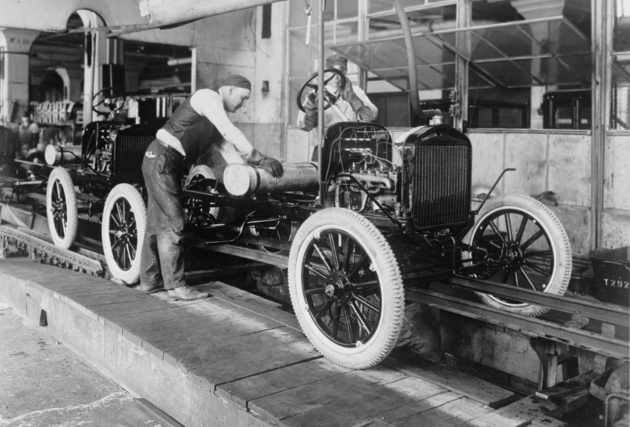
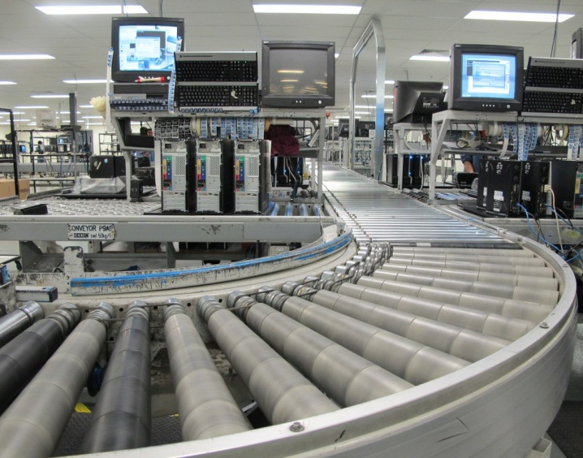
How has the theory evolved since its inception?
In the beginning: Workers didn’t use as much machinery and worked individually to complete small jobs.
1900s: Henry Ford created assembly lines and mass production had changed the way people had worked. Workers would work one station using the organizational theory.
Today: Most factories use robots to replace the work of employees.
http://www.youtube.com/watch?v=D6LUg-siJVs

Slide 10
Does the theory still have value today?
Adam Smith’s division of labor theory created the basics of modern economics.
Today we still use this idea but in a different way.
Everything is mostly done by machines, computers, and robots. Although this theory has changed a little bit his idea is used to this day, which is why some people acknowledge him as the father of economics.

Slide 11
Globalization theory-Factories would be set all over the global to produce products. This ways is less expensive for paying for employees. Comparative Advantage theory-Producing something to make it a lower cost than anyone else. Laissez Faire- Opposing any government intervention into business affairs. Classical Economics- theory about the way markets and market economies work. Primarily concerned with the dynamics of economic growth.
What connections exist with one of the other theories?

Slide 12
Works Cited
http://www.economist.com/
https://jmc.msu.edu/specialization/pe/
http://oll.libertyfund.org/index.php?option=com_content&task=view&id=1634&Itemid=263
http://www.dailymail.com/News/NationandWorld/201301140139
https://wiki.uchicago.edu/download/attachments/54231678/adam+smith.jpg?version=1&modificationDate=1286245912000
http://smallbusiness.chron.com/specialization-labor-can-lead-increased-productivity-12347.html
http://www.econlib.org/library/Topics/Details/comparativeadvantage.html
http://www.investopedia.com/terms/c/classicaleconomics.asp

