Slide 1
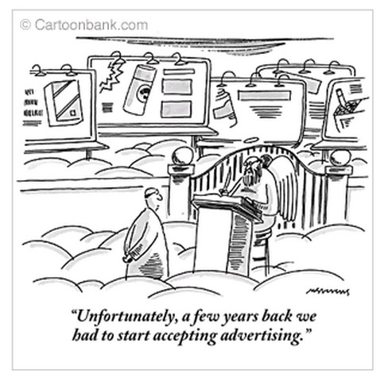
Monopolistic Competition
AP Micro Economics final project
Leah Sturgis

Slide 2
What is monopolistic competition?
A market structure in which there are…
-Many competing firms (many buyers and sellers)
-differentiated products
Sellers are price searchers and price makers and produce where MR=MC
Firms advertise
-free entry/exit in the industry in the long run
A mix between a monopoly and perfect competition

Slide 3
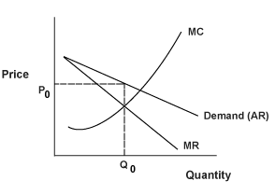
Demand curve is downward sloping: since there are many buyers and sellers, the demand curve is highly elastic and the firms will try to find a price that will maximize profits
http://i.investopedia.com/inv/articles/site/micro3.14.gif

Slide 4
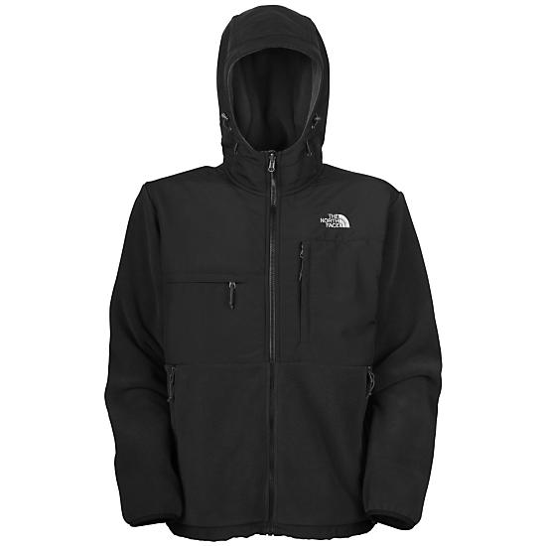
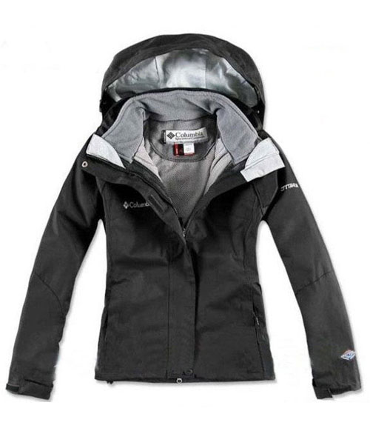
Each firm has some ability to set the price of their differentiated product, but how high they set the price is limited by competition faced by other firms who may have a close but not identical product.
North face vs. Columbia
m

Slide 5
Comparing Monopolistic competition to perfect competition and monopolies
Monopolistic competition is not a monopoly because the firms face competition, but M.C is still not like perfect competition because the firms still have some power to set the prices.
Like monopolies, M.C firms charge a price above marginal cost
In P.C and M.C the prices received by every firm is equal to ATC of production in the long run

Slide 6
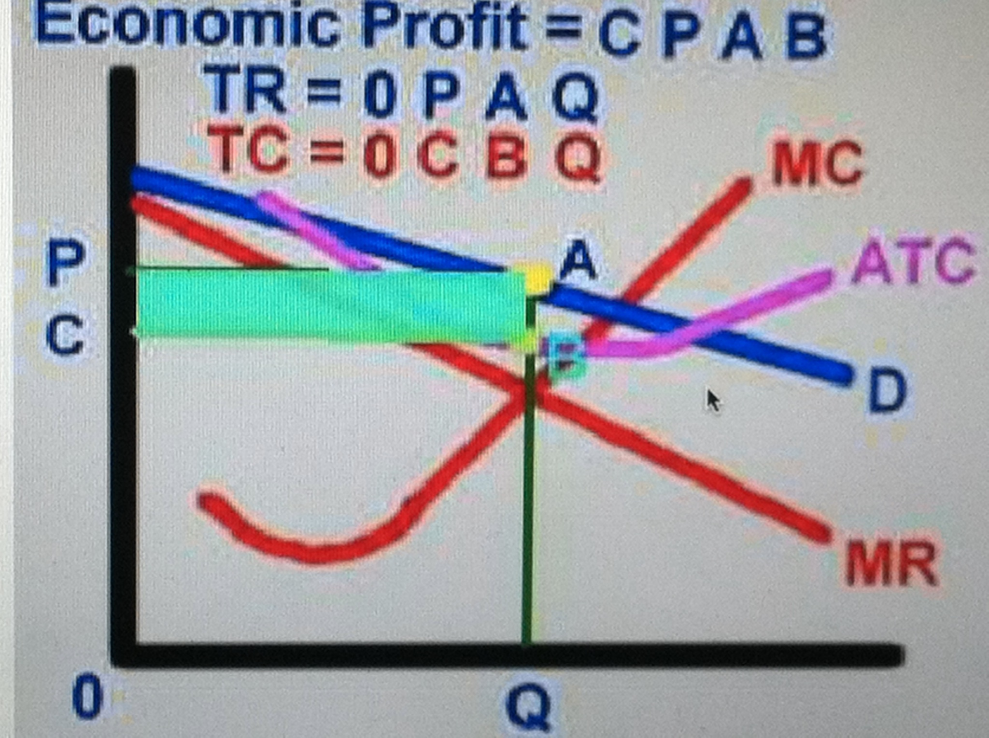
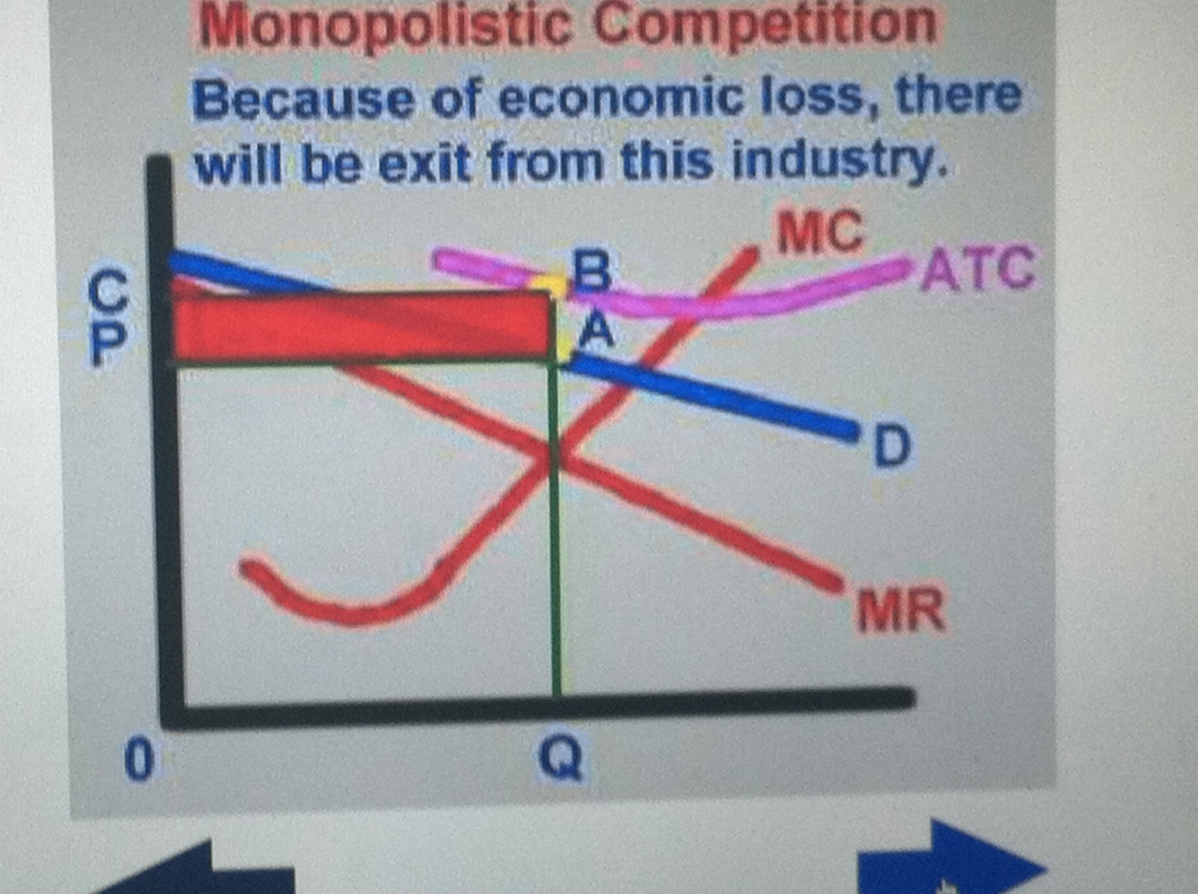
Short Run
- Profit and loss is possible in the short fun for monopolistically competitive firms.
Profit will occur if the ATC curve is below the price, while loss will occur if ATC is above the price (shown below in the graphs)
Photos: reffonomics.com

Slide 7
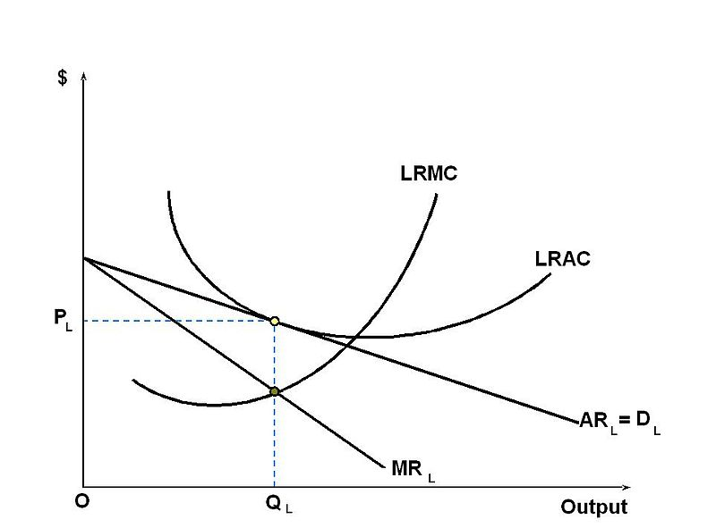
Long Run
In the long run, a monopolistically competitive firm will be in the zero profit equilibrium, which is the point where each firm makes zero profit at it’s profit-maximizing quantity
The demand curve will be tangent to the ATC curve at the firms profit maximizing quantity (where MR=MC)
Point of tangency
http://en.wikipedia.org/wiki/File:Long-run_equilibrium_of_the_firm_under_monopolistic_competition.JPG

Slide 8
Firms in a monopolistically competitive industry have “excess capacity”– they produce less than the output at which ATC is minimized
More producers= higher ATC but more diversity (so there are some trade-offs)

Slide 9
Do monopolistically competitive industries exist in the real world??
YES! Companies that sells goods like toothpaste, shampoo, soap, toilet paper– firms that advertise (but have basically the same product) and claim their product is superior to competitors products are monopolistically competitive firms!
Think different brands..
But don’t get this mixed up with superior and inferior goods..it’s not the same because different brands are not always considered inferior or superior to another one..they are just differentiated.

Slide 10
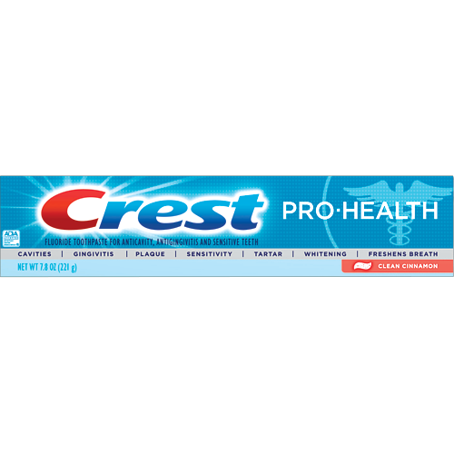
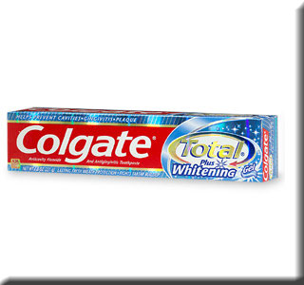
Toothpaste
If I believe crest is better than Colgate but crest raises their prices and Colgate doesn’t, will I still buy crest? ….Maybe not, I am still sensitive to price and may just go for the better deal..since after all, its just toothpaste.
Colgate guarantees whiter teeth, while crest guarantees protection against cavities, gingivitis, plaugue,ect..so although at the end of the day, toothpaste is still toothpaste, I may be more likely to purchase the brand that wins me over through advertising their superior( and differentiated) product.

Slide 11
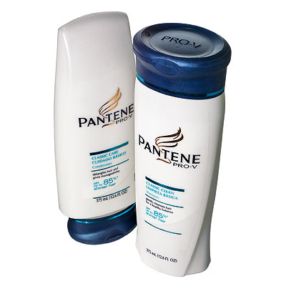
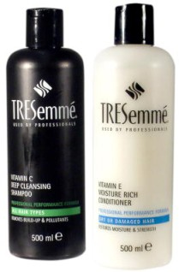
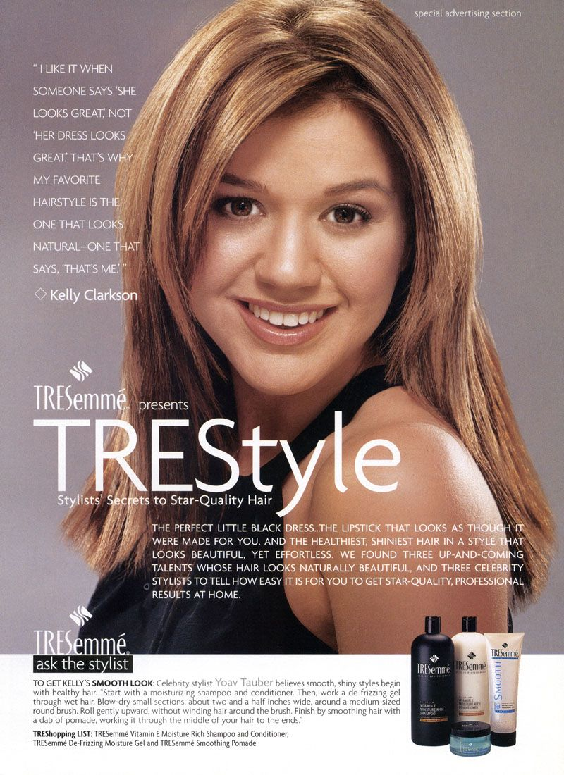

Shampoo and Conditioner
Sometimes celebrities are used in advertising different products because if a consumer thinks a celebrity uses a specific shampoo they might have a incentive to buy it

Slide 12
Practice
Correct answer: E
First of all, A is not one of the characteristics of a M.C market
B- if the goods were perfect substitutes than the firm would be P.C
C&D: complementary goods are not characteristics of goods in a M.C market
E: firms will advertise similar goods but differentiate them so consumers will buy their product. If the price of one good becomes too high, the consumer may purchase another firms good because it is a close substitute.
Monopolistic competitors make products that are
A: used in conjunction with one another
B: perfect substitutes
C: Perfect complements
D: close but not perfect complements
E: Close but not perfect substitutes

Slide 13
As its output increases, a firm’s short-run marginal cost will eventually increase
because of:
(a) diseconomies of scale
(b) a lower product price
(c) inefficient production
(d) the firm’s need to break even
(e) diminishing returns
Answer: E
Diminishing returns to an input: the effect observed when an increase in the quantify to an input, while holding the levels of all other inputs fixed, leads to a decline in the marginal product of that input.

Slide 14
Which of the following results is possible for an monopolistic competitor in the short run?
I: Positive Economic Profit
II: Normal Profit
III: loss
A) I only
B)II only
C) III only
D) I and II only
E) I, II, and III
Answer: E
Since this question is asking about the short run, all three results are possible, if it was asking for the long run the answer would not be the same.

Slide 15
Free Response-2004 Exam
#3- Assume that a profit maximizing firm in a monopolistically competitive industry is in long-run equilibrium.
A) Draw a correctly labeled graph that shows the profit maximizing firm’s price and output.
B) Assume that the city in which this industry operates eliminates the business license fee (a fixed cost) for all of the firms in this industry. How does the elimination of the license fee affect each of the following for the individual firm in the short run? Explain your answers.
(i) Output
(ii) Economic Profits

Slide 16
Answers to FRQ
A) –Draw a correctly labeled graph--must show a downward sloping demand curve
-downward sloping marginal revenue curve above the demand curve
Q from MR=MC and P from demand directly above Q
Long run equilibrium- ATC is tangent to Demand at Q
B) the individual firms output level will not change
-since the license fee is a fixed cost, it will not effect marginal cost
-economic profits will increase

Slide 17

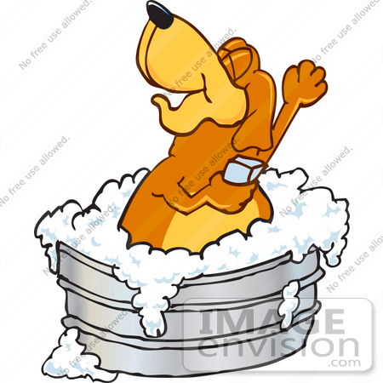
Economic Art- My own “business”
Leah’s Soapy Car Wash
Quick! You’re car will be clean and sparkling within 5 minutes or your money back
Effective! Use of luxury soaps and cleaning supplies will keep your car cleaner than any other car wash within 100 miles
Convenient! Open 24 hours a day: coffee and bagels served inside
Complimentary air freshener received with every purchase!

