Slide 1
Why We Need Algebra!
By Eliska Estrella

Slide 2
Many people or different jobs need algebra.
Farmers
Construction workers
Animators
Computer Scientist
Astronaut
Fashion Designer
Computer Game Designers
Many jobs surrounding health and nutrition need math for their everyday life

Slide 3
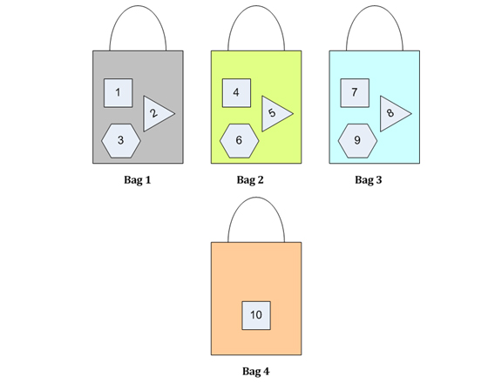
Ex:
We could use algebra when going shopping
Ex: We use simple algebraic formula xyxy to calculate the number of bags.
x = Number of items purchased = 10
y = Capacity of 1 bag = 3
103103 = 3.333.33 bags ≈ 44 bags
So,we need 4 shopping bags to put 10 items.

Slide 4
The prices are
a = Price of two dozen eggs = $10
b = Price of one bread = $5
c = Price of one bottle of juice= $8
=> Money needed = a + 3b + 5c
=> Money needed = $10 + 3($5) + 5($8) = $10 + $15 + $40 = $65

Slide 5
Algebra can also be used for everyday word problems
A group of 5 boys goes to the theatre. The cost of ticket and popcorn is $55 and $25 respectively. What is cost per person?
Here’s how to solve the problem
1. Understand the problem
A group of 5 boys goes to the theatre. The cost of ticket and popcorn is $55 and $25 respectively. What is cost per person?
2. Write the variable
Let’s say, xx = cost of ticket/person and yy = cost of popcorn/person
3. Write the equation
If 5 tickets cost $55, then cost of one ticket is,
5x5x = 55
xx = 555555
If 5 bags of popcorn cost $25, then the cost of each bag is,
5y5y = 25
yy = 255255
Total cost of the movie (ticket + popcorn) per person = x+yx+y

Slide 6
4. Solve the equation
Cost of ticket/person
xx = 555555
xx = $11
Cost of popcorn/person
yy = 255255
yy = $5
5. Check your answer
Cost of ticket/person + Cost of popcorn/person = Total cost
11 + 5 = 16
If we add up 16 five times (since there are 5 boys), the result is,
16 + 16 + 16 + 16 + 16 = 80
$80 is the total cost.

Slide 7
Why It’s important to me!
Math Is important to my future because in the future I would like a job relating to nursing

Slide 8
Why Doctors/Nurse need math!
Calculating Dosages
Converting Between Systems
Calculating IV Drip Rates
Drug Titration
They must calculate intake and output of their patients
A patient's doctor may need to know the number of calories the patient has consumed in a day.
Depending on a nurse's specialty, she may need to calculate ovulation dates, body mass index, glycemic index, scores on various scales of normalcy, or an expected date of confinement, also called due date in pregnancy.

Slide 9
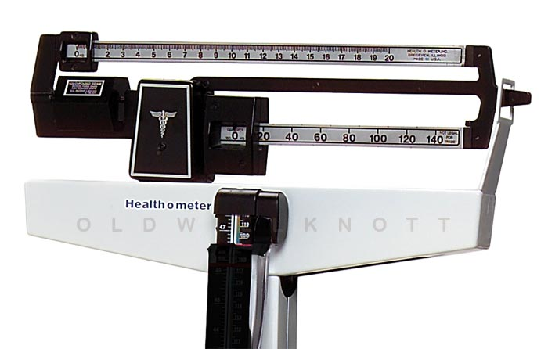
Why Doctors/Nurse need Math!

Slide 10
Video Game Designers
Video games need math in order for characters to do what they can do like; jump, run up a slope, punch,
Determining the path of a bullet or the movement of a car over a race track
Probablity is a big deal in games, some games are based on probability so designers use probability as a form of math in video games.
Geometry is also used when making video games because shapes need to be made for characters, settings, and basically everything.

Slide 11
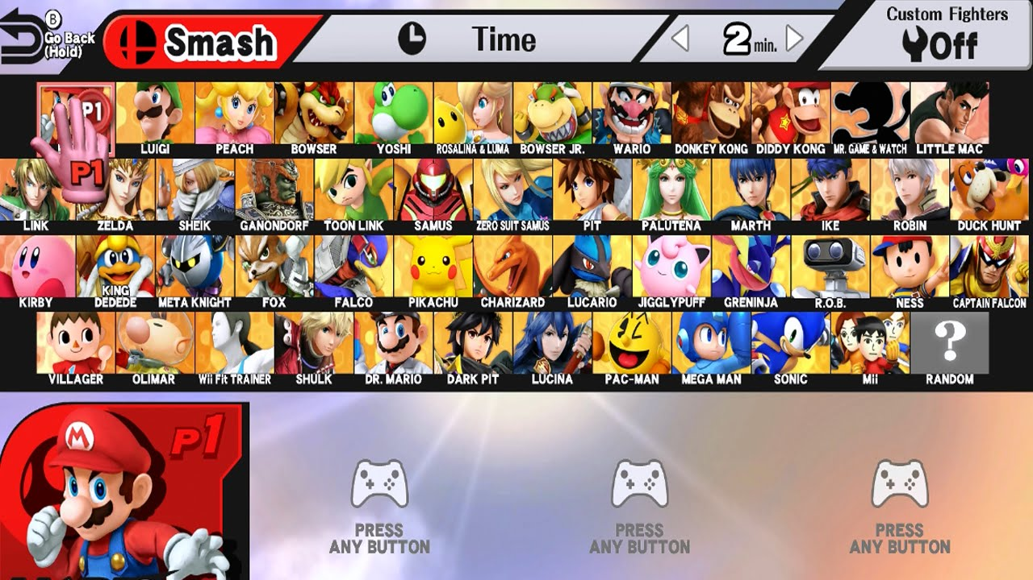

Slide 12
Why Construction Workers Need Math!
Construction workers have to know the dimensions of the pieces they work with, and make sure they use just the right amount, which requires adding and subtracting lengths of material. They also have to use math to work with their budget, like most people do.
Construction workers must use math in a variety of ways while practicing their trade, including taking measurements, converting quantities and solving equations.

Slide 13
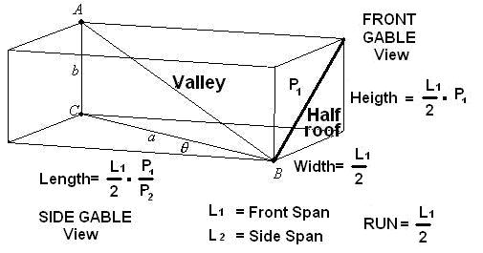
Why Construction Workers Need Math!

Slide 14
Why Farmers Need Math!
Create a feed ratio to meet livestock nutrient needs.
Calibrate a fertilizer spreader
Create a fertilizer blend
Apply a herbicide rate
Determine the perimeter of a field.
Determine how much fence wire, fence posts, staples and supplies needed to fence in the perimeter.
Determine proper stocking rate
Determine interest cost on an agriculture loan

Slide 15
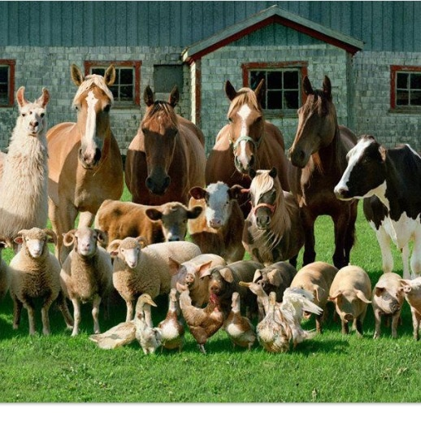
Why Farmers Need Math!

Slide 16
10 Reasons We Need Math
Math helps you with money problems
You can build things
Can use it in the grocery store for many things
Use math to bake or cook using the measurements
Can use math when calculating fuel usage for traveling
Using math can help you save money and help you make less financial mistakes
You can use math to plan time or your schedule for the day
Dancers count with math in their head and use geometry for formations
Determining Probability
Converting to Metric System
There are many other times when we use math and we don’t even realize it

Slide 17
Sources
http://startingwright.cs.wright.edu/Teacher/ingut/21-seriously-cool-careers.pdf
http://www.ipracticemath.com/learn/algebra/algebra_in_daily_life
http://work.chron.com/nurses-use-math-jobs-10475.html
https://www.quora.com/In-what-ways-do-construction-workers-use-algebra-and-for-what
https://www.thinkthroughmath.com/math-real-life-examples/
http://archive.bridgesmathart.org/2012/bridges2012-453.pdf
https://www.quora.com/How-is-math-used-in-video-game-designing-and-programming
https://www.reference.com/hobbies-games/math-involved-designing-video-games-6a45fe832e6d9d71

