Slide 1
PROTEIN-Eggs

Slide 2
Facts-
• A hen requires 24-26 hours to produce an egg. Thirty
minutes later she starts all over again.
• If an egg is accidentally dropped on the floor, sprinkle it heavily with salt for easy clean up.
• Egg yolks are one of the few foods that naturally contain vitamin D.
• Yolk color depends on the diet of the hen. Natural yellow-orange

Slide 3
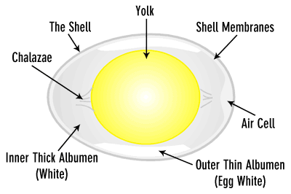

Slide 4
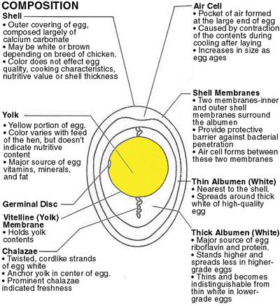

Slide 5
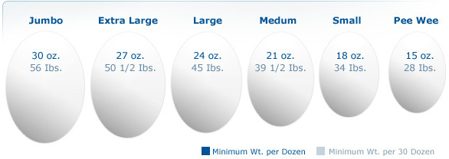
Sizes of Eggs

Slide 6
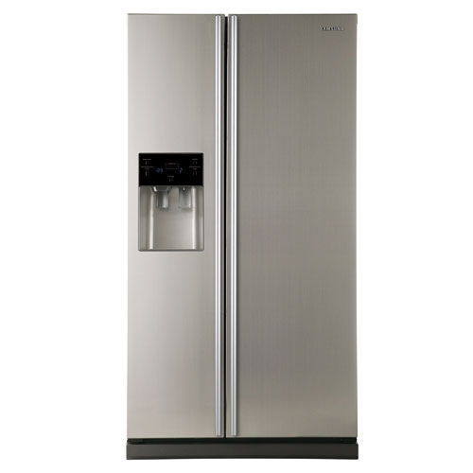
Storage of eggs:

Slide 7
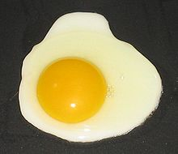
Important things to remember when cooking eggs:
Low temperature
Cook until desired firmness

Slide 8
Composition & Nutritional Value
1. One medium egg contains between 4-5 grams of fat
2. High cholesterol
• ~200 mg/egg
3. High in Complete Protein
4. High in vitamins & minerals
• Vitamins ADEK, some B vitamins, zinc, iron, copper

Slide 9
Egg Functions
1. Flavor, color, nutrition
2. Emulsifying agent
3. Aids in thickening/structure
4. Binding/coating agent
5. Leavening agent

Slide 10
Purchasing Eggs
Grading
• The best-quality eggs are graded USDA
Grade AA, followed by USDA Grade A.
– The grades sold at supermarkets.
• USDA Grade B, the lowest grade.
– Available to food service establishments and
not sold directly to consumers.

Slide 11
Differences between grades of eggs
 | White/yolk | shell | Use in recipe
Grade AA/A | thick | perfect | Fried, poached
Grade B/C | thin | Pale in color | Baking

Slide 12
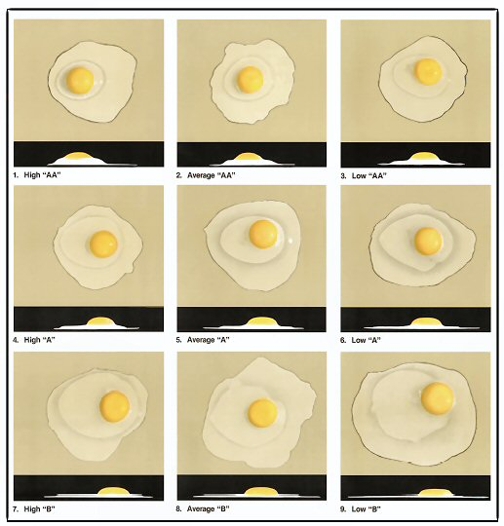
Characteristics of Fresh/High Quality Eggs
• Yolk is high & firm above the white
• Small yolk diameter
• Yolk is centered in white
• High ratio of thick to thin white
• High standing thick white

Slide 13
Preparation of Eggs
• Dry Heat
– Fried
– Scrambled
– omelets
• Moist heat
– “Boiled” eggs
–prepared in a cup
– Poached eggs
– A variety of
custards

Slide 14
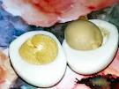
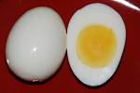
What is responsible for the dark ring around the cooked egg yolks?

Slide 15
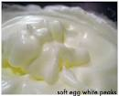
Stages of beaten egg whites

Slide 16
Inspection
• The Egg Products Inspection Act of 1970 requires
that egg processing plants be inspected and that
their eggs and egg products be:
– Wholesome
– Unadulterated
– Truthfully labeled
• This law is enforced by the USDA Poultry
Division and applies to all eggs, whether imported
or shipped intra- or interstate.

Slide 18
Egg Safety Tips
1. Inspect before buying and discard any
broken eggs
2. Refrigerate immediately at or below 40 F
3. Keep in cartons
4. Cook until the whites are coagulated & yolks
begin to thicken to kill the salmonella
bacteria
5. Egg dishes should not be kept out >1hour

