Slide 1
Linear Perspective Ms. Brassard
“Perspective is the rein and rudder of painting"
Leonardo da Vinci

Slide 2
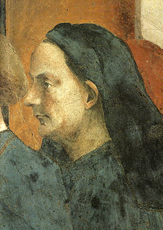
Brunellesco
Filippo Di Ser Brunellesco lived from 1377 to 1446. He was a sculptor, architect and engineer. He is given credit for the invention of linear perspective.
Brunellesco was depicted in the
Resurrection of the Son of Theophilus by Masaccio.

Slide 3
One of Brunellesco’s Masterpieces The Duomo Built 1418-1436 in Florence, Italy.

Slide 4
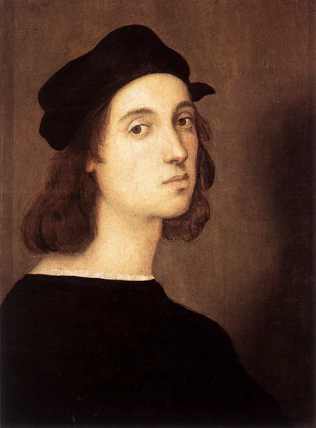
Donatello
The earliest surviving use of linear perspective in art is attributed to Donato di Niccolò di Betto Bardi (1386-1466) who was called Donatello.

Slide 5
Donatello The Feast of Herrod c. 1425

Slide 6
Raphael The School of Athens c. 1509

Slide 7
Diagram from watercolorpainting.com

Slide 8
Diagram from watercolorpainting.com

Slide 9
Diagram from buzzle.com

Slide 10
Relativity M.C. Escher 1953

Slide 11
Van Gogh Bedroom at Arles 1888

