Slide 1
Chapter 4 Biochemistry aka Organic Chemistry

Slide 2
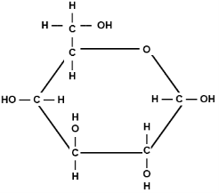
Carbohydrates
Molecular Formula | Empirical formula | Structural Formula**recognize it
C₆H₁₂O₆ | CH₂O | Has a ring structure

Slide 3
Carbohydrates
(composition and uses)
Elements Present
  Carbon
  Hydrogen
  Oxygen
  H:O = 2:1 Always !!
Used by organisms for
Energy See starch and glycogen below | Structure See Chitin and cellulose below

Slide 4
Building Blocks (monomer, simplest unit)
Monosaccharides (simple sugars
Ex: glucose THIS IS THE BODIES quick cheap energy supply

Slide 5
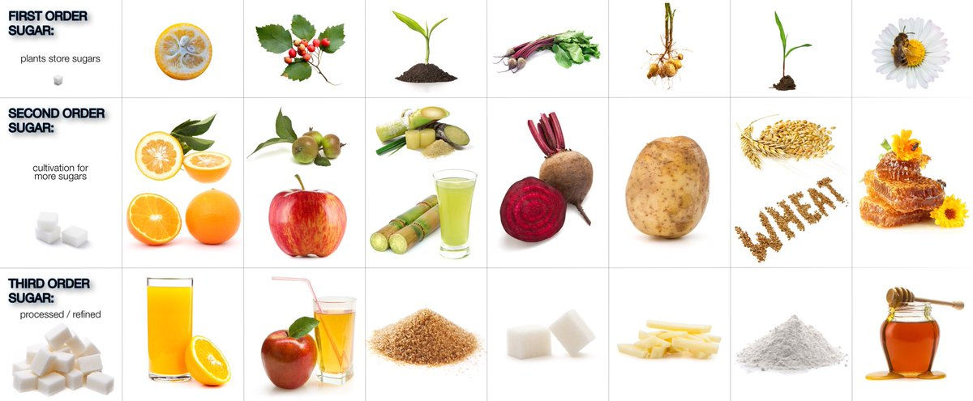
Other monomers of carbohydrates
Fructose = processed and synthetic sugar

Slide 6
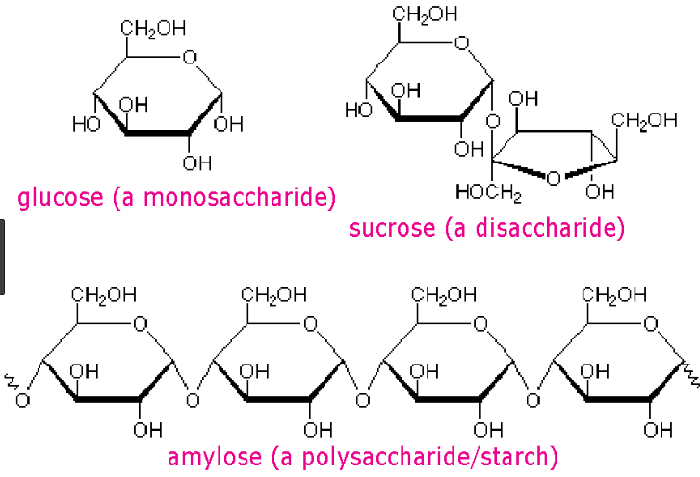
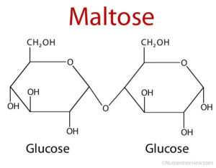
Examples & Functions / Related terms & info
Disaccharide = 2 connected monosaccharides
Polysaccharide = 3 or more connected monosaccharides

Slide 7
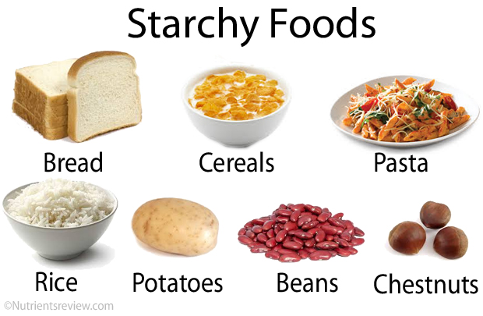
Starch
Starch – polysaccharide stored in plants used as energy reserve

Slide 8
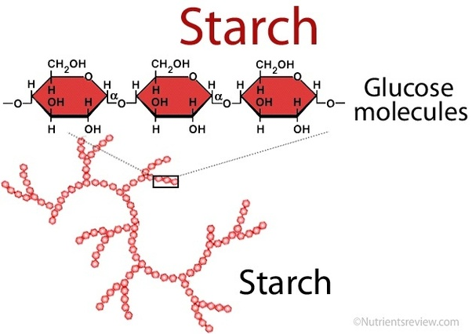

Slide 9
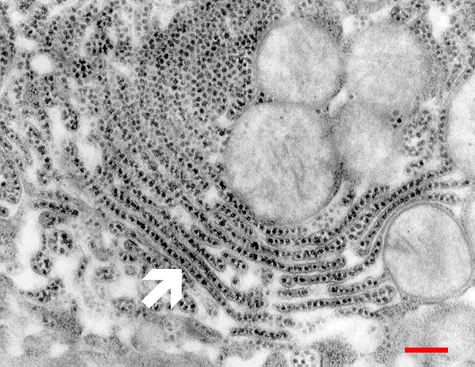
Glycogen
Glycogen - animal equivalent to starch used for energy reserve and stored in liver.

Slide 10
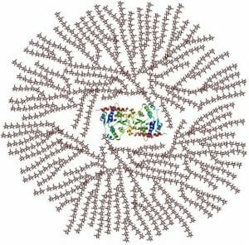
One Glycogen can contain up to 30,000 units of glucose

Slide 11
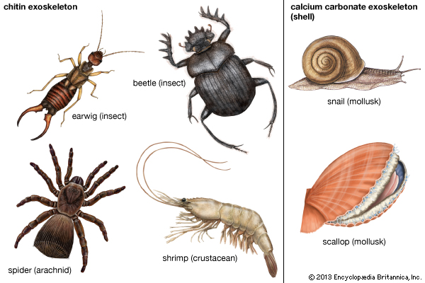
Chitin
Chitin – makes up the exoskeleton (provides support) of arthropods which are invertebrates.

Slide 13
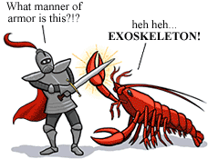

Slide 14
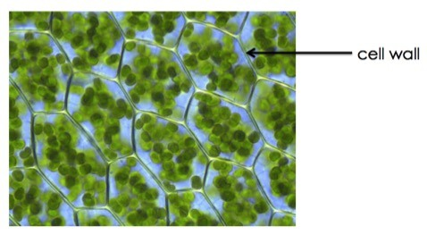
Cellulose
Cellulose – makes up the cell walls of plant cells (provide support and structure to cell)

Slide 15
Naming of carbohydrates
Names of carbohydrates usually end in -ose ex: glucose, fructose, sucrose, galactose, lactose

Slide 16
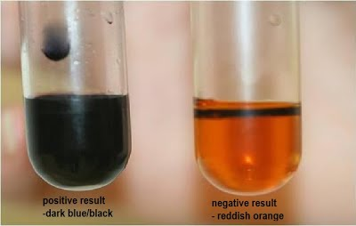
Indicators
Lugol’s Solution
Lugols iodine solution turns from amber to bluish black when starch is present.

Slide 17
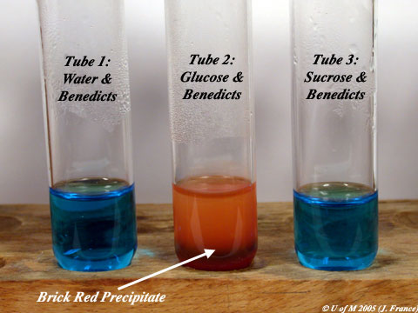
Benedicts Solution
Benedicts solution turns from blue to brick red when glucose is present with the addition of heat.

Slide 18
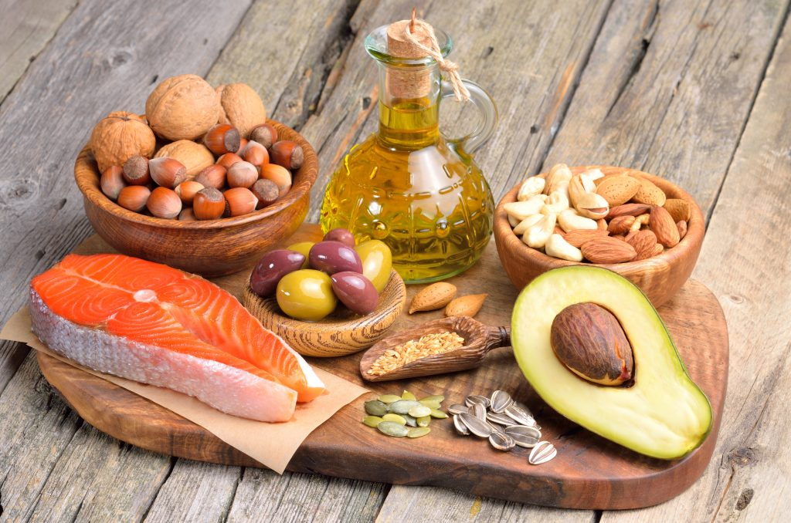
LIPIDS

Slide 19
Elements Present
Carbon
Hydrogen
Oxygen
NO SPECIFIC RATIO
OF H:O
Used by organisms for
Stored energy See types of fats | Structure Importance of cell membrane

Slide 20
Types of Fats
Saturated fats
All single bonds C-C
Straight chain
Solid at room temperature
FATS
Mostly animals

Slide 21
Building Blocks of Lipids
Carboxyl Group (COOH)
3 fatty Acids
1 Glycerol

Slide 22
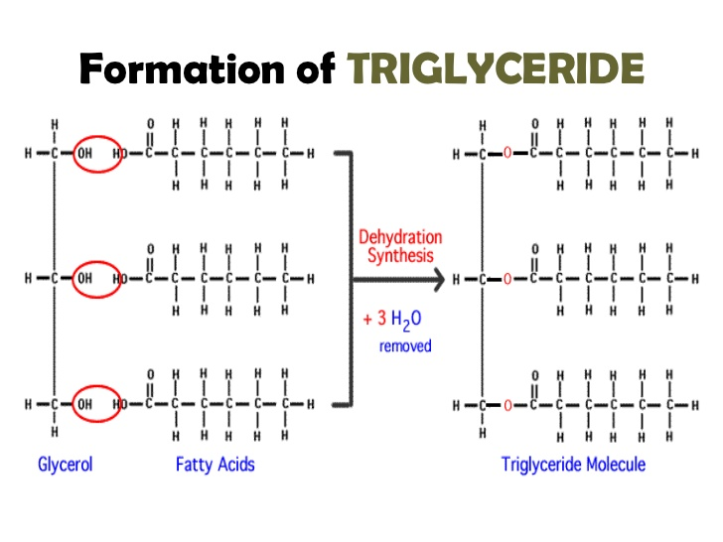

Slide 23
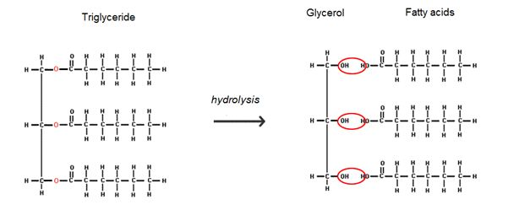

Slide 24
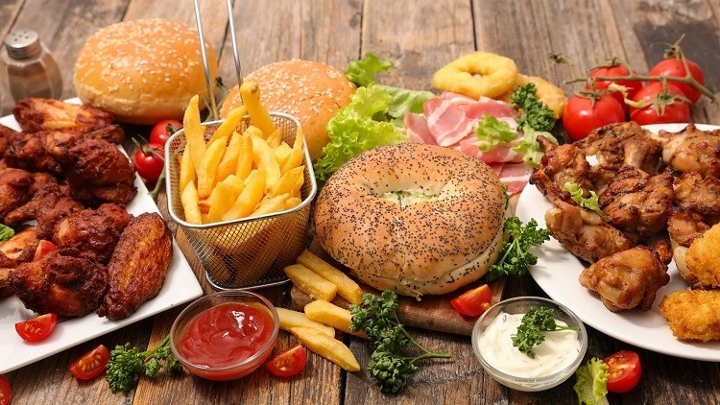

Slide 25
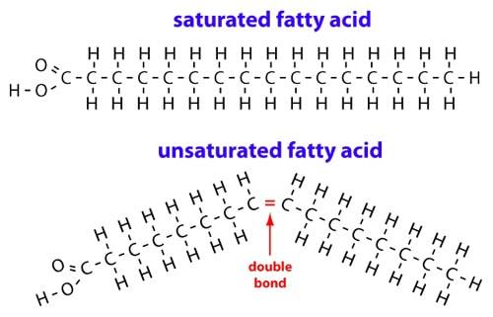

Slide 26
Types of Fats
Unsaturated Fats
Some double C=C bonds or triple bonds
Bent chain
Liquids at room temp
OILS
Mostly plant

Slide 27
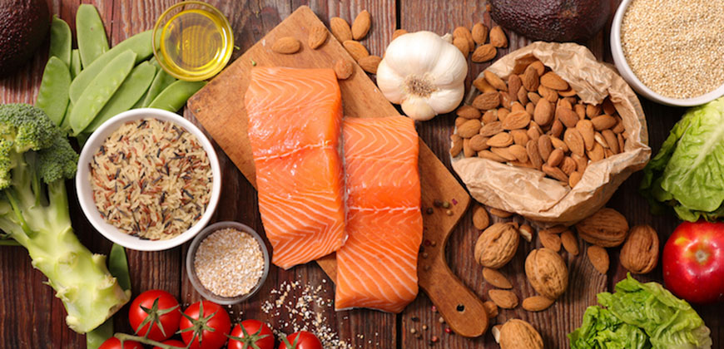

Slide 29
Types of Fats
Cholesterol
Cholesterol C₂₇H₄₆O
Component of cell membrane and hormones

Slide 30
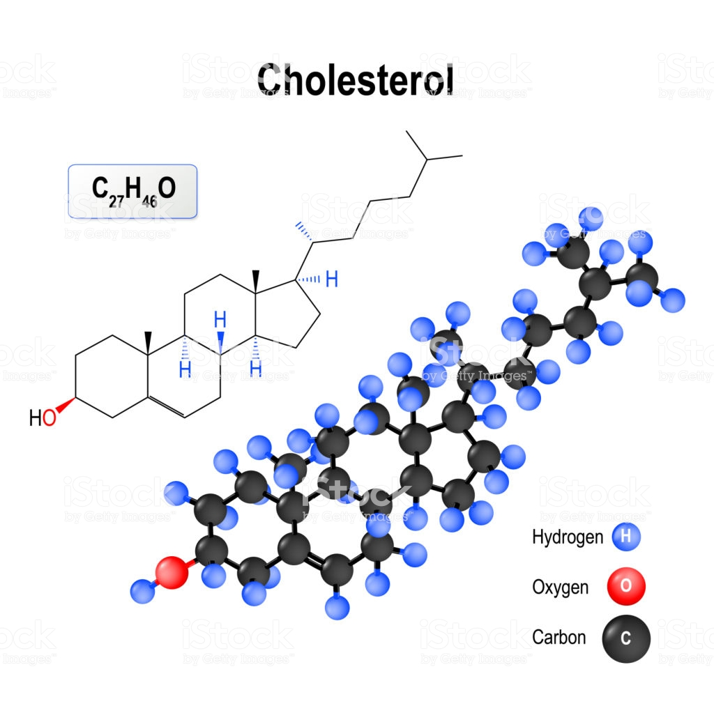

Slide 31
Types of Fats
Triglycerides
Triglycerides – calories not used right away converted to this for storage in fat cells

Slide 32
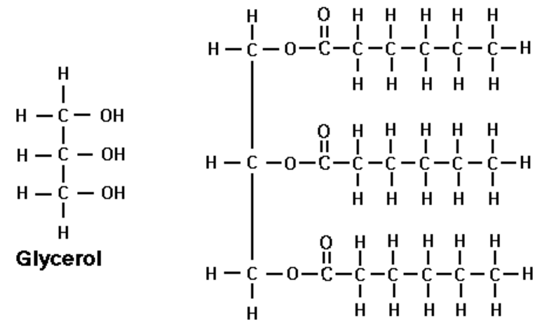

Slide 33
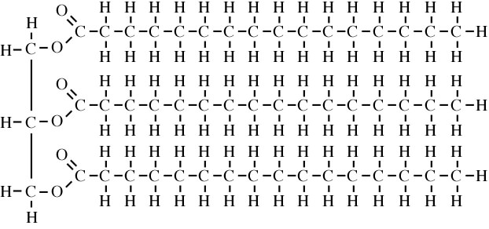

Slide 34
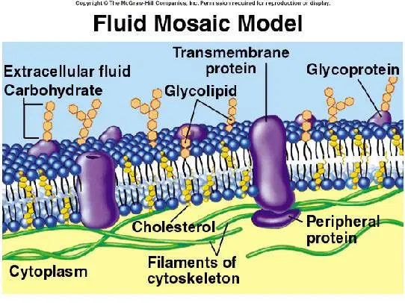

The Cell Membrane
Fluid Mosaic Model

Slide 35


Slide 36
Why is it important to have the right amount of nutrients?
Homeostasis and regulation around a stable point

Slide 37

Having the right amount of lipids aka “The Fats goldilocks theory”
Combination of multiple types of fats each has role in how fluid/open the gaps in the cell membrane are.
Three Types of Fat Molecules

Slide 38
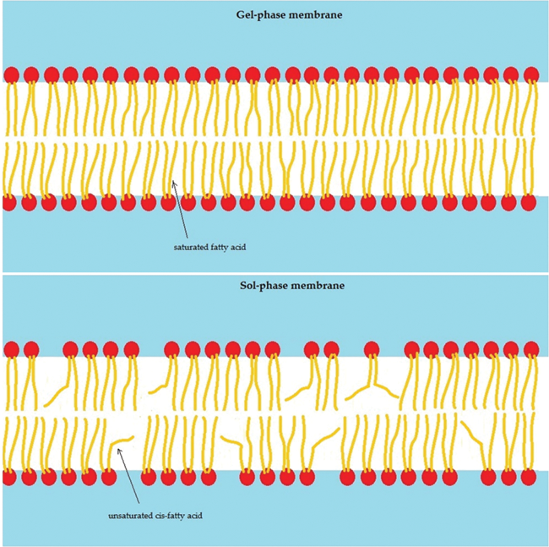
Saturated Fats= Tightly bonded
TOO MUCH = Low Fluidity
TOO LITTLE= High fluidity

Slide 39
Unsaturated Fats= bent molecules
TOO MUCH = High Fluidity
TOO LITTLE=Low fluidity

Slide 40
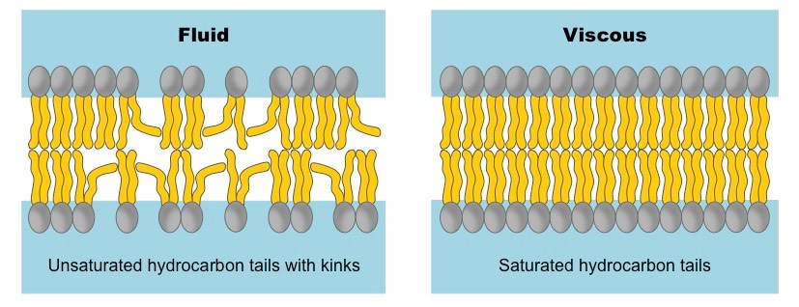

Slide 41
Cholesterol = very large and takes up space
TOO Much= “Clogging” Too Little: High fluidity
Keeps the cell membrane together

Slide 42
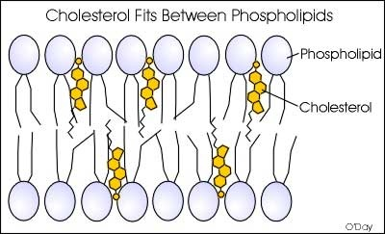
JUST RIGHT
combination of the three types of fats that results in enough “gaps” to allow for smaller crucial molecules (ie glucose and water) to pass through but not larger bulky molecules (ie starch)

Slide 43
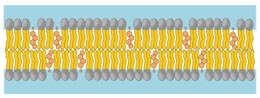

Slide 44
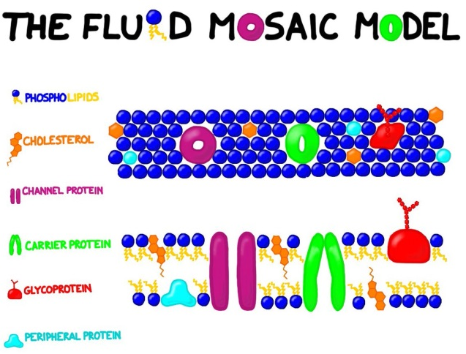

Slide 45
Now Let’s practice with these two bio molecules in the Big ‘ol Molecules Lab

Slide 46
ProteiNs
Elements Present
Carbon
Hydrogen
Oxygen
NITROGEN

Slide 47
Used by organisms for
Structure and movement (muscles)
Enzymes
Antibodies
Hormones
Pigments

Slide 48
Related Terms & Info
Peptide bond- bond between 2 Amino Acids
Dipeptide – 2 amino acids bonded
Polypeptide = long chain of AA bonded

Slide 49
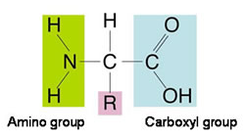
Building Block= Amino Acids (AA)
R= Side chain.. varies among amino acids

Slide 50
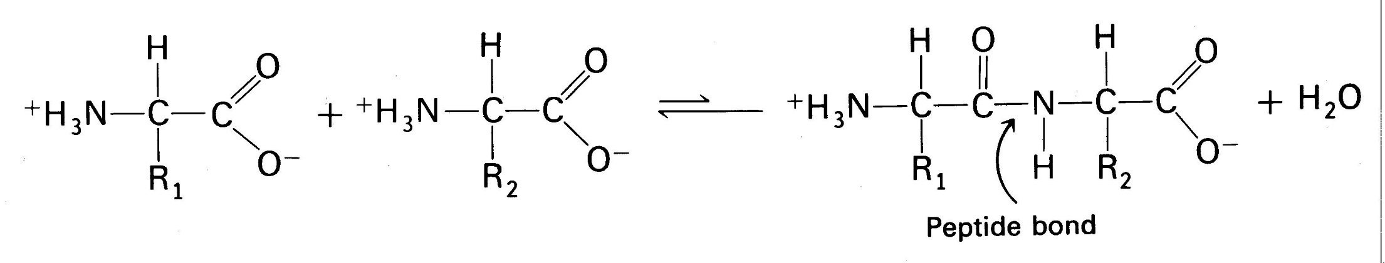
Making ProteiNs

Slide 51
Important Proteins and Functions
Enzymes- speed up chemical reactions (more later)

Slide 52
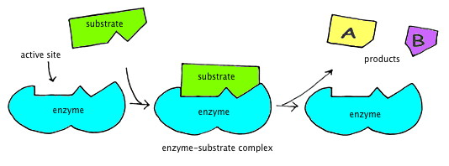

Slide 53
Antibodies
Antibodies – natural immune system in body

Slide 54
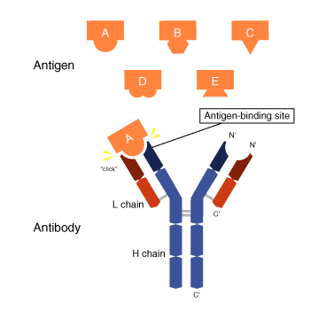

Slide 55
Hormones
Hormones – chemical signals that affect activity in separate area of body

Slide 56
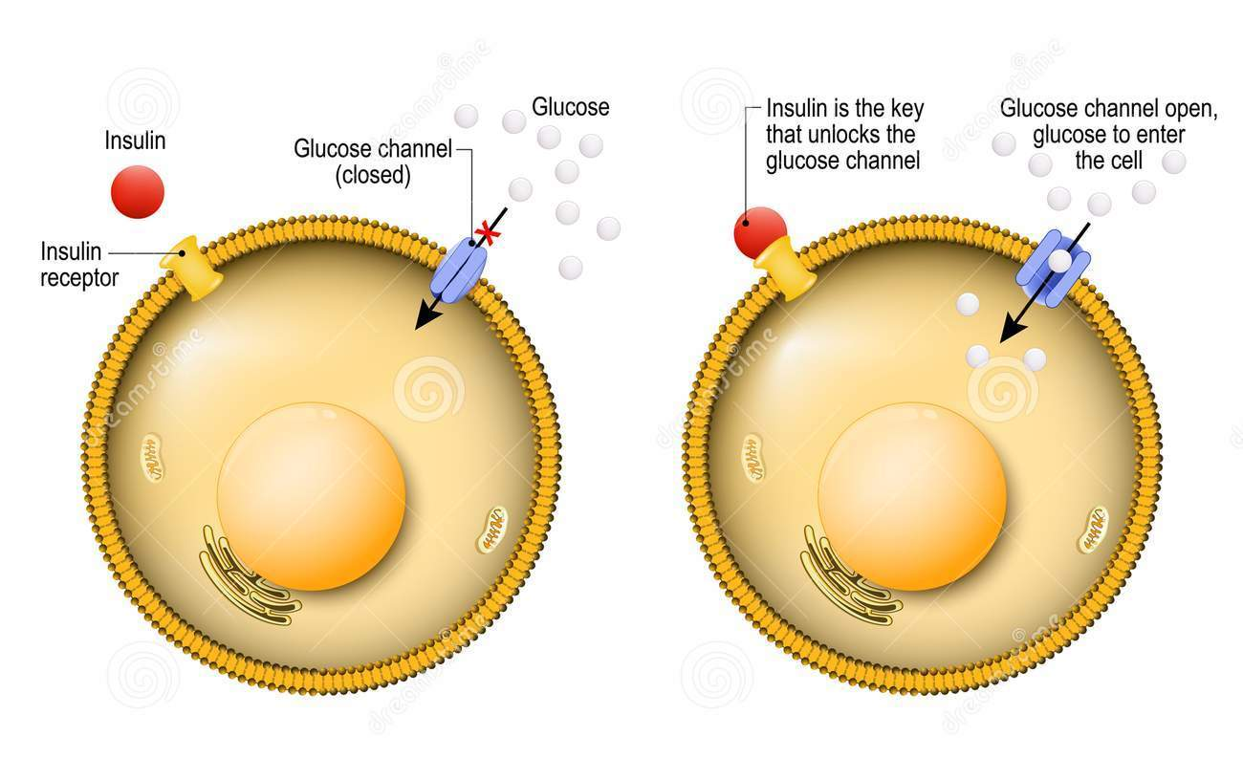
Insulin is a Hormone

Slide 57
Muscle and Movement
Muscle and Movement – component of all tissues and organs, provides higher and more sustained energy

Slide 58
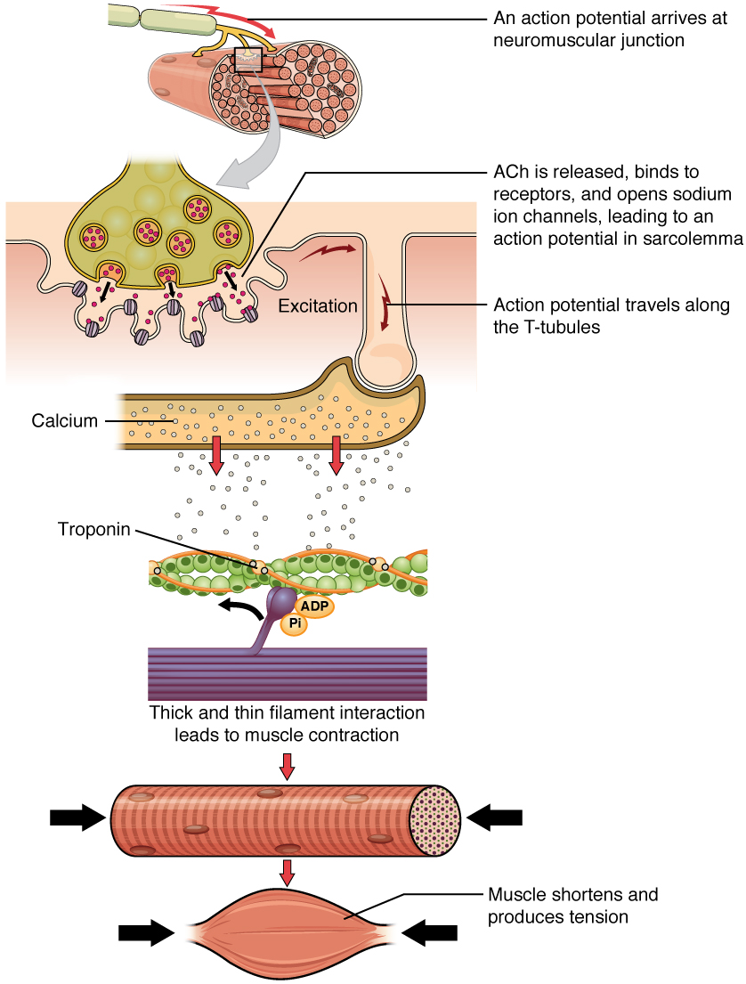

Slide 59
**** Shape of the protein → Determines Function See next page
Many of you were asking during molecular models lab “well this way works why is this not the correct structure.
The reason is that while the composition may be the same (molecular formula) the arrangement of the bonding patterns aka shape leads to different functions/uses in an organism.
Even just one change or flip in bonding pattern can result in a different compound and therefore a different way the body reacts to/uses the compound.

Slide 60
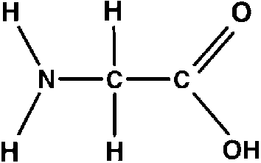
Other information
20 Amino Acids in total
9 Essential amino acids = cannot be made by the body and must be ingested
Largest Protein = Titan 27,000 Amino Acids long
Smallest amino acid = glycine

Slide 61
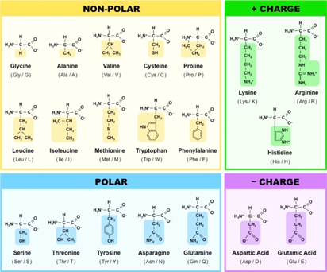

Slide 62
Flip the page and follow along the graphic organizer of Shape and function for proteins

Slide 63
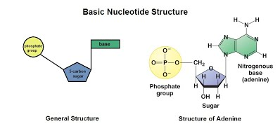
Nucleic Acids
Building block= nucleotides

Slide 64
DNA
Full Name: Deoxyribonucleic acid
Basic Structure 2 long twisting strands of nucleotides in the form of a “double helix”
Nucleotide sugar deoxyribose
Nitrogenous bases
  Guanine (G)
  Cytosine (C)
  Adenine (A)
    Thymine (T)

Slide 65
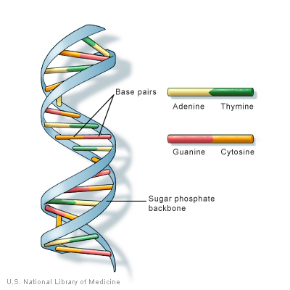
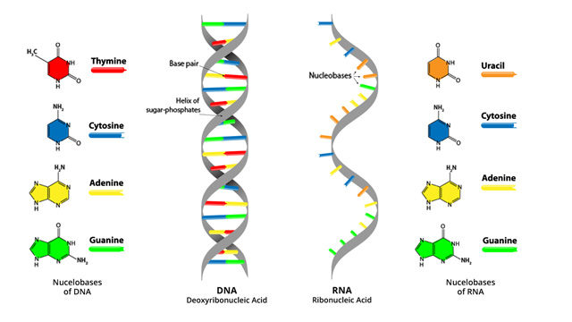

Slide 66
DNA
Location in cell: Nucleus (the chromosomes)
Function: Hereditary material, directs and controls activities

Slide 67
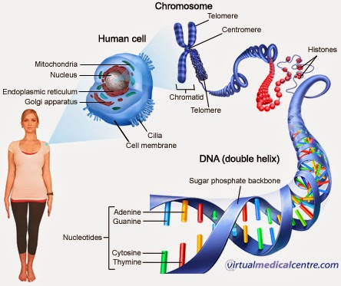

Slide 68
RNA
Full Name Ribonucleic acid
Basic Structure 1 Single strand of nucleotides
Nucleotide sugar Ribose
Nitrogenous bases
  Guanine (G)
  Cytosine (C)
  Adenine (A)
    Uracil (U)

Slide 70
RNA
Location in cell: Cytoplasm and ribosomes
Function Protein synthesis

Slide 71
