Slide 1
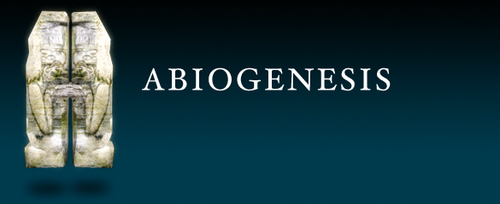
or
Spontaneous Generation
Producing life from non-living material

Slide 2
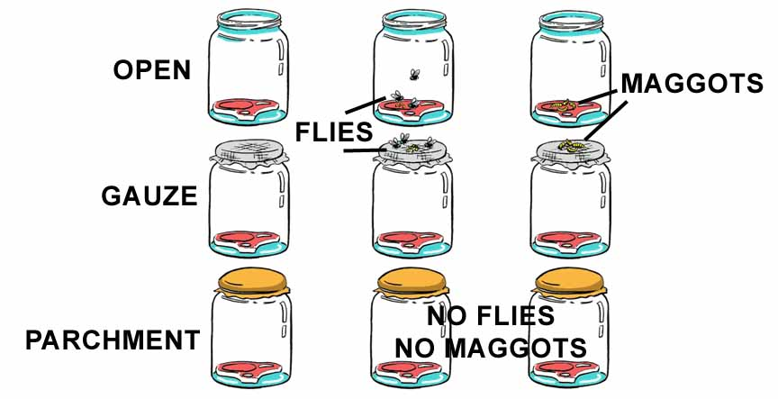
Experiment to disprove abiogenesis by Francesco Redi mid-1600s
First record of a scientist using a controlled experiment.
Experiment
Results

Slide 3
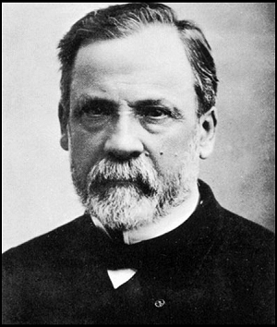
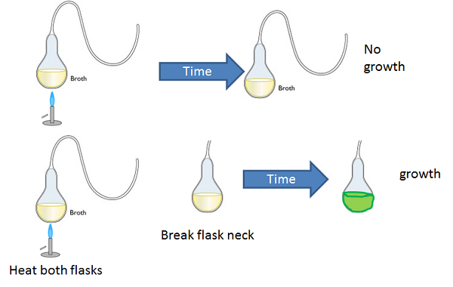
Louis Pasteur finally disproved abiogenesis with his Swan-necked Flask experiment in the 1860s

Slide 4
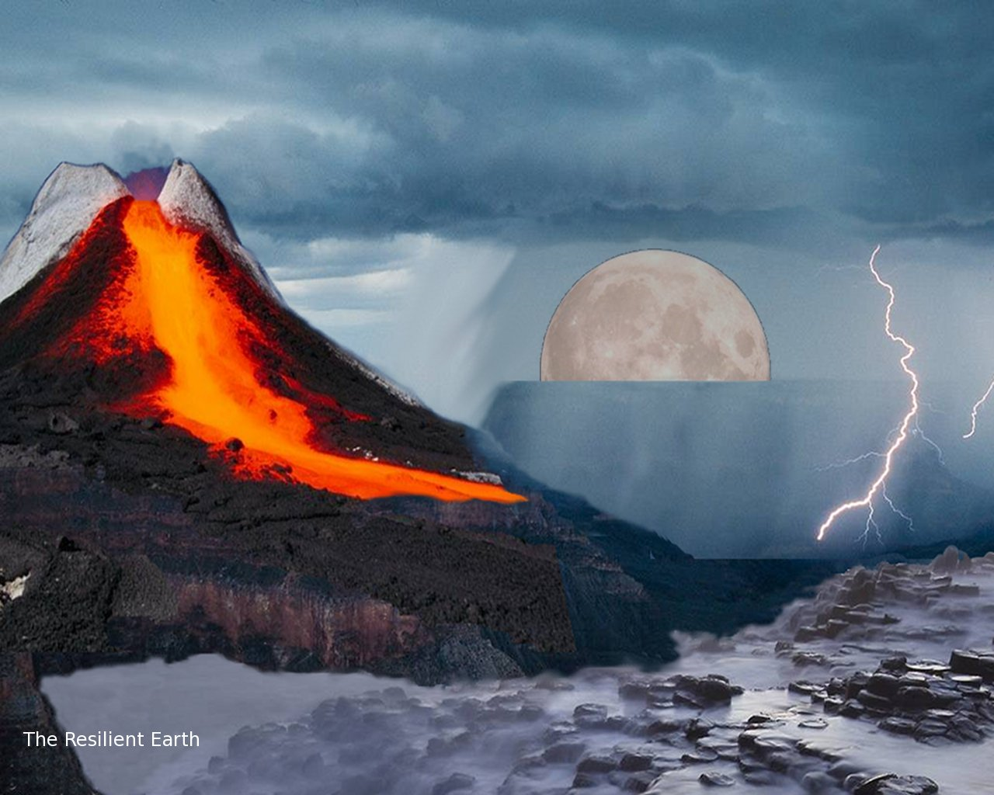
If abiogenesis is not possible then how come there is life on the earth today?

Slide 5
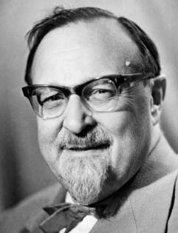
Heterotroph Hypothesis
Our best guess of how life began on the earth
Alexander I. Oparin
A.I. Oparin, a Russian biochemist, developed this idea of how life could have started on the earth in the 1920s.

Slide 6
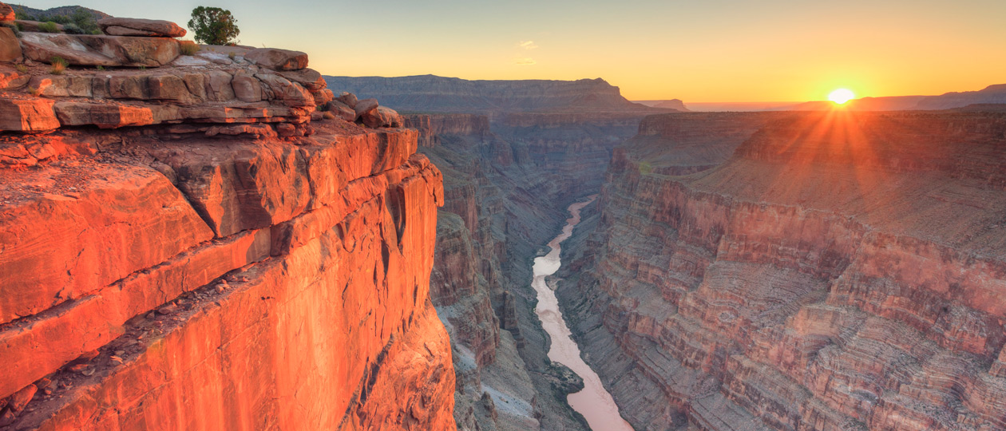
Oparin went to the bottom of the Grand Canyon and collected rocks that were around before there was oxygen in the atmosphere.
He found that the primitive atmosphere contained:
Methane, Ammonia, Hydrogen and Water.
He believed that given the right conditions these could give rise to life.

Slide 7
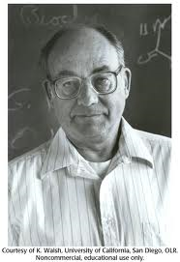
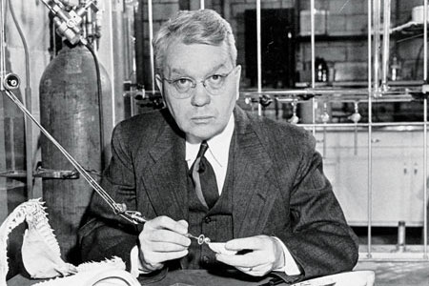
In the 1950 two researcher at the University of Chicago wanted to test Oparin’s hypothesis to see if it could really work.
Stanley Miller
Harold Urey
Miller and Urey developed a devise that would try to replicate the conditions on the primitive earth, called the Reflux Apparatus, to test the hypothesis.

Slide 8
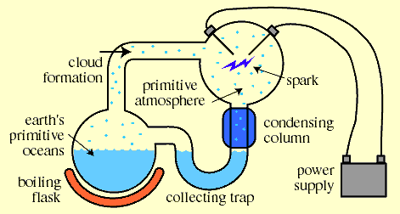
Reflux Apparatus
Used by Miller & Urey to test the
Heterotroph Hypothesis
Water, Ammonia,
Methane, Hydrogen
Produced urea, amino acids,
hydrogen cyanide, lactic acid and acetic acid
after only one week.

Slide 9
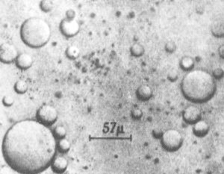
The results were good. In a short time they produced chemical that could produce life on this planet.
They also produced more complex structures called Coacervates
These seem to function like primitive cells consuming chemicals from their environment.
That’s why it is called the HETEROTROPH Hypothesis

Slide 10

The progression of life is believed to have been:
Simple heterotrophic cells (coacervates)
Simple chemoautotrophs (bacteria)
Simple photoautotrophs (algae)
Complex photoautotrophs (plants)
Simple heterotrophs (protists)
Complex heterotrophs (animals)

