Slide 1
A Brief History of DNA Research

Slide 3
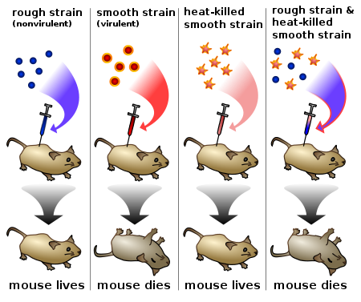
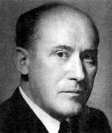
Fredrick Griffith 1928
Transformation
Streptococcus pneumoniae
R strain is non-encapsulated
S strain is capsulated (causes disease)

Slide 4
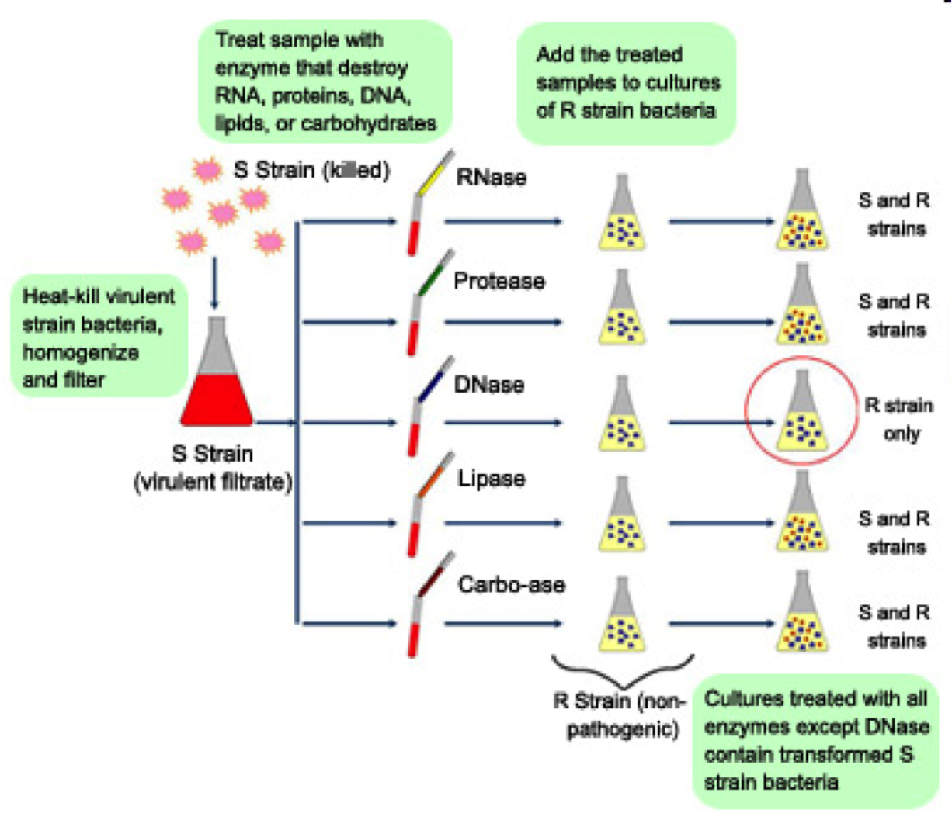
R strain is non-encapsulated
S strain is capsulated (causes disease)

Slide 5
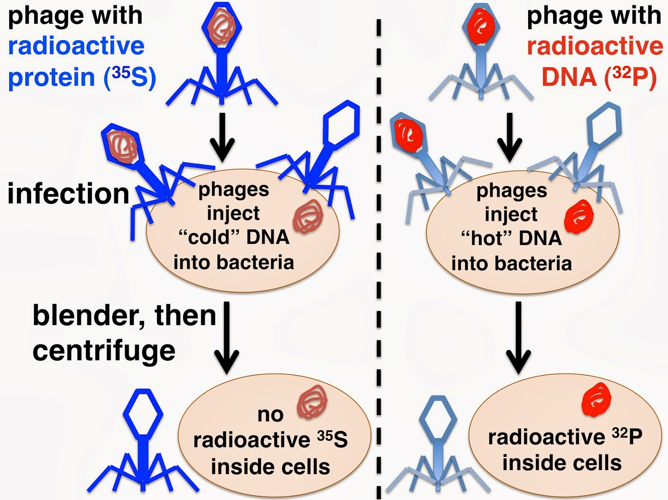
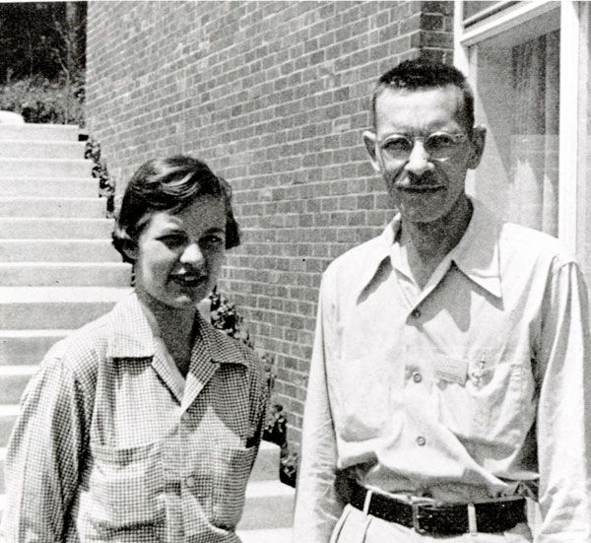
Hershey & Chase 1952
Bacteriophage

Slide 6
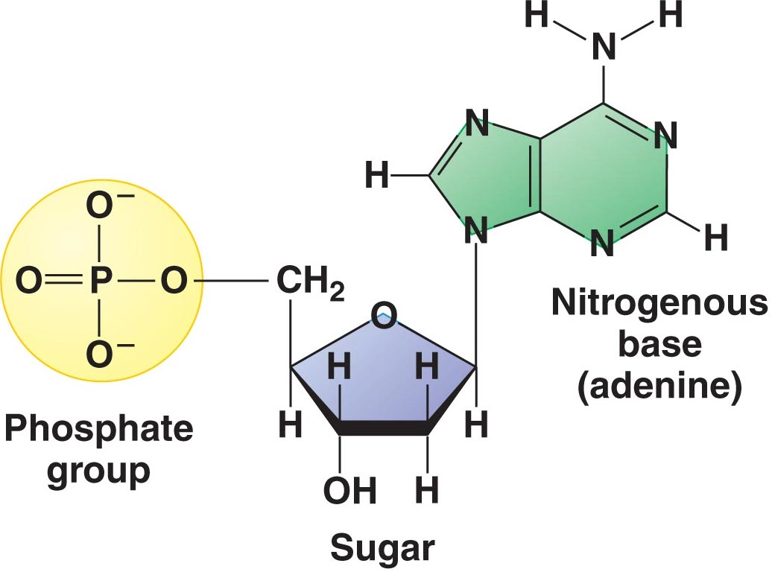
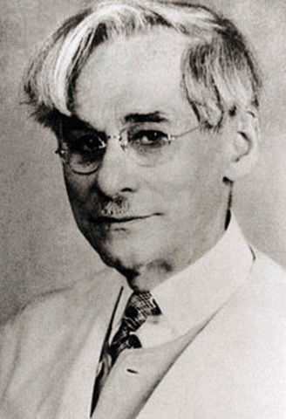
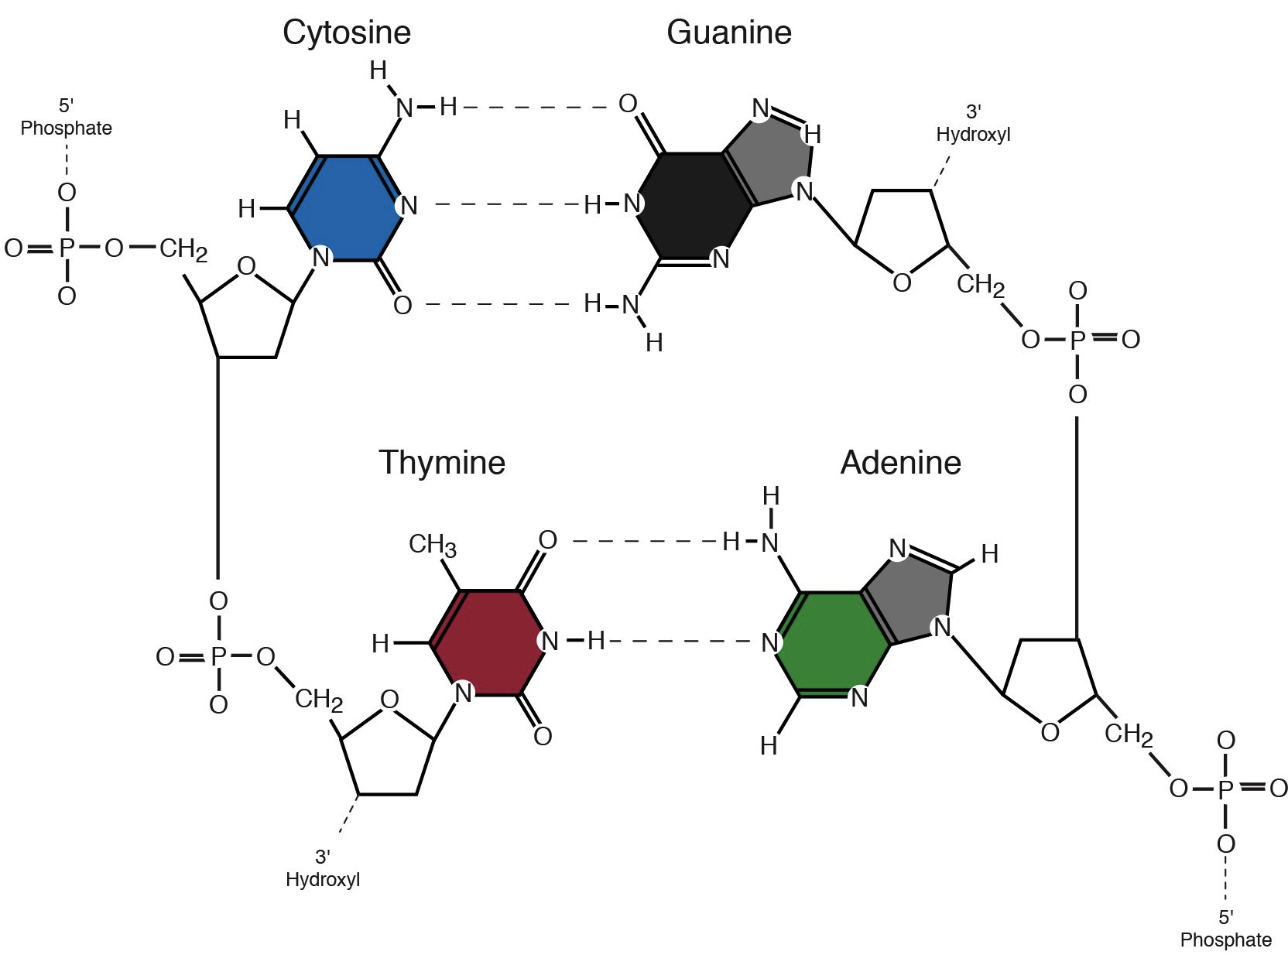
Nucleotide
P A Levine 1920’s
Purines A & G
Pyrimidines T & C

Slide 7
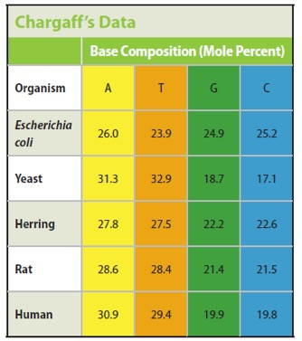
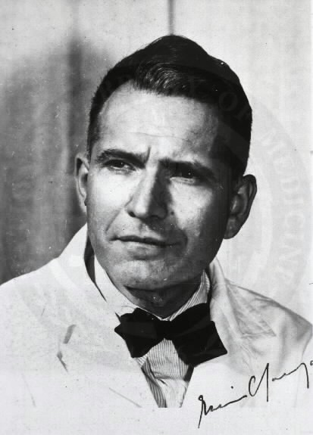
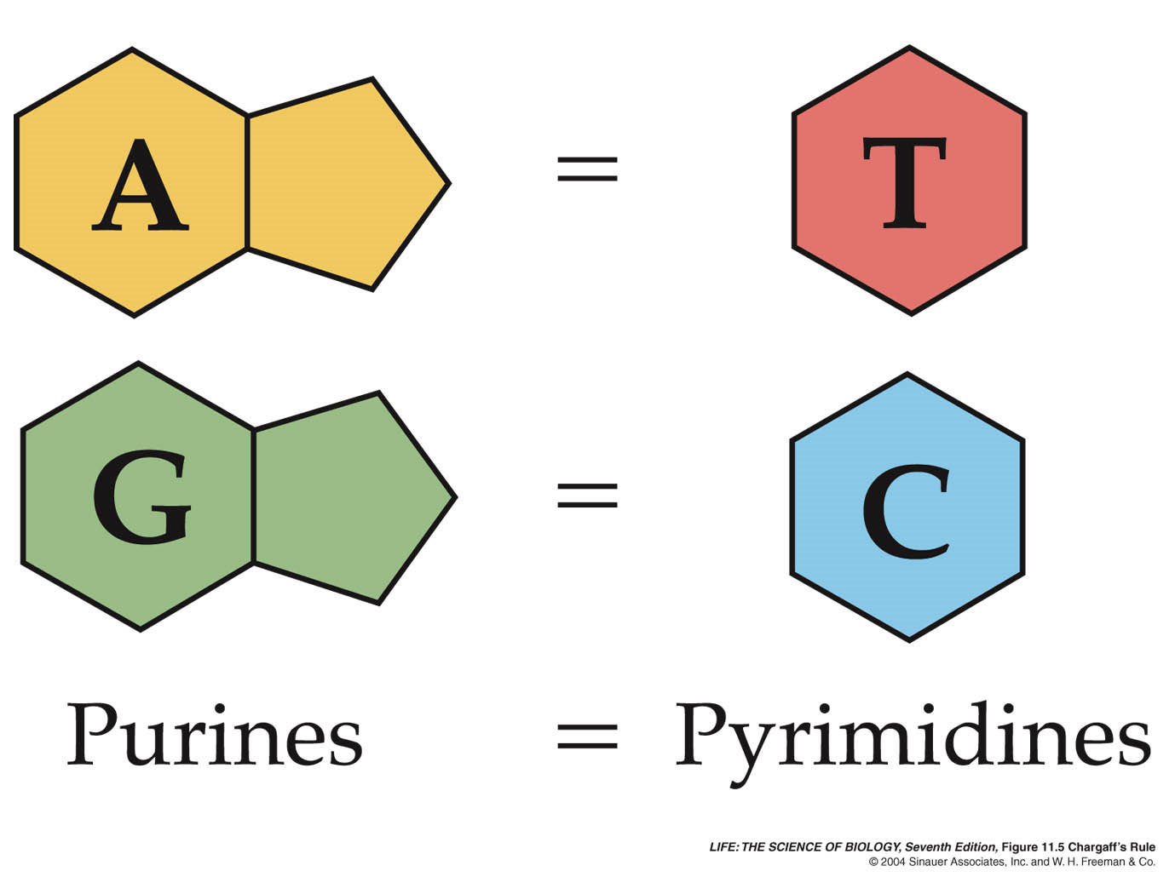
Erwin Chargaff 1947

