Slide 1
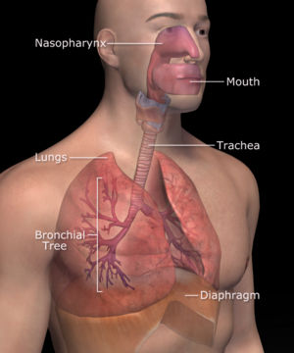
Respiratory System

Slide 2
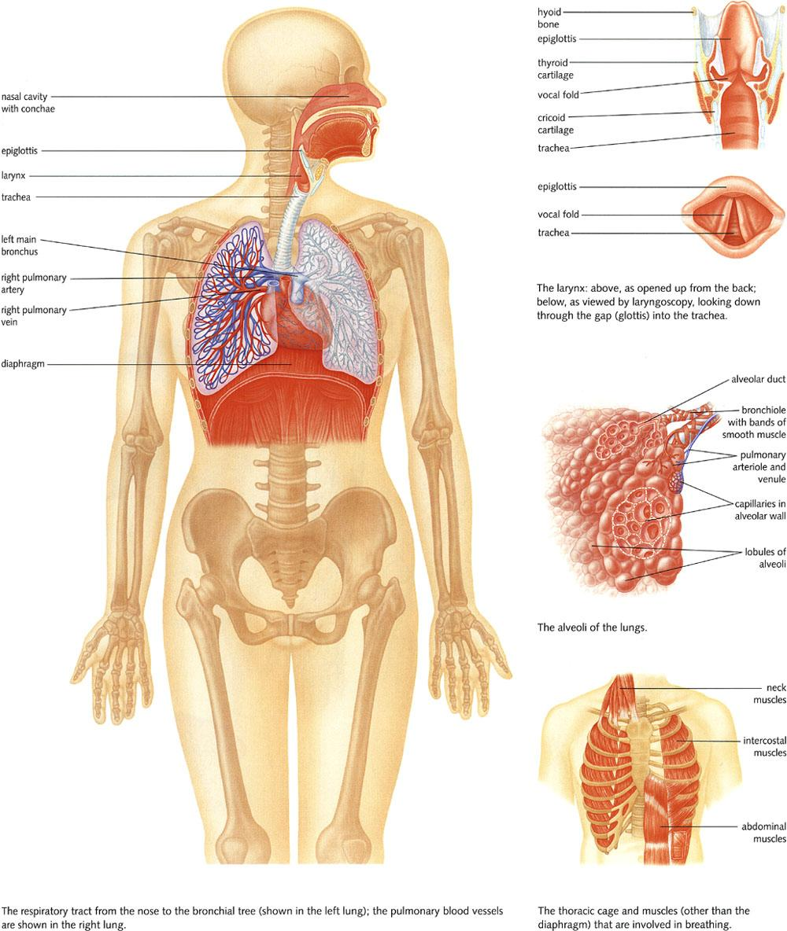

Slide 3
Respiratory System
The integrated system of organs involved in the intake and exchange of oxygen and carbon dioxide between an organism and the environment.
Respiratory Surface
Thin
Moist
Highly Vascularized
In contact with environment

Slide 4
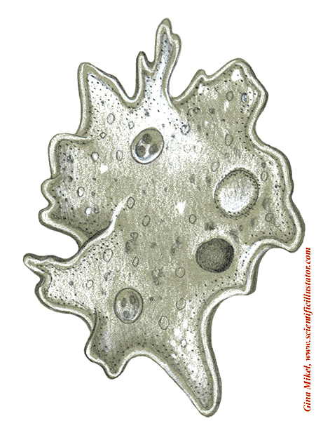
Protists
Cell Membrane
Amoeba

Slide 5
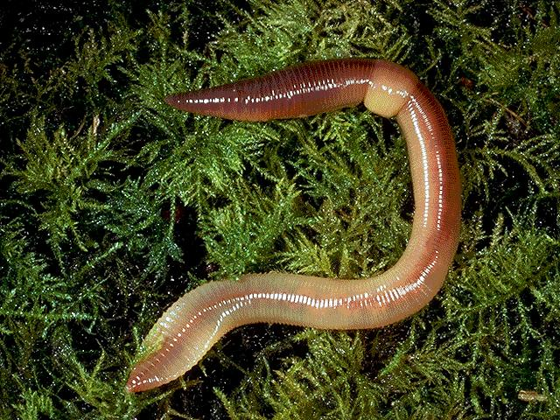
Earthworms
Skin

Slide 6
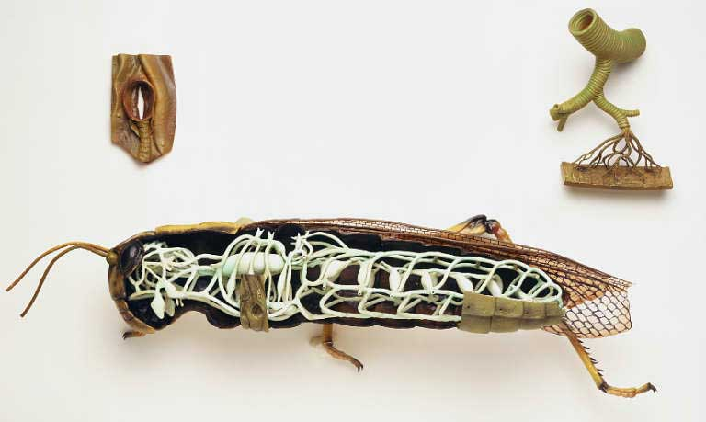
Grasshoppers
Tracheal Respiratory System
Air Sac
Spiracles
Tracheal Tubes

Slide 7
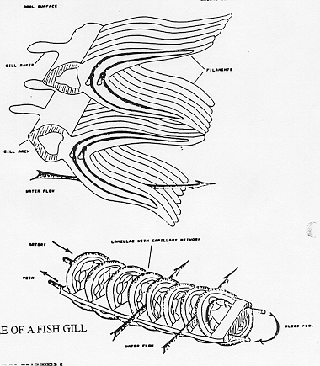
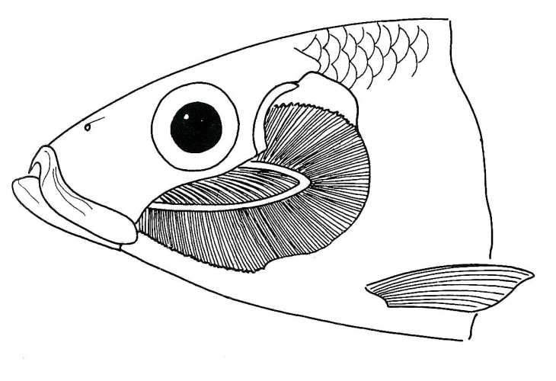
Fish
Gills

Slide 8
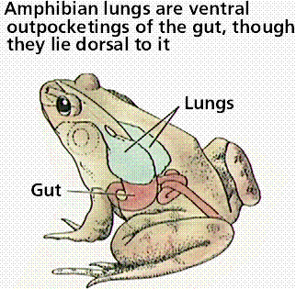
Frogs
Skin

Slide 9
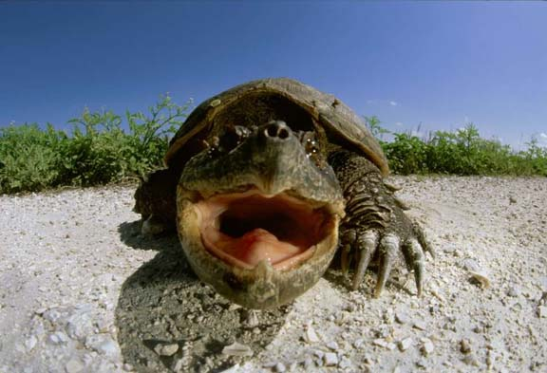
Reptiles

Slide 10
Problems in Respiratory System
COPD
Chronic Obstructed Pulmonary Disease
Common problems
Some common problems of the respiratory system include:
Asthma - wheezing and breathlessness caused by a narrowing of the airways.
Bronchitis - inflammation of the lung’s mucous lining.
Emphysema - disease of the alveoli.
Hayfever - an allergic reaction to pollen, dust or other irritants.
Influenza - caused by viruses.
Laryngitis - inflammation of the vocal cords (larynx).
Pneumonia - inflammation of the lung.

