Slide 1
Governments
Most Democratic to Least Democratic

Slide 2
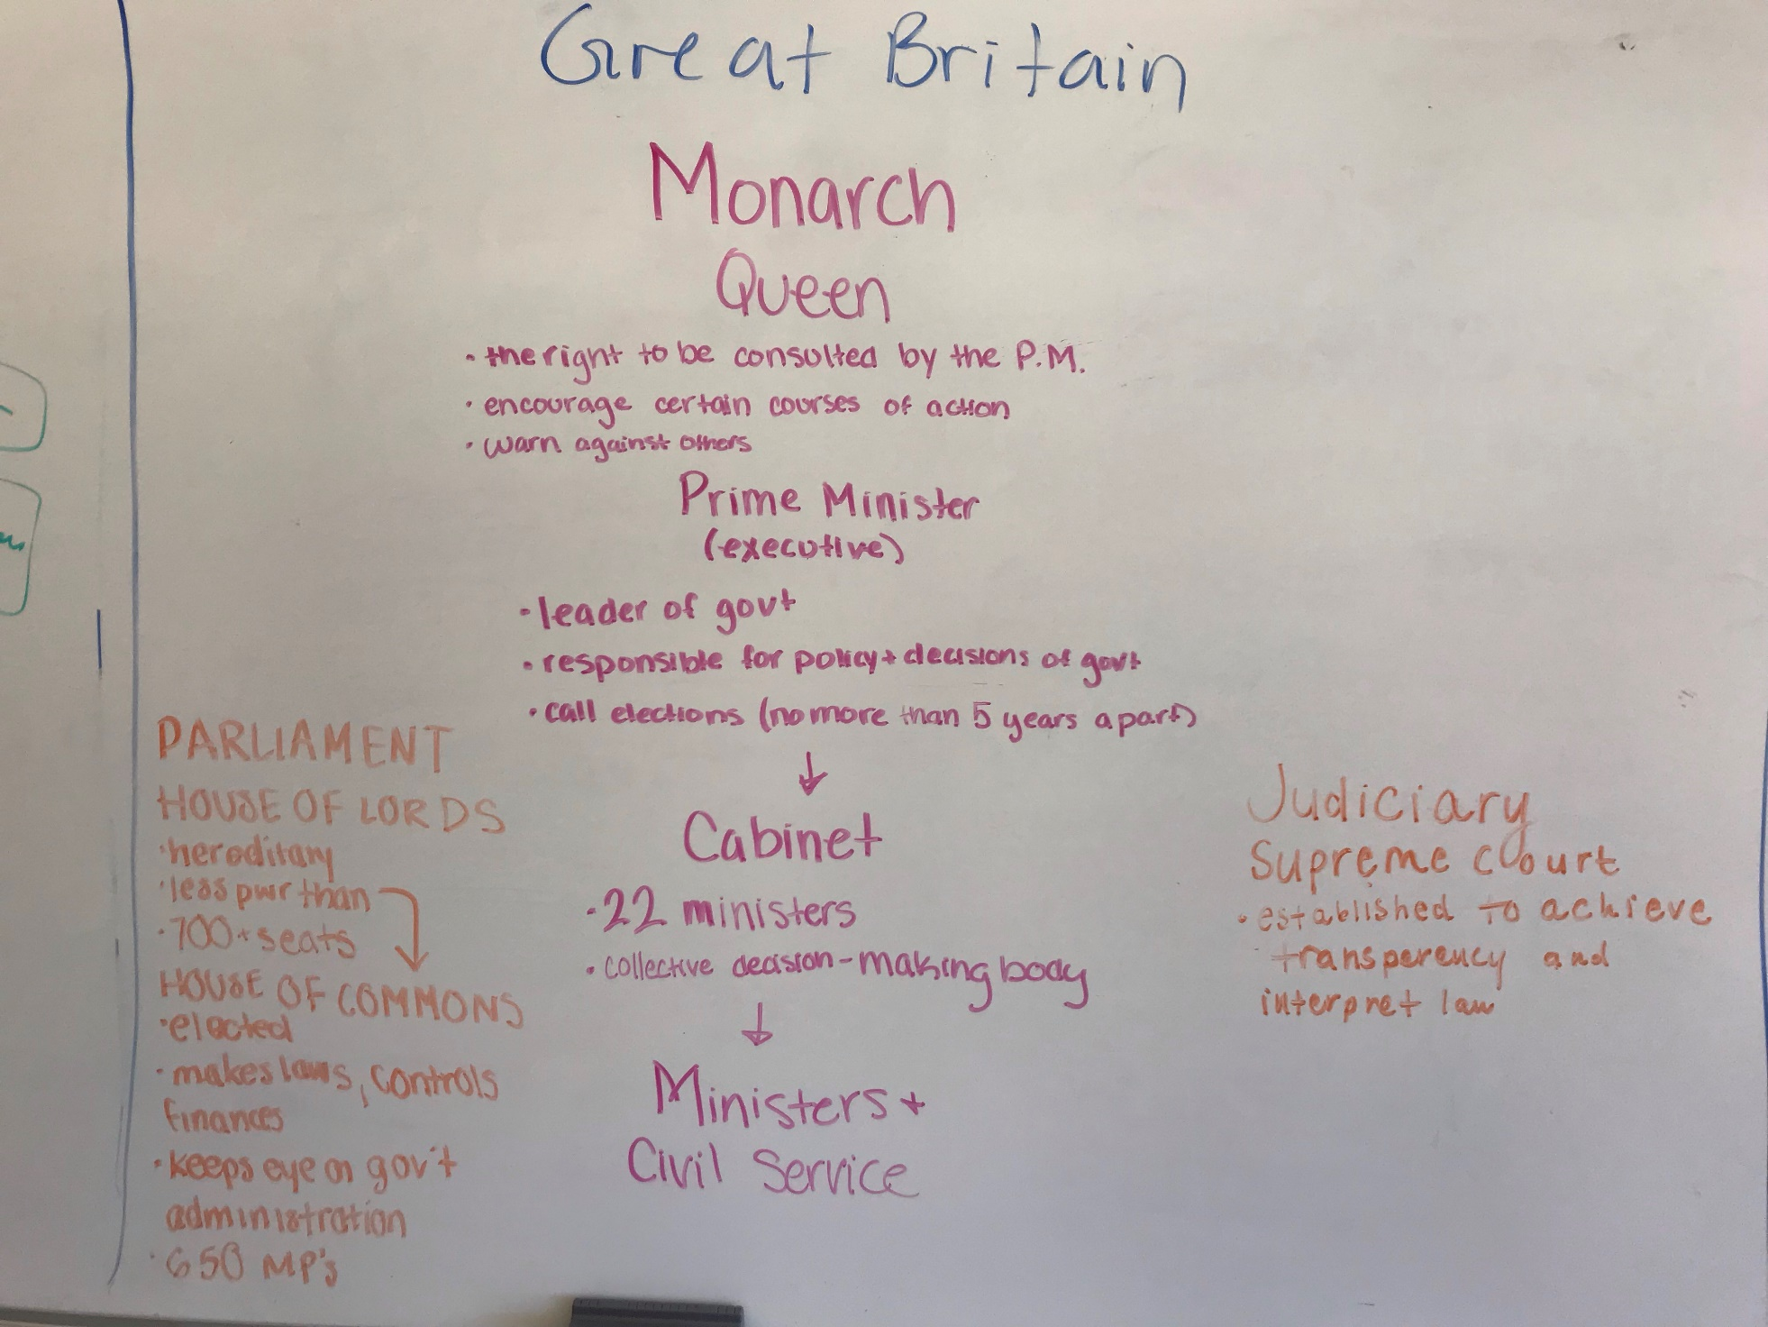
Britain

Slide 3
#1 UK
Can hold their government accountable
They have free speech, press, assembly
Parliamentary democracy—people vote for govt
A lot of separation of powers
Competition in elections (multiple parties)
Free Market economy
Political pluralism/free civil society

Slide 4
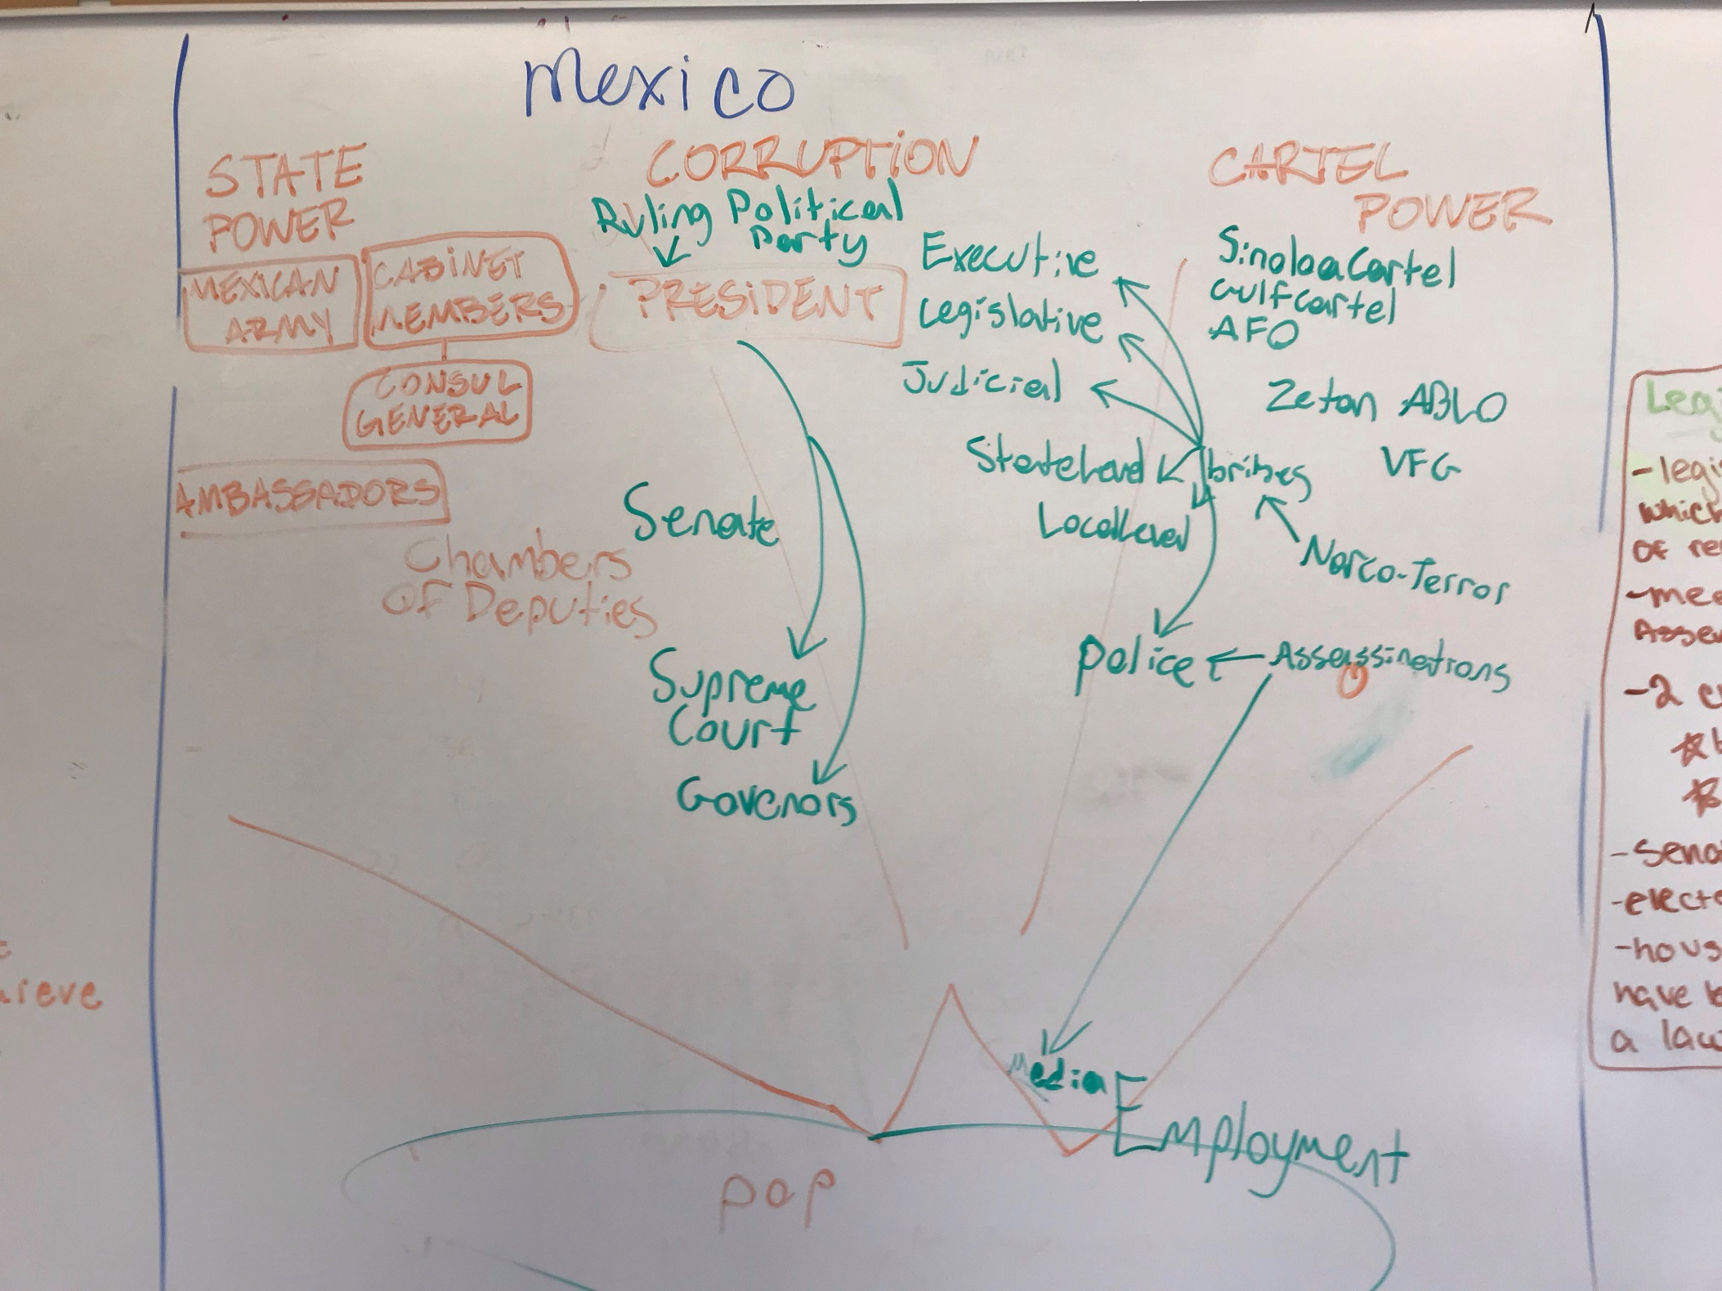
Mexico

Slide 5
#2 Mexico
Increasingly free elections
Increasingly developing market economy
Cormac feels good about it
Not a lot of separation of powers (president has a lot of power)
Free elections are relatively new (PRI for a long time)
NEW market economy
Crime, gangs and corruption keep the government from working as it should

Slide 6
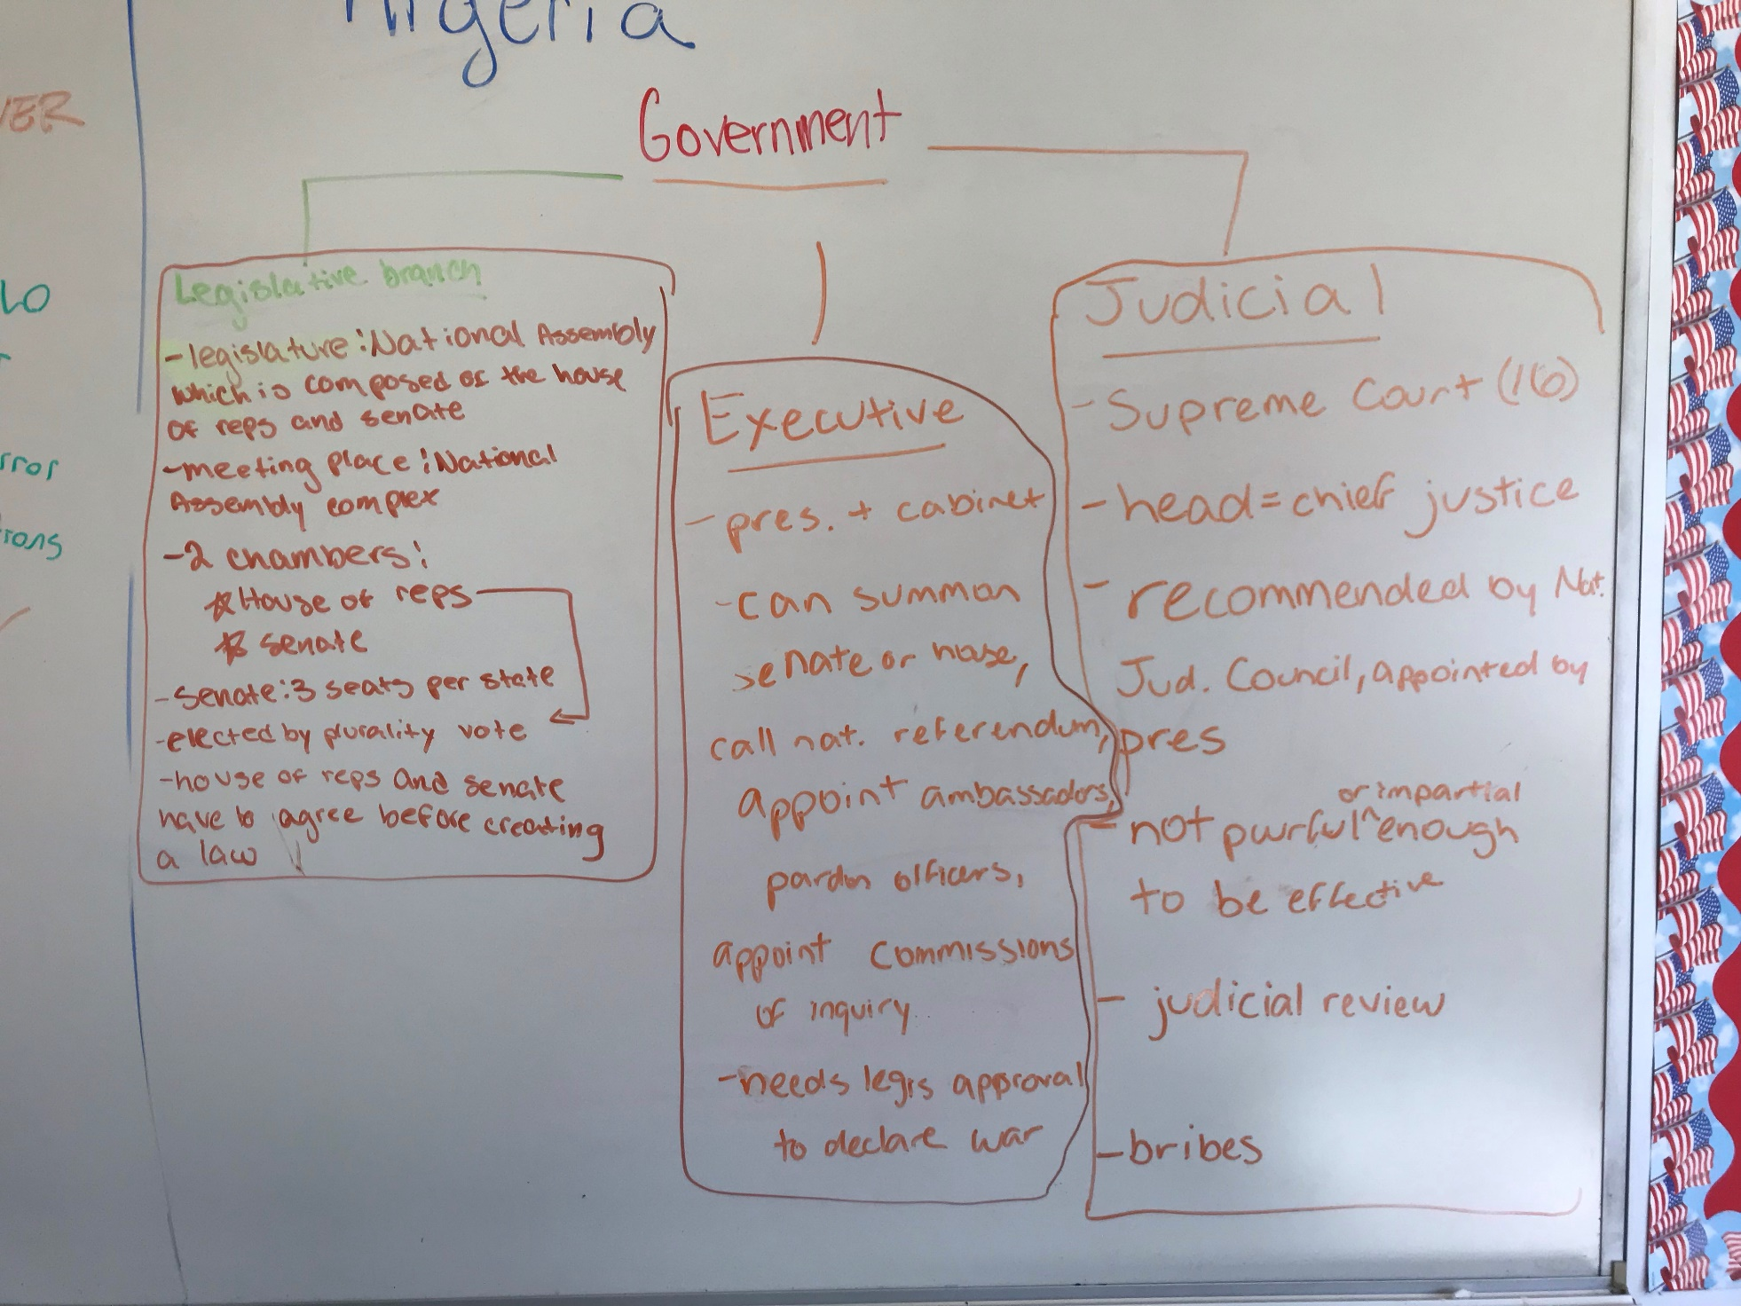
Nigeria

Slide 7
#3 Nigeria
Has separation of powers (3 branches) on paper
Definitely has political pluralism (a LOT of registered political groups)
Constitution guarantees speech expression and press
There are little laws limiting freedoms
Imprison journalists and activists
Elections are rigged
Lots of violence
System maintained by beneficiaries at the top
Huge wealth gap
Somewhat peaceful transitions of power between governments

Slide 8
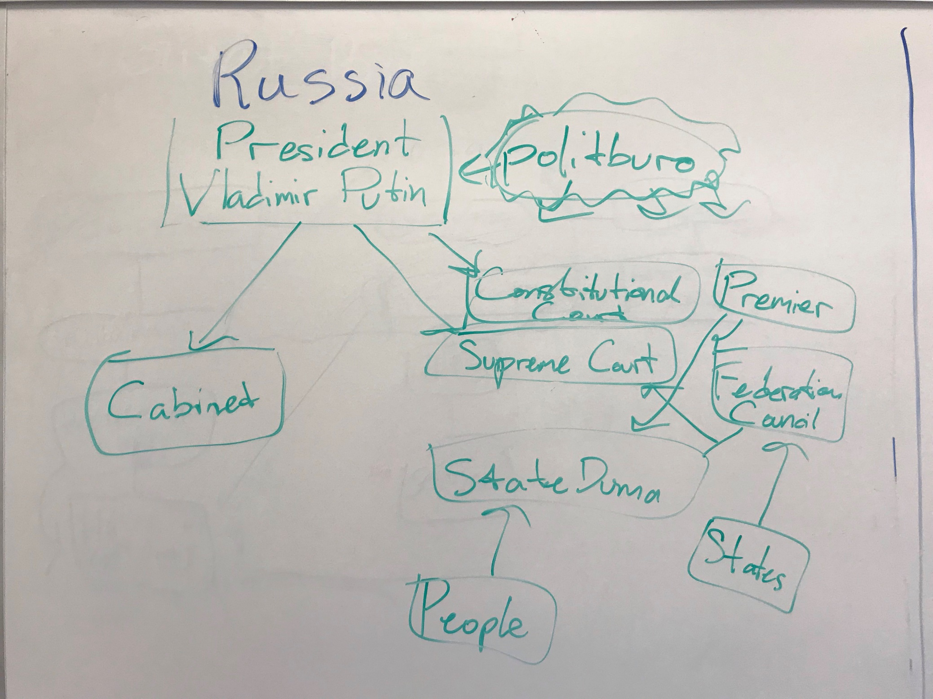
Russia

Slide 9
#4 Russia
Has different branches of government (they’re there)
The executive branch has all the power
The entire government system is pretty much rigged to keep United Russia in power
Other parties are allowed to exist
Many opposition parties are funded by United Russia to look like competition, picked by Putin
Elections are rigged
No free speech, press
Organizations that do exist are funded by government
Allowed to do anything as long as the government is ok with it
No civil liberties (in original constitution, but other laws and actions take away)
Orthodox church is favored (nationalism)
Supposed to be checks and balances—but no
Technically have rights—but no (homosexuality banned)
A lot of the news comes directly from the Kremlin

Slide 10
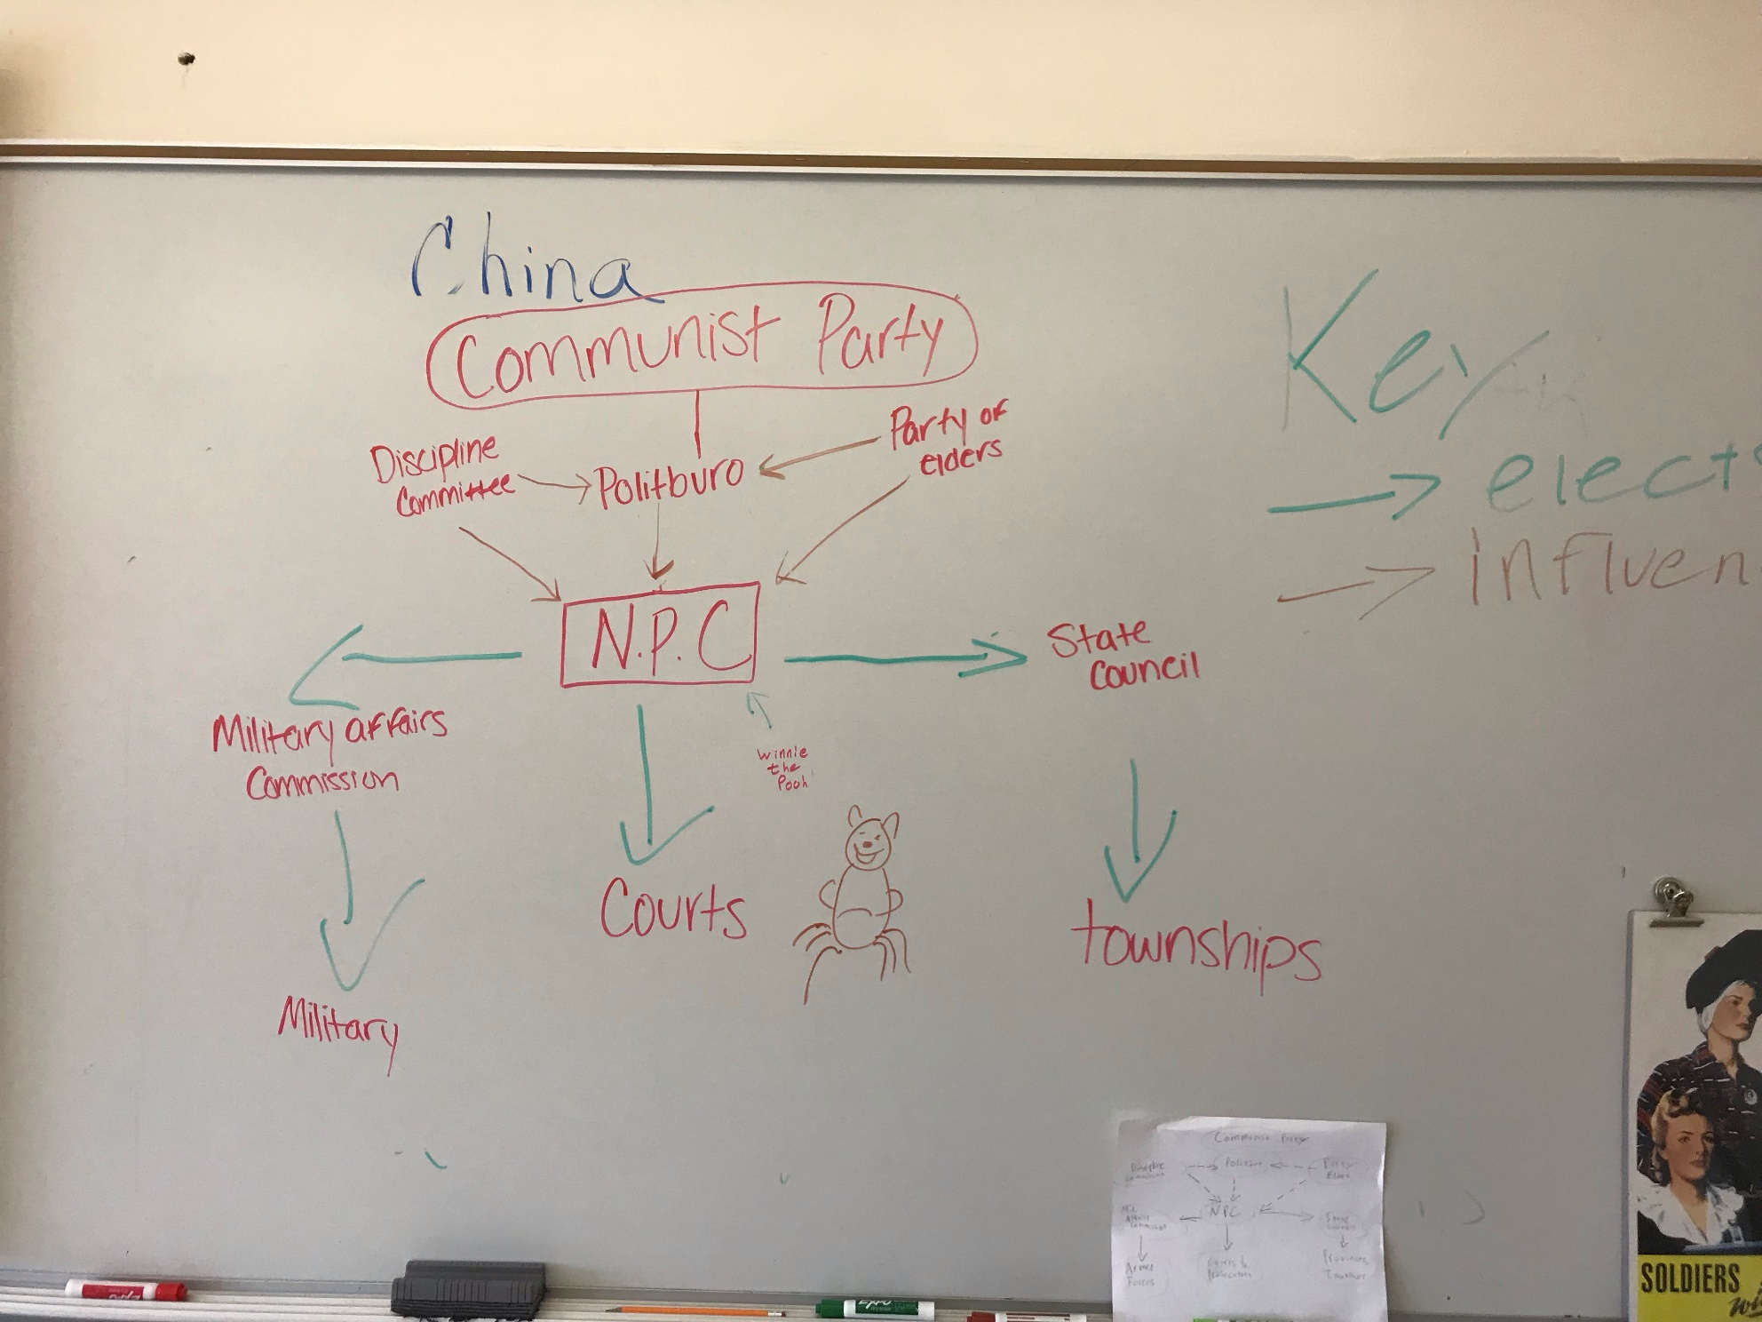
China

Slide 11
#5 China
Technically there’s a free market economy (really for the rich)
Technically there are separate branches of govt (really only one)
Constitution says only 1 party—Communist!! (must rule)
Very hard for citizens to hold the government accountable (only a superior can remove from office)
No direct elections
No criticism of govt (go away)
Internet is heavily censored (Great Firewall and Winnie never shares his honey)
More dissidents in jail than any other country
No equality under law (Eastern—religious and ethnic minorities persecuted)
Transfer of power not really violent (after death)
No checks and balances at all (internal personal power struggles—there’s nothing)
Workers rights are non-existent
No competition in elections
All organizations have to be approved by government
Lots nepotism (favoring relatives and friends)

Slide 12
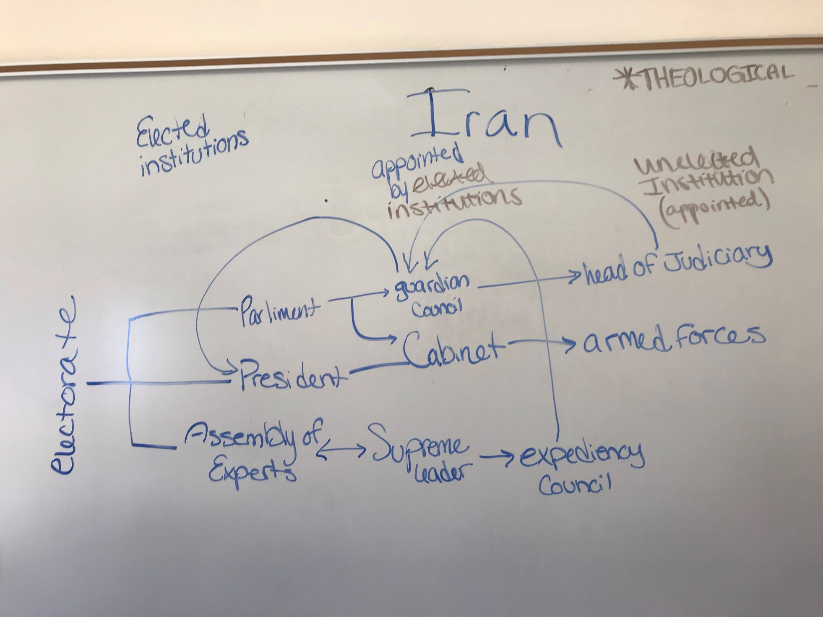
Iran

Slide 13
#6 Iran
Chart looks great--But you got to read the flow—the supreme leader has everything down
Anyone can vote at 18 yrs
Bunch of political parties—all approved by leader (align with govt ideas)
Candidates have to be approved by guardian council (denies women, approves people like him)
Assembly of Experts also have to be approved and have been dismissed by supreme leader
President is more a mouthpiece for supreme leader’s opinions (Rouhani wanted to meet with Trump—SL said no way—gets final say)
Guardian council can veto laws (and SL)
SL there until death
No free speech (illusion? No!)
Torture everyone (who speaks out)
Full control over broadcasting and media
Have forced confessions from activists and opposition
Goes all the way into sports (all is political)
Full control of economy—own OIL and make major economic decisions
SL ultimate say declaring and ending war
No way to hold the government accountable
Banned messaging app
Spy on journalists with cell phones

