Slide 1
Ideologies

Slide 2
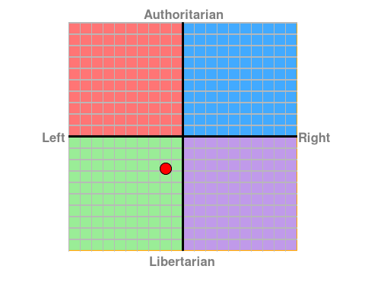
Your Political Compass
Economic Left/Right: -1.5
Social Libertarian/Authoritarian: -2.82

Slide 3
Individualism/libertarianism
Belief in individual civil liberties and freedoms over governmental restrictions
Primary function of government is to protect people’s rights
Most government actions believed to restrict rights
  Regulations
  Licenses
  standards

Slide 4
neoliberalism
Belief in limited governmental intervention in the economy and society
Supports:
  Privatization
  free trade
  deregulation
  elimination of state subsidies

Slide 5
communism
Belief in the abolition of private property with near total governmental control of the economy
Value of the collective over the individual
Belief in government’s power and authority to regulate and promote collective goals

Slide 6
Socialism
Belief in the reduction of income disparities
Nationalization of major private industries
Government as source of
  poverty reduction
  Rehabilitation
  education
  Misc. support

Slide 7
fascism
Extreme nationalism ideology that favors authoritarian rule
Favors rights of ethnic majority over that of ethnic minorities
Favors authoritarian rule over political opposition
Wide range of economic philosophies, leaning toward authoritarianism

Slide 8
populism
Political philosophy that supports the interests and rights of the common people over those of the elites
The role of the government is to do what the majority of people want
Can be aligned left or right
Tend to support
  more direct referenda
  Recall voting

