Slide 1
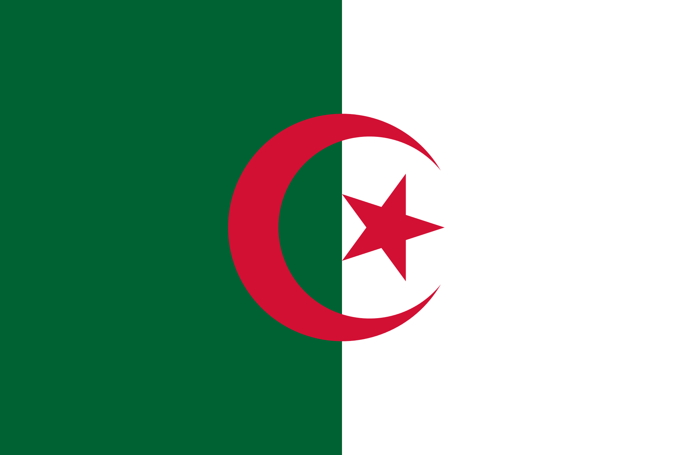
Algeria
By: Emmanuel Drice

Slide 2
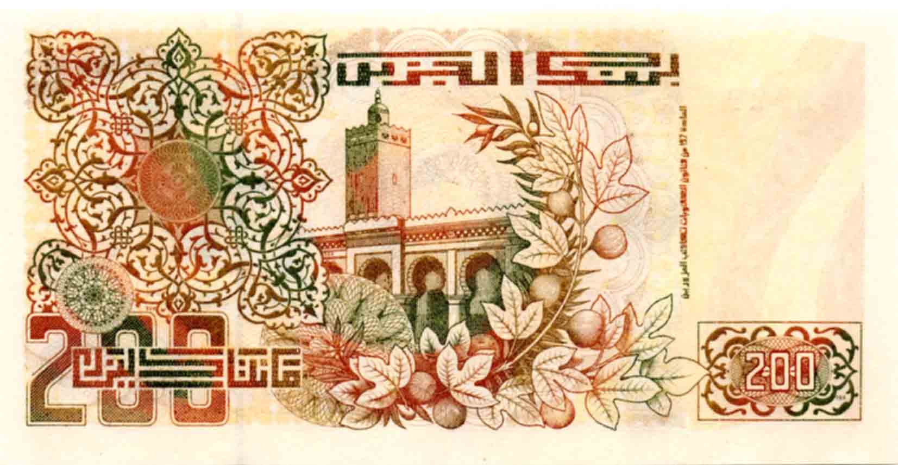
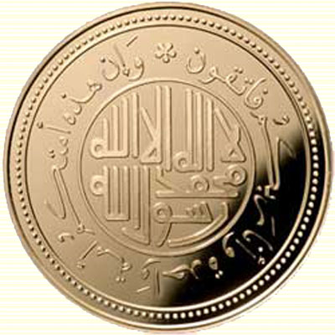
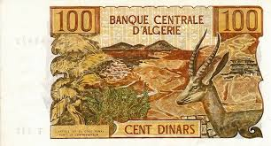
A Little About Algeria
Population: 39.2 Million
Algeria's currency is Dinar
Algeria's main trade is natural gas, and oil. Oil production stands at 1.1 million barells/day. Algeria has the 10th largest reserve of natural gas in the world and is the 6th largest gas exporter. Hydrocarbons account for 60% of budget revenues.

Slide 3
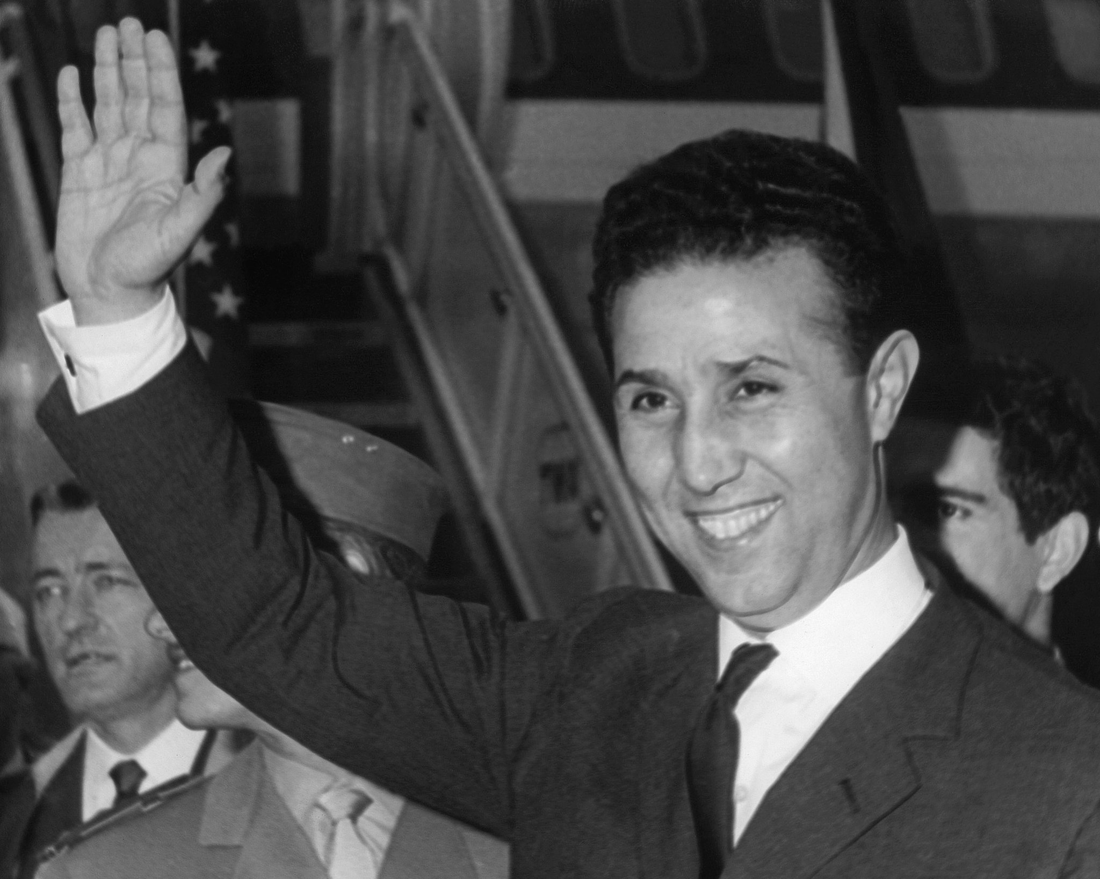
History
Algeria's first president was Ahmed Ben Bella, he was overthrown in 1965 by Houari Boumediene his defense minister. Under Ben Bella the government had become socialist
Algeria became independent on July, 62

Slide 4
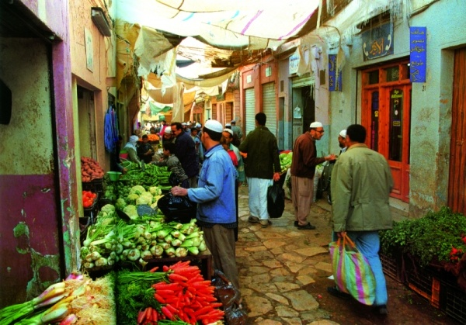
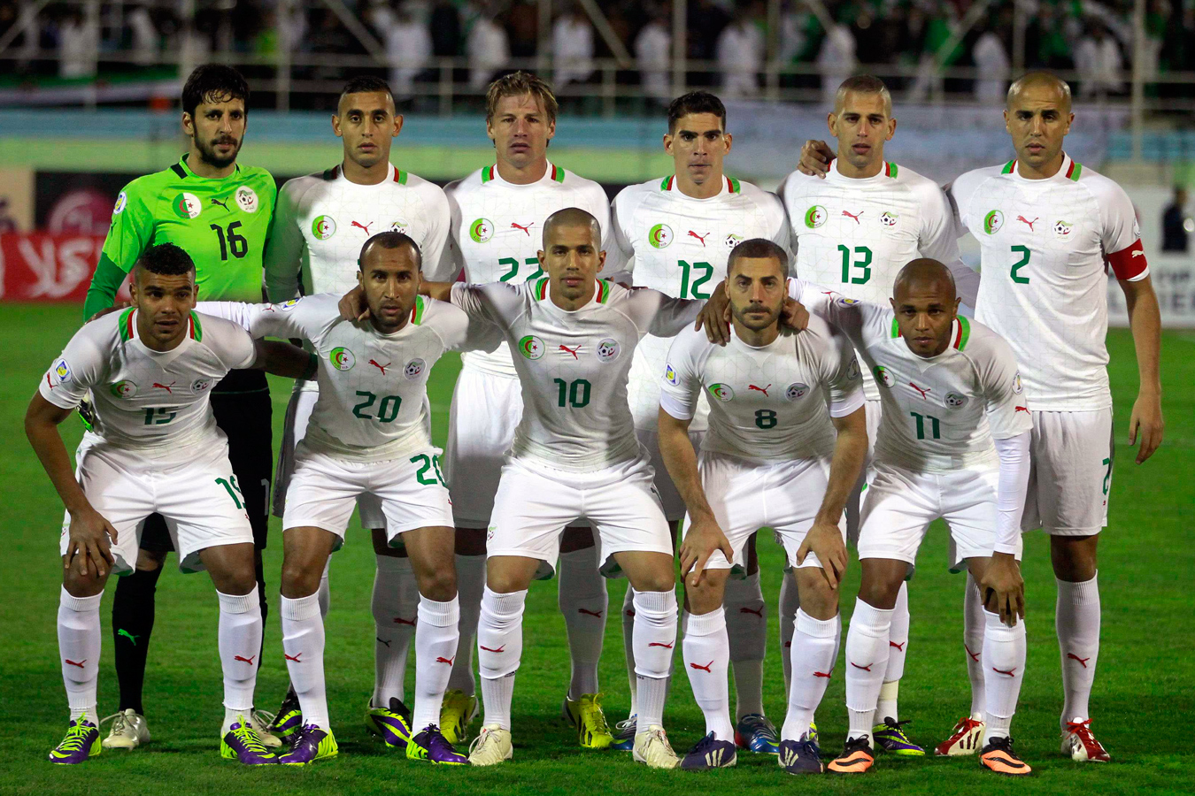
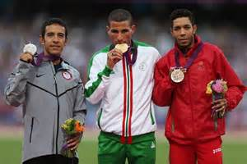
Algerian cULTURE
Algeria has many world championships and olympic gold medals
The center of commercial life in Algeria is the souk, large, open-air markets where farmers and craftspeople sell their products.
One can buy locally produced meat, fruits, vegetables, and grains—oats, barley, grapes, olives, citrus fruit—as well as woven rugs, jewelry, baskets, metalwork, and other crafts.

Slide 5
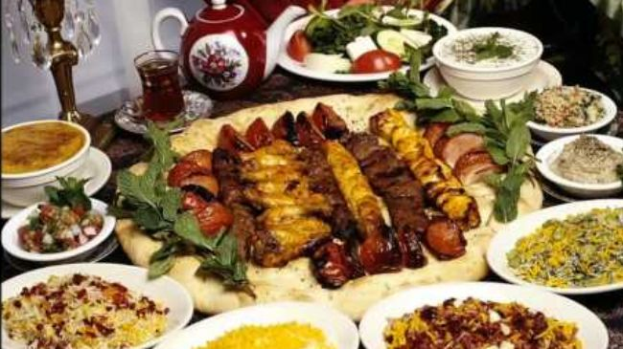
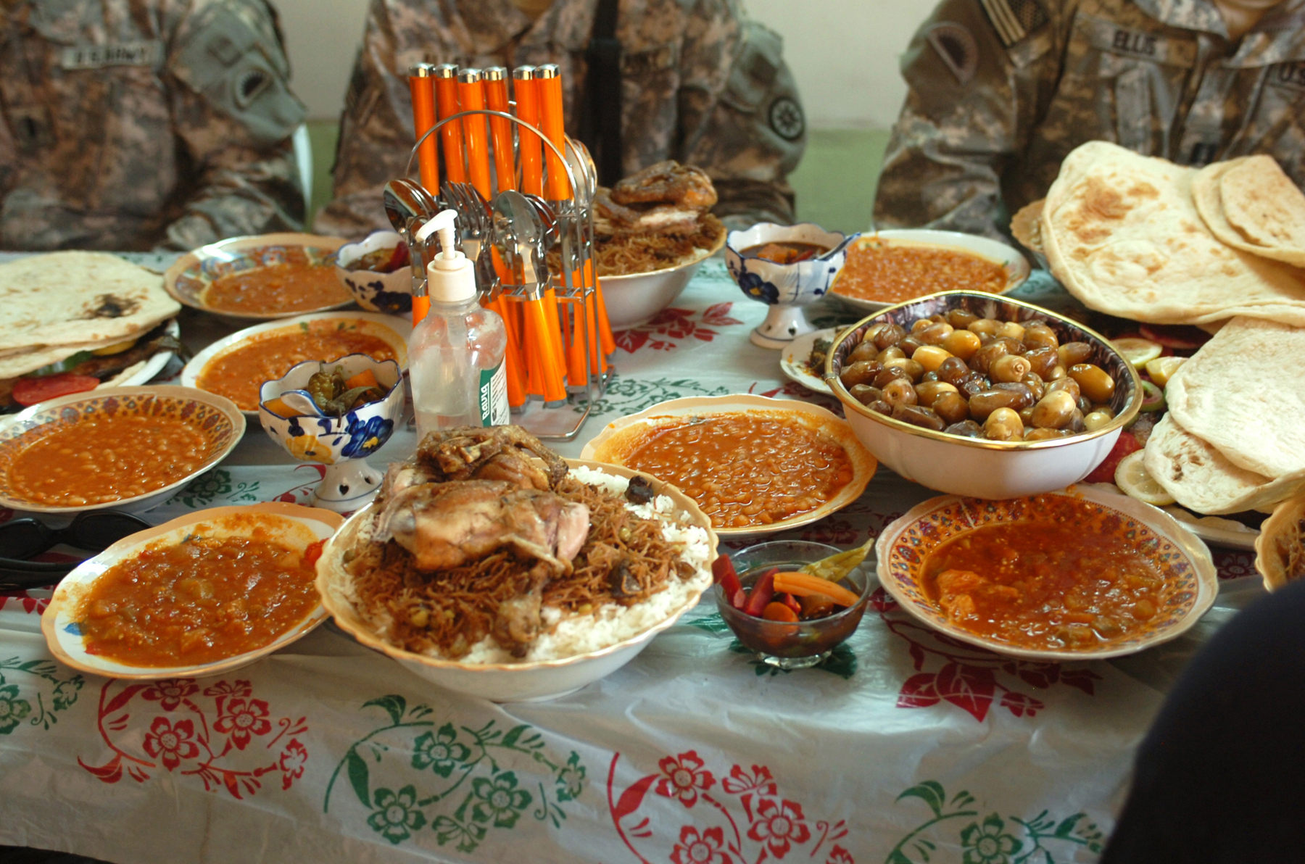
Food
Religious holidays are often celebrated with special foods. For the birthday of Muhammad, a holiday called Mulud, dried fruits are a common treat.
During the month of Ramadan, Muslims refrain from food and drink during the daylight hours. Each evening, the fast is broken with a family meal. Eid al-Fitr, the final breaking of the Ramadan fast, involves consuming large quantities of foods, sweets, and pastries in particular.
The national dish of Algeria is couscous, steamed semolina wheat served with lamb or chicken, cooked vegetables, and gravy. This is so basic to the Algerian diet that its name in Arabic, ta'am, translates as "food."

Slide 6
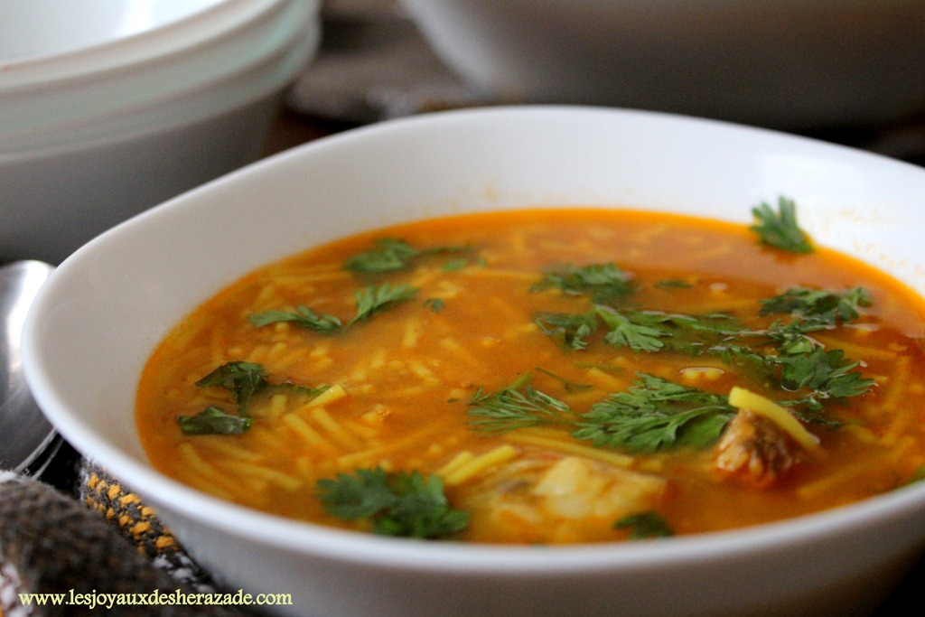
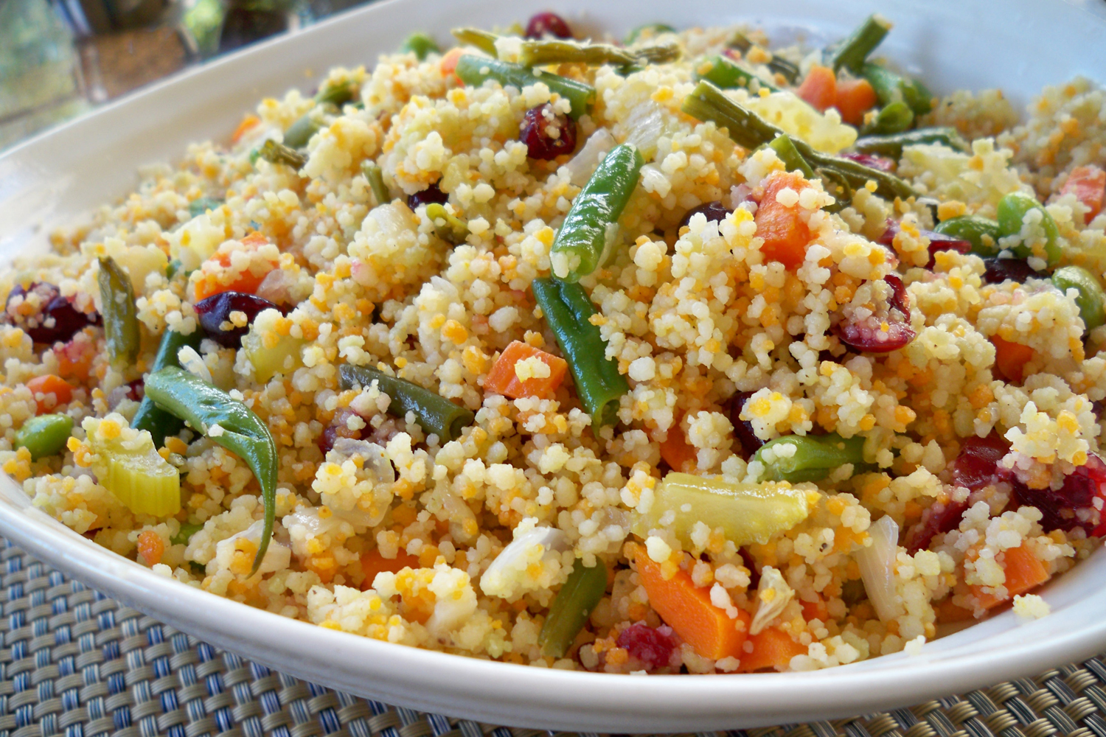
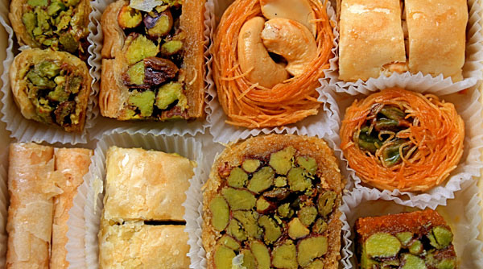
Food Con't
Common flavorings include onions, turnips, raisins, chickpeas, and red peppers, as well as salt, pepper, cumin, and coriander.
Alternatively, couscous can be served sweet, flavored with honey, cinnamon, or almonds. Lamb also is popular, and often is prepared over an open fire and served with bread. This dish is called mechoui.
Other common foods are chorba, a spicy soup; dolma, a mixture of tomatoes and peppers, and bourek, a specialty of Algiers consisting of mincemeat with onions and fried eggs, rolled and fried in batter.

Slide 7
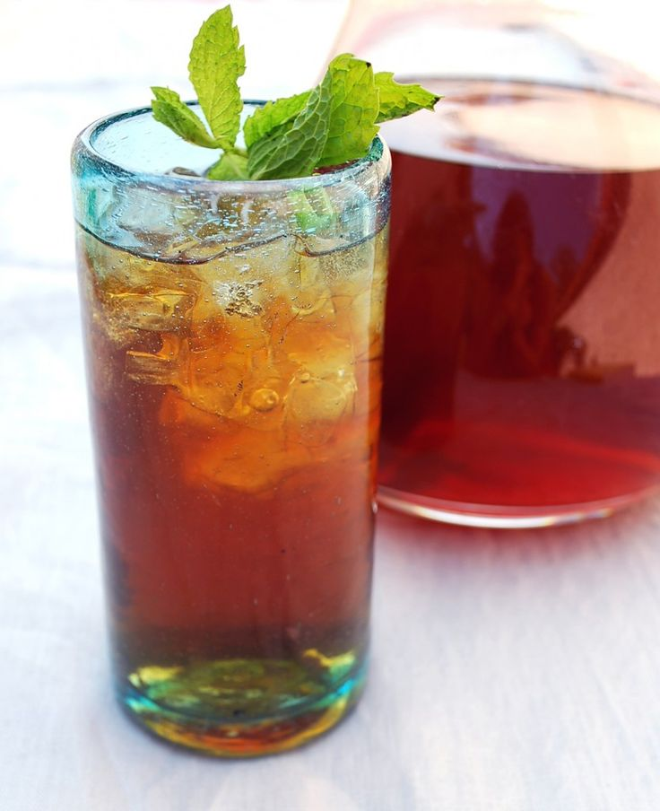
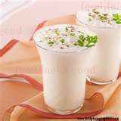
Last slide on food Pt.3
Strong black coffee and sweetened mint tea are popular, as well as apricot or other sweetened fruit juices.
Laban also is drunk, a mixture of yogurt and water with mint leaves for flavoring.
Algeria grows grapes and produces its own wine, but alcohol is not widely consumed, as it is forbidden by the Islamic religion.

