Slide 1

EGYPT
Arabic class 4b
Eman Khalifa and Adam Mansour

Slide 2
Egyptian flag
The Egyptian flag consists of the three equal horizontal red, white, and black bands of the Arab Liberation flag dating back to the Egyptian Revolution of 1952. The flag bears Egypt's national emblem, the Eagle of Saladin centered in the white band.

Slide 3
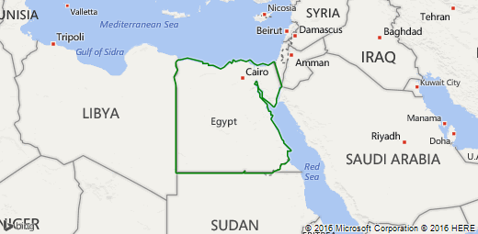
Neighboring Countries: Libya and sudan

Slide 4
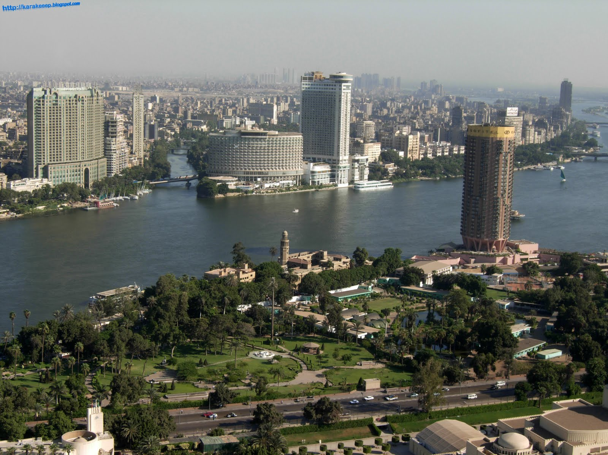
Estimated Population as of 2015: 88,487,000

Slide 5
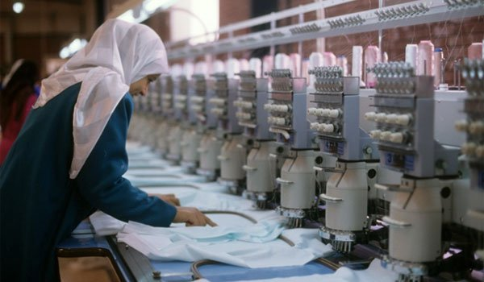
Economy: Textile industry , agricultural activity near nile river and foreign investment

Slide 6
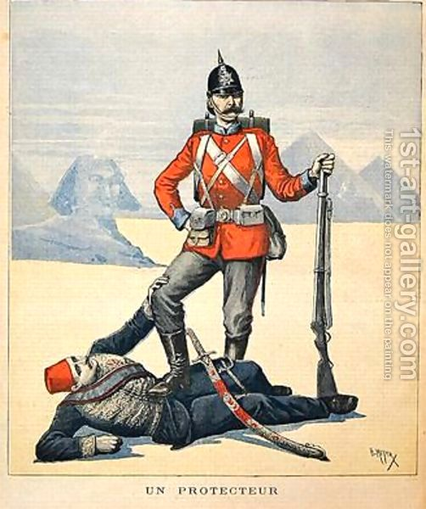
Egypt gained independence on February 28,1922 from Britain (picture below represents British imperialism in Egypt)

Slide 7
Languages spoken
Standard Arabic
Egyptian Spoken Arabic
Sudanese Arabic
Ta’izzi Adeni Spoken Arabic
Armenian
Amharic
Greek
North Levantine
Adyghe

Slide 8
Most common dishes
Macaroni Bechamel
Falafel
Fattah
Baladi
Ful
Koshari
Shawarma
Baklava

Slide 9
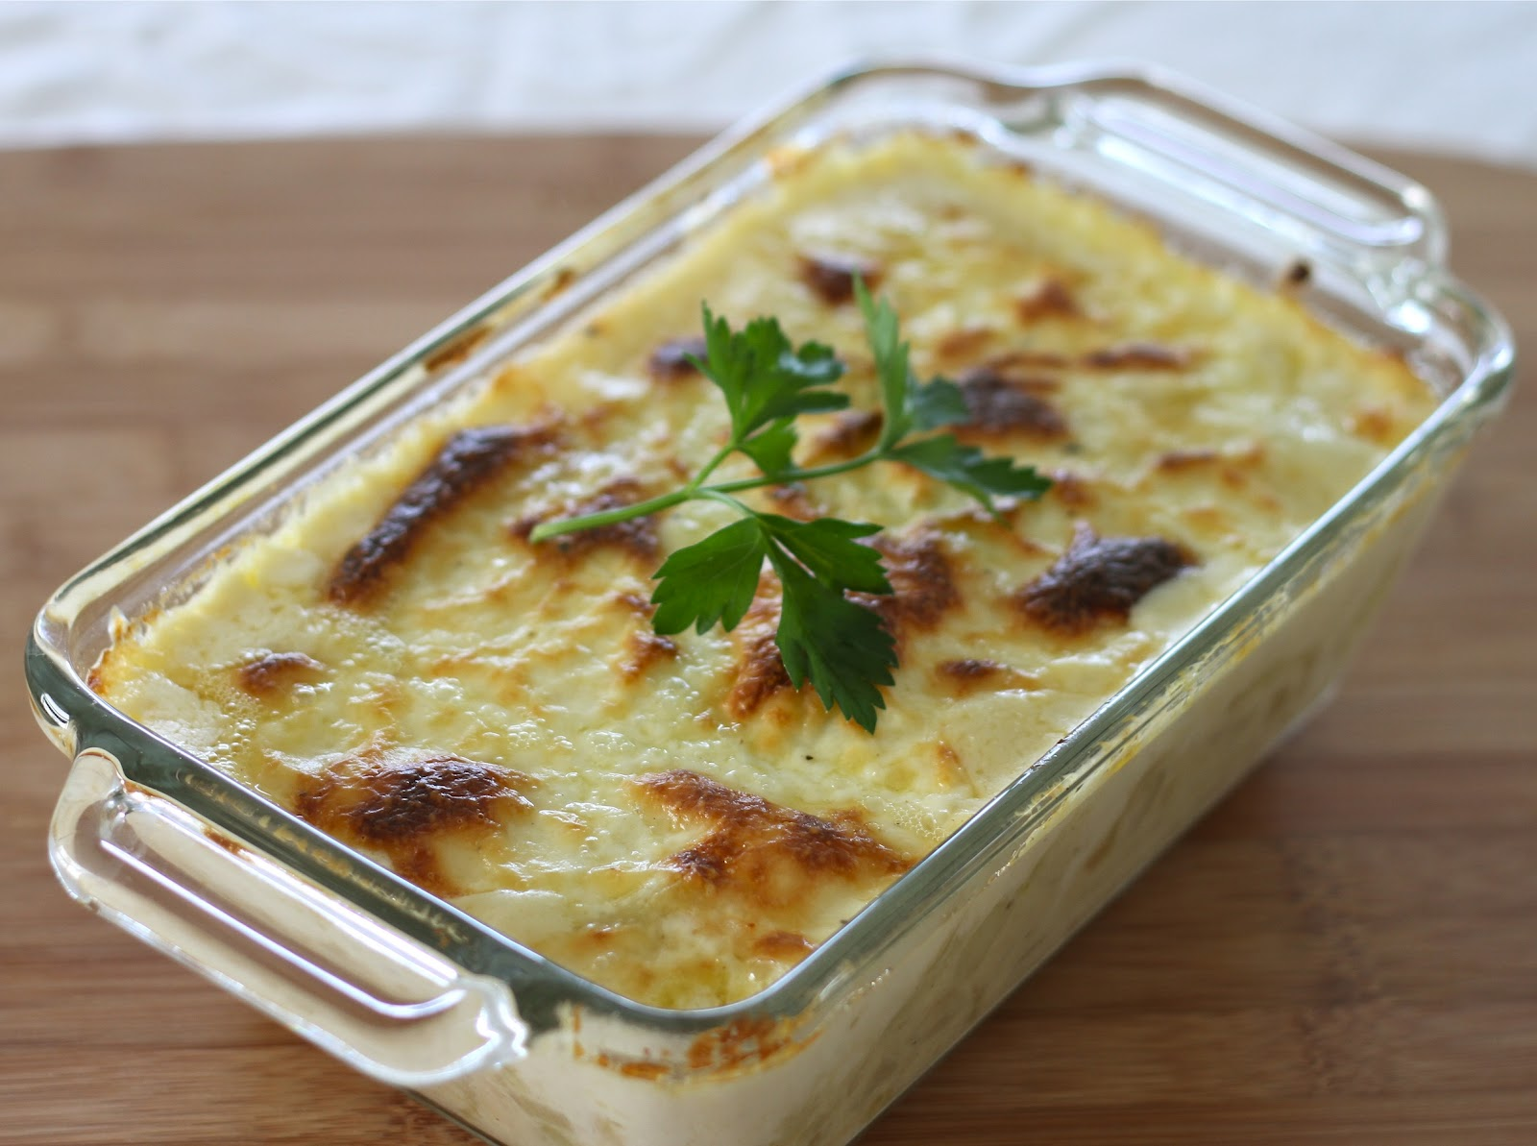
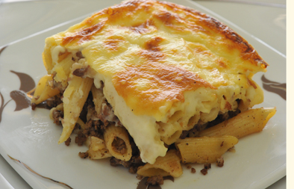
Macaroni béchamel
An Egyptian favorite made with ground meat mixture between two layers of pasta (usually penne) smothered in a creamy béchamel sauce , then baked until top is golden brown.

Slide 10
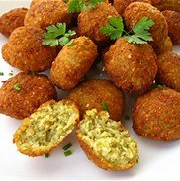
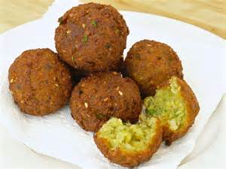
Falafel
A deep fried ball or patty made from ground chick peas or fava beans (or both)

Slide 11
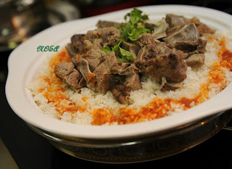
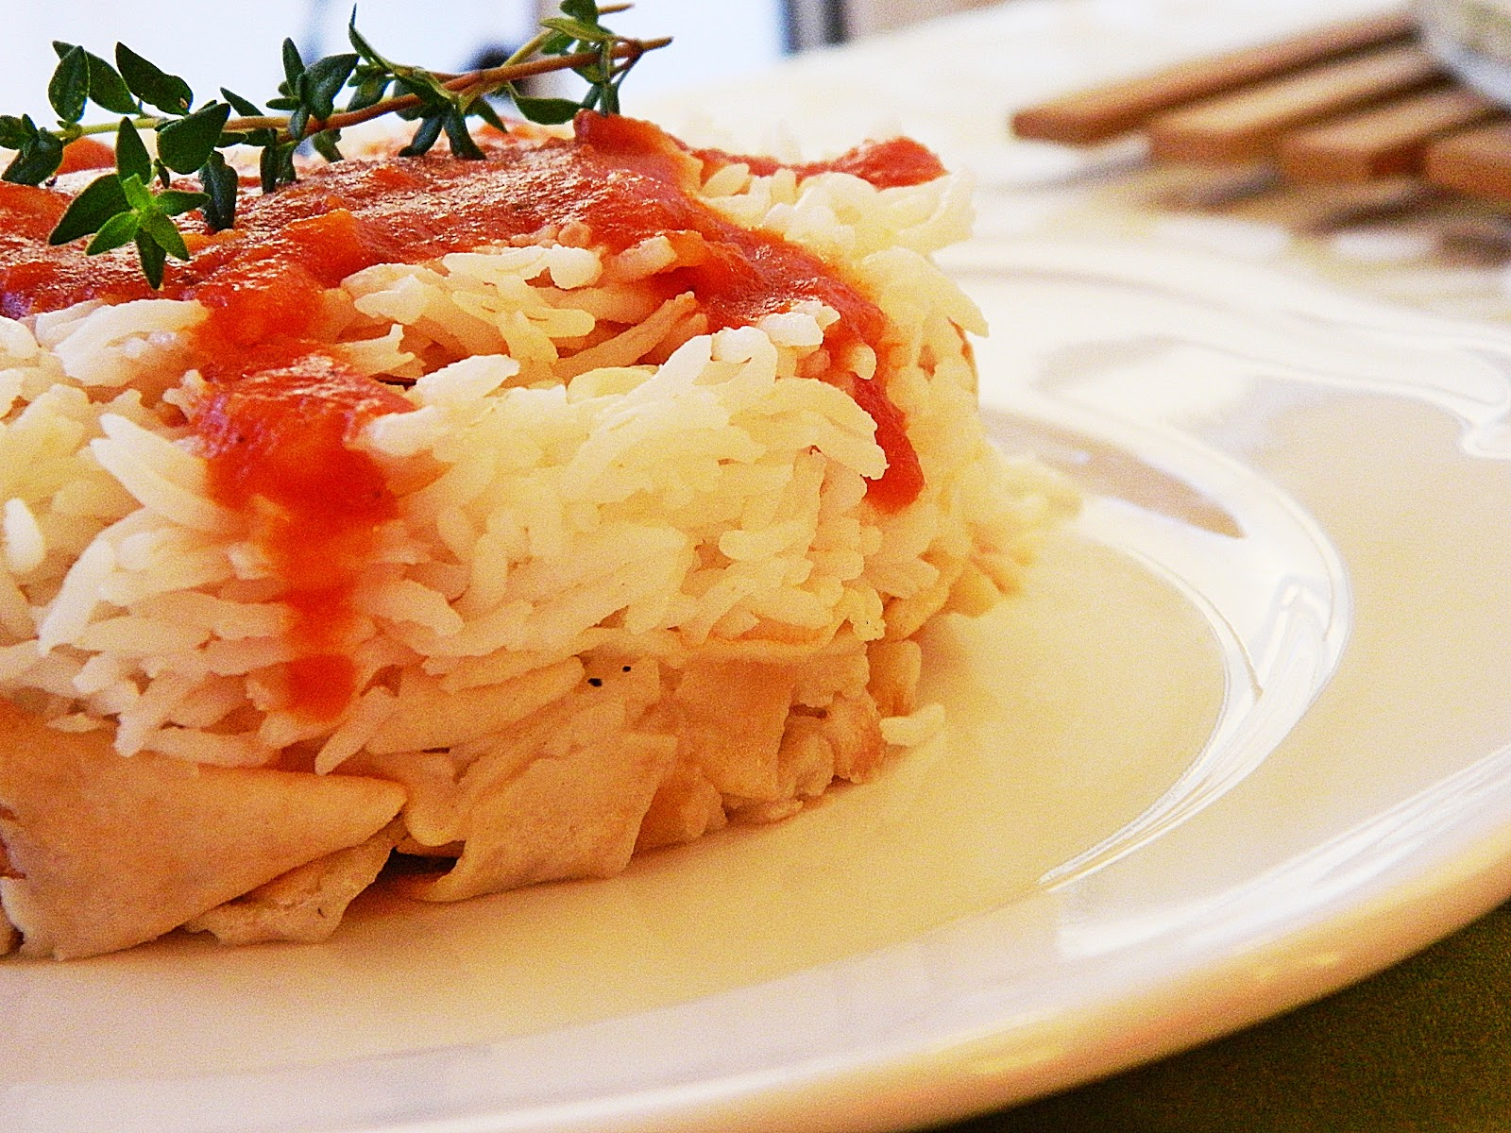
Fattah
A dish that consists of bread, meat , rice layered on top of the other with various types of sauces (usually tomato sauce and vinegar) . The bread is typically baladi bread.

Slide 12
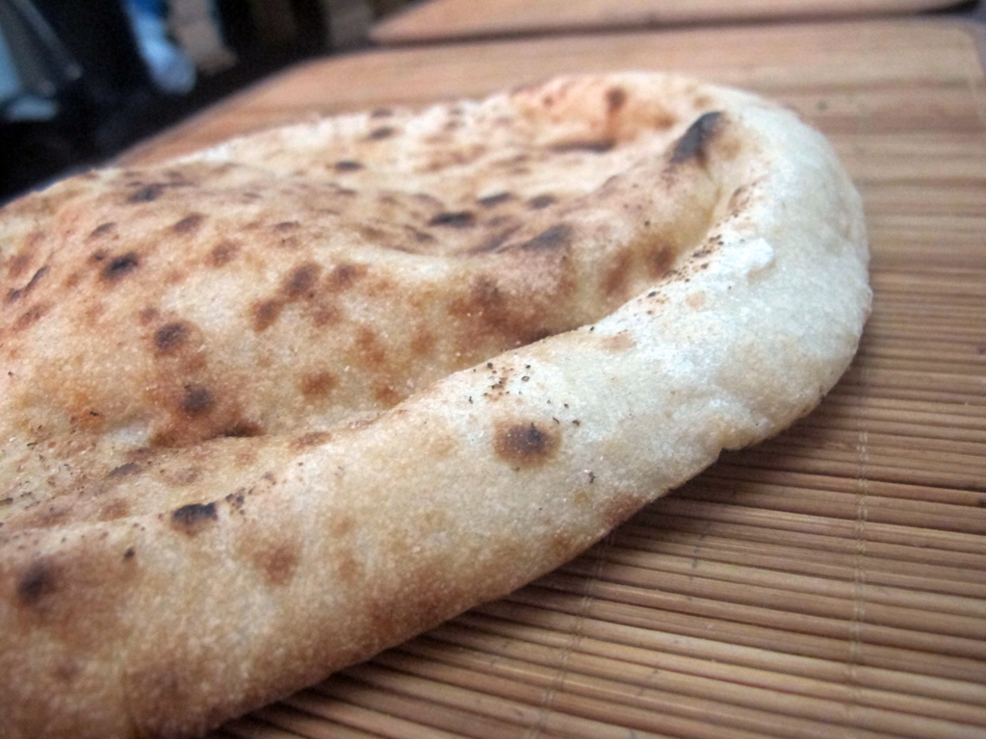
Baladi bread
Most popular bread in Egypt , in fact it’s so popular that in the 70s when the government moved to stop subsidizing the bread , it resulted it country wide riots . It is a flat bread made of whole wheat and bran.

Slide 13
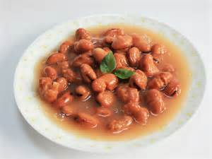
Ful
A dish consisting of cooked fava beans served with vegetable oil and cumin. It is typically topped with parsley.

Slide 14
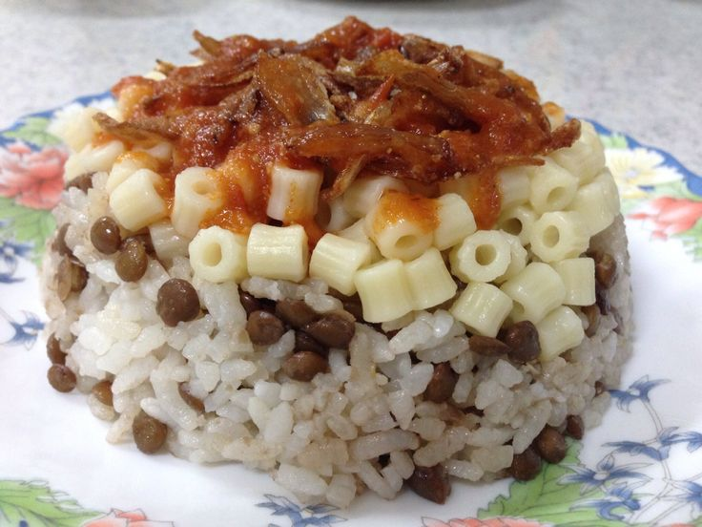
Koshari
A classic Egyptian street food that consists of rice, pasta, and legumes topped with a spicy-sweet tomato sauce and creamy caramelized onions.

Slide 15
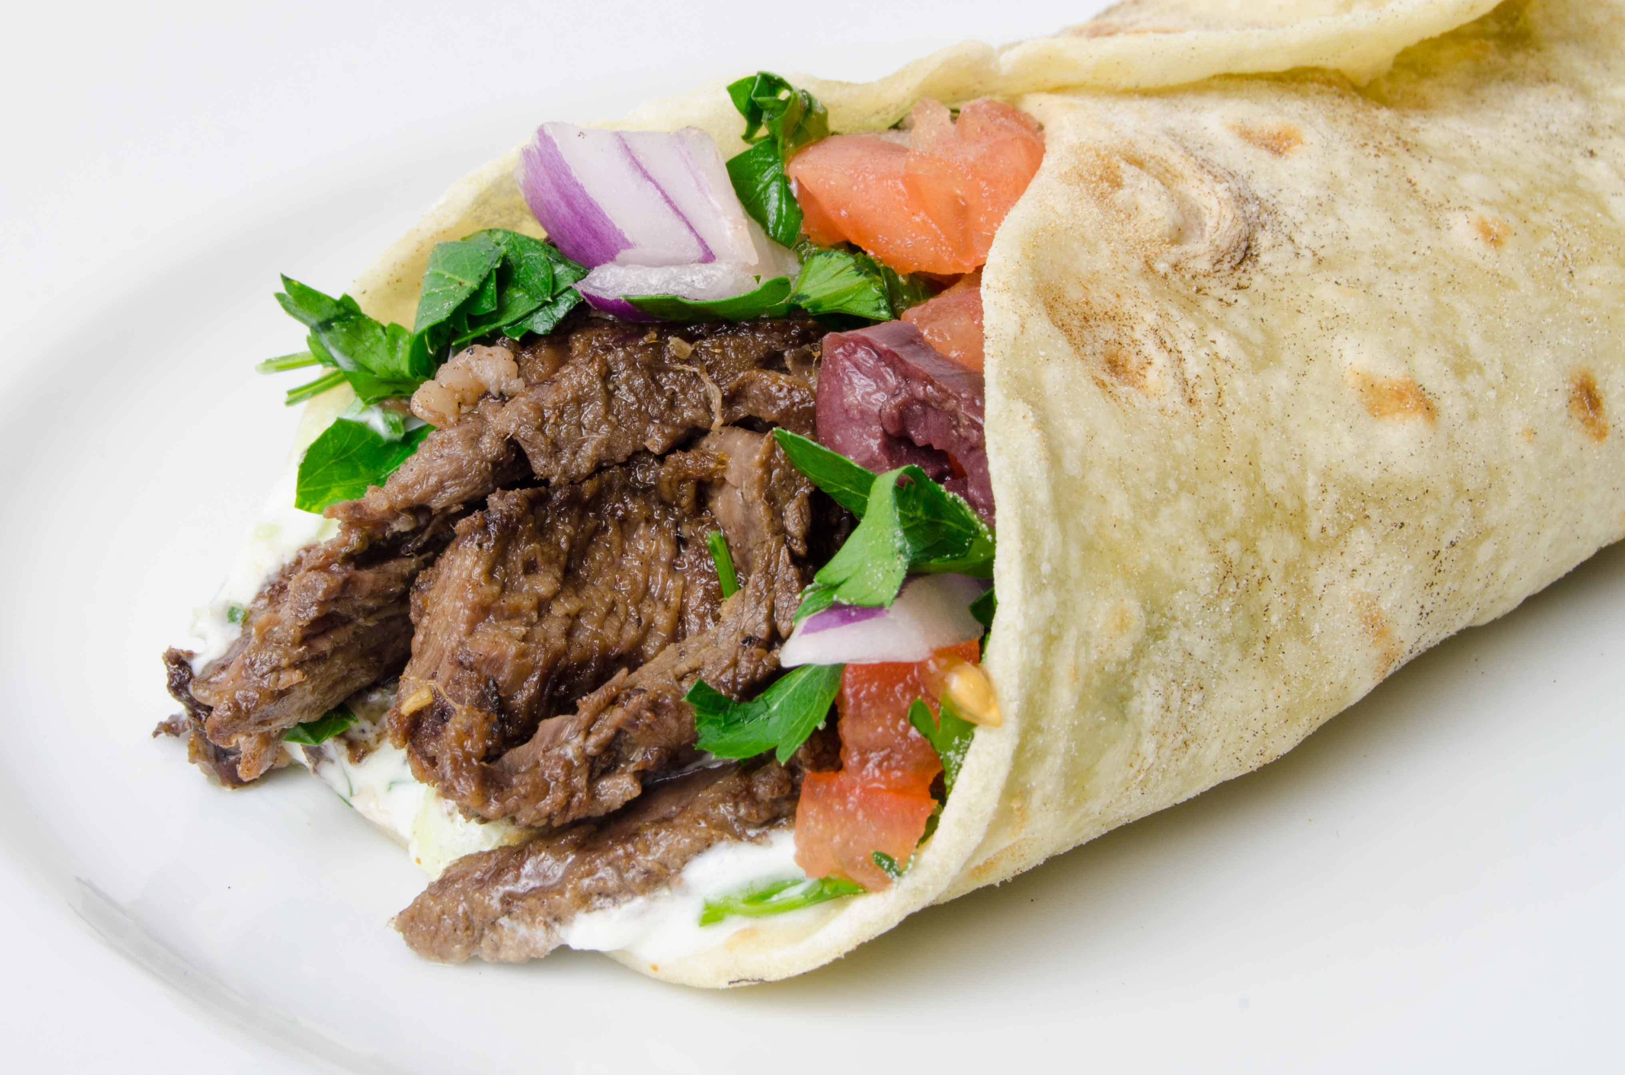
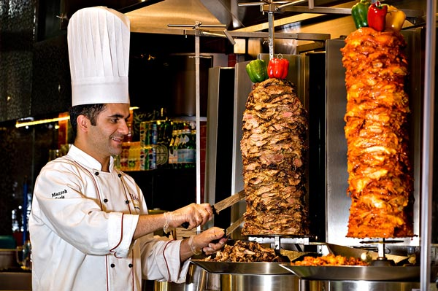
Shawarma
It starts with Levantine Arab meat preparation , where lamb , chicken , turkey , beef or mixed meats are placed on a spit and grilled for as long as a day. Shavings are cut off the block for serving . Usually eaten in a sandwich.

Slide 16
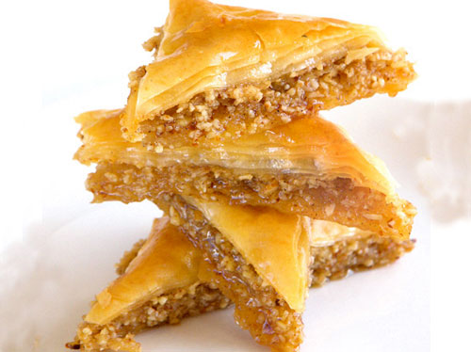
Baklava
Rich , sweet pastry made with filo dough filled with nuts and sweetened with syrup or honey.

Slide 17
What is an arab?
a member of a Semitic people, originally from the Arabian peninsula and neighboring territories, inhabiting much of the Middle East and North Africa
© Oxford University Press

Slide 18
What does an Arab look like?
An Arab is a human being and does not have a specific look, their dress may depend on their region or culture. But there is no specific look nor do they need to be categorized in that way.

Slide 19
Major Islamic holidays
There are two official holidays in Islam:
Eid Al-Fitr
Eid Al-Adha.

Slide 20
Eid Al-Fitr
Eid Al-Fitr is celebrated at the end of Ramadan (a month of fasting during daylight hours), and Muslims usually give zakat (charity) on the occasion. It indicates the first day of the Islamic month of Shawwal. It marks the end of Ramadan, which is a month of fasting and prayer, Ramadan is the ninth month of the Islamic calendar. Fasting is one of the Five Pillars of Islam. The month lasts 29–30 days based on the visual sightings of the crescent moon. Every day during this month, Muslims around the world spend the daylight hours in a complete fast. During the month of Ramadan, Muslims all over the world abstain from all food, drink, and other physical needs during the daylight hours (such as smoking or sex). It is a time to purify the soul, refocus attention on God, and practice self-discipline and sacrifice.

Slide 21
Eid Al-Adha.
Known as the Feast of Sacrifice, each year. This festival commemorates Ibrahim’s (Abraham) willingness to sacrifice his son to God. This festival also marks the end of the Hajj pilgrimage to Mecca. Eid al-Adha is known as the Feast of Sacrifice because it traditionally includes the sacrifice of an animal permitted for food (eg. a lamb) as an act of thanksgiving for God’s mercy. The meat from the sacrifice of Eid al-Adha is mostly given away to others. One-third is eaten by immediate family and relatives, one-third is given away to friends, and one-third is donated to the poor.

Slide 22
Climate
Egypt has a hot desert climate . The climate is generally extremely dry all over the country except on the northern Mediterranean coast which receives more rainfall in winter and is generally cool, windy and humid . The climate in Egypt varies from unusually cold to extremely hot.

Slide 23
International trading
Egypt has grown increasingly reliant on imports over a very long period of time, and has, as a result, maintained an external trade deficit for most of the past 6 decades. The deficit, however, grew considerably between 1974 and 1984 as a result of President Sadat's open-door policy that encouraged imports, and reached US$4.86 billion in 1980.
Read more: http://www.nationsencyclopedia.com/economies/Africa/Egypt-INTERNATIONAL-TRADE.html#ixzz45p8xQV9Z

Slide 24
Dress code
No dress code . People can wear whatever they like . The government nor culture has control over one’s appearance

Slide 25
English words of from Arabic origin
Algebra
Alcohol
Apricot
Alkali
Average
Caravan
Caraway
Carat

