Slide 1
Quadratics in life applications
Lesson 8-1

Slide 2
Form
A Quadratic Equation is an equation with No variable raised to a power greater than 2.
Standard Form: y = ax² + bx + c, where a ≠ 0 . Its also named the sum-product form.

Slide 3
Graph
A U-shaped graph called a parabola.
-If the leading coefficient a of the equation is positive, the parabola opens up.
-If the leading coefficient a is negative, the parabola opens ­­­­­­­­­­­­­­­­­down.

Slide 4
properties
Vertex is
the lowest point of a parabola that opens up (minimum)
or
the highest point of a parabola that opens down (maximum)

Slide 5
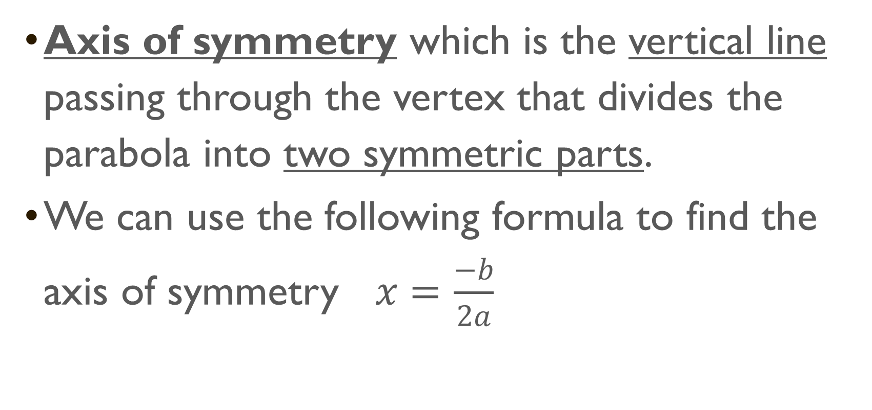
properties
Axis of symmetry which is the vertical line passing through the vertex that divides the parabola into two symmetric parts.
We can use the following formula to find the axis of symmetry $x=\frac{−b}{2a}$

Slide 6
Properties
Intercepts:
x-intercepts are called the roots, solutions and zeros. The parabola crosses the x axis at the x intercepts. A quadratic equation can have 0, 1, or 2 zeros.
Y-intercept or c is where the parabola crosses the y axis.

Slide 7
