Slide 1
Solving Quadratics by factoring
Lesson 8-2

Slide 2
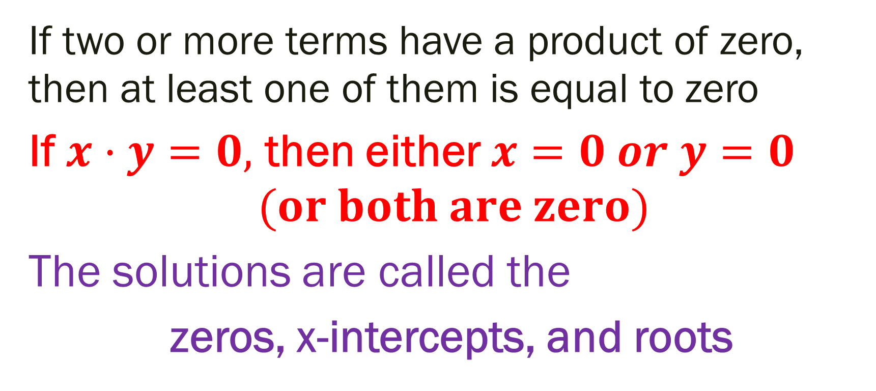
The Zero product Property
If two or more terms have a product of zero, then at least one of them is equal to zero
If $x·y=0,$ then either $x=0 or y=0$
$$(or both are zero)$$
The solutions are called the
zeros, x-intercepts, and roots

Slide 3

Example 1:
$$3x=0 means$$
$$x=0$$

Slide 4

Example 2:
$$x\left(y\right)=0 means$$
$$x=0 or y=0$$

Slide 5
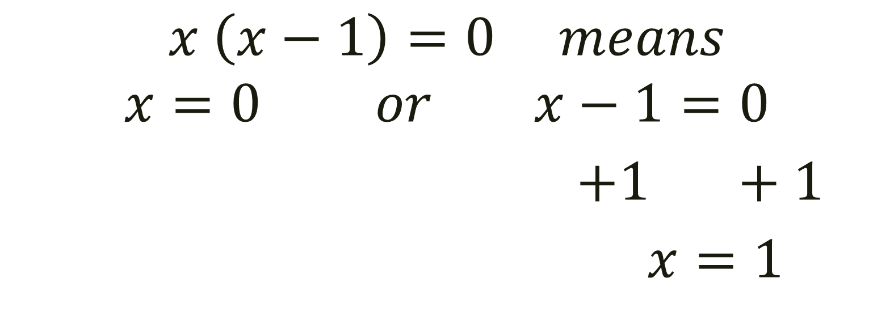
Example 3
$$x \left(x−1\right)=0 means$$
$$x=0 or x−1=0$$
$+1 +1$
$x=1$

Slide 6
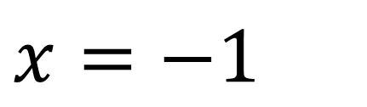
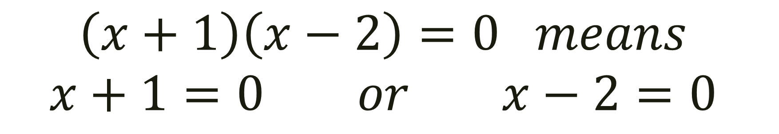
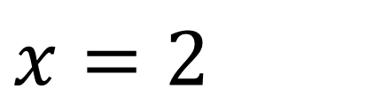
Example 4:
$$\left(x+1\right)\left(x−2\right)=0 means$$
$$x+1=0 or x−2=0$$
-1 -1
+2 +2
$x=−1$
$x=2$

Slide 7
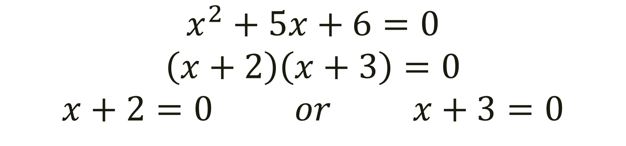
Example 5:
$$x^{2}+5x+6=0$$
$$\left(x+2\right)\left(x+3\right)=0$$
$$x+2=0 or x+3=0$$

