Slide 1
Welcome to Arabic 2: Lesson 1

Slide 2
Copy down each slide and make 5 complete sentences either in the form of statements or questions.

Slide 3
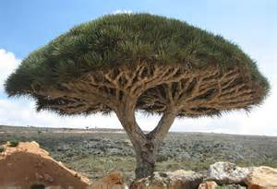
How do you say: This is?

Slide 4
Greetings
Respond to the following greetings:
السلام عليكم

Slide 5
Greetings
Respond to the following greetings:
كيف الحال؟

Slide 6
Greetings
Respond to the following greetings:
صباح الخير

Slide 7
Greetings
من اين انتَ؟
من اين انتِ؟

Slide 8
Asking basic questions
هل عندكِ قَلَم جَديد؟
Say yes, I do have a new pen.
Say no, my pen is old.

Slide 9
Thank you-شُكْرًا
It’s response:

Slide 10
PLEASE (TO A FEMALE)-مِن فَضْلِك

Slide 11
Here you are (to male)-تَفَضَّل
Here you are!!

Slide 12
Here you are (to female)-
Here you are!!

Slide 13
YOUR?…(MASCULINE)-...كَ
This is yours…

Slide 14
YOUR?(FEMININE)-...كِ
This is yours…

Slide 15
HIS-...هُ
This is his…

Slide 16
HER-...هَا
This is her…

Slide 17
MY-...ي
This is my….

Slide 18
I’D LIKE-أُريد
I’d like…..

