Slide 1
Welcome to Arabic 2
Lesson 5: Representation of Foreign Sounds

Slide 2
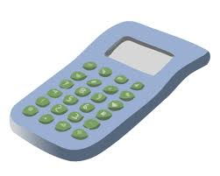
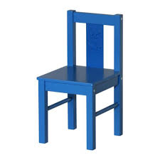
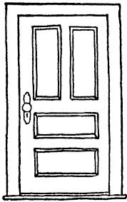
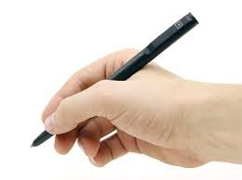
Recap from last lesson: Name that object

Slide 3
Review: Next to; on; under; in between; In; In the middle; There is; this is.
Describe what you see in this picture.

Slide 4
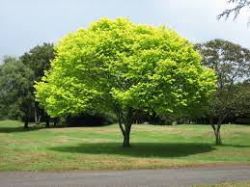
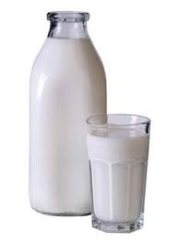
Warm up: Describe the following using this is/there is; write down the transliteration.

Slide 5
A few sounds that exist in other languages are not in the Arabic Sound system. Of these, the following three are most commonly used because they are part of the sound systems of most European languages with which Arabic has close contact.
Foreign Sound Representation in Arabic
P With 3 dots under ب
V with 3 dots above ف
G غ

Slide 6
The sound g, however, is represented by ج in Egypt because the letter ج is pronounced g in most parts of Egypt, Yemen, and Oman. It is represented by غ in the eastern part of the Arab world.
Read and transliterate the following sentences:

Slide 7
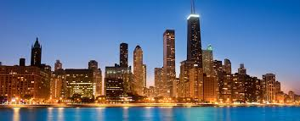
اين مدينة شيكاغو؟
اين مدينة كوبنهاغن؟

Slide 8
Homework: Find 5 different major cities that use “G” and state one fact for each.
Your assignment is in English, however, the town/cities must be written in Arabic and English.

Slide 9
Classroom and surroundings
Culture: Arab Unity
http://www.youtu.be/ztWqfVTggUs

