Slide 1
Welcome to Arabic 2 by Kurzban

Slide 2
Lesson 6:
Objectives:
Review
Conversational
Arab States: Identifying and inquiring about Arab countries, capitals, and cities
Practice
Homework
Culture: Rich Arabs: http://youtu.be/n3vsVkjRi40
https://www.youtube.com/watch?v=QeCY3CmFHSk

Slide 3
Do Now: Review
Combine the letters in each set.
د+ل+ا+ل=
ت+ن+ك+ط=
ي+س+ش+ز=
و+ه+ع+ف+ص=

Slide 4
Continue connecting the letters to form words. Lesson 19: Focus on Haa, lam and Mim
بَ+ه+ل+و+لْ=
ا+ل+مَ+ل+ا+هِ+ي=
سَ+ف+ي+ه=
فِ+د+ا+ه=
مُ+ه+ا+تَ+ر+ا+ت=

Slide 5
Lesson 6: Review
Where? أيْنَ؟
When? مَتَى؟
Why? لِماذا؟
In what? In Which? (m./f.) فِي أيِّ؟ أيَّةِ؟

Slide 6
Lesson 6: Nisba
Describing one’s national regional affiliation involves providing information about one’s place of origin or residence. This function requires the use of a noun called :noun of nisba”.

Slide 7
Lesson 6:
انا مِصْريّ
هُوِ مِنْ مَدِينَة الْقَاهِرَة

Slide 8
The relative Noun Nisba
The noun used to indicate affiliation is called a relative: “noun.”The Arabic word for it is nisba (relation). It is derived form a noun that refers to a city, country, region, ethnic group, etc. This process is fairly simple.
It involves adding one suffix to nouns ya with shadda.

Slide 9
Lesson 6:
Egyptian:________________________مصر
Now say, he is from Egypt:
She is from Egypt:
Tunisian: ______________________تونِس
Repeat with Tunisian.

Slide 10
If a noun ends with a ta marbuta or alif, drop them and add yaa
French: فَرَنْسا ________>فَرَنسيّ
He is from: (In Arabic)
She is from: (In Arabic)
I am from: (In Arabic)

Slide 11
Lesson 6
If a noun ends with ya and ta marbuta or ya and alif, drop the ta marbuta or alif and attach ya which will make a doubled ya with original one.
Syrian سورية __________سوريّ
Say: I am from Syria

Slide 12
Your turn:
مَغْرِب
لُبْنان

Slide 13
Provide words or phrases to answer or question the right hand column
كَيفَ الحال؟
مع السلا مة
مَرحَباً
مصر
انتَ
لا
إسمي زيْنية؟

Slide 14
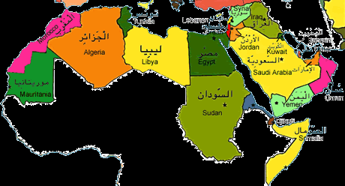
Lesson 6: Inquiring about and identifying Arabic Cities
The map below displays some of the names and locations of some Arab countries

Slide 16
Lesson 6
For practice, ask your partner where certain town is located and answer the question using the name of that city and the country.
Here is an example:
أينَ بَغْداد؟
بَغْداد في العراق

Slide 17
Lesson 6: Inquiring about and identifying Arabic Cities
You might need to learn about capital cities of some Arab countries in order to finish this exercise.
Capital Country
المغرب الرباط
مصر القاهرة
لبنان بيروت

Slide 18
Homework
There are 22 Arab countries. Find and write their names in Arabic as well as their capitals.

