Slide 1
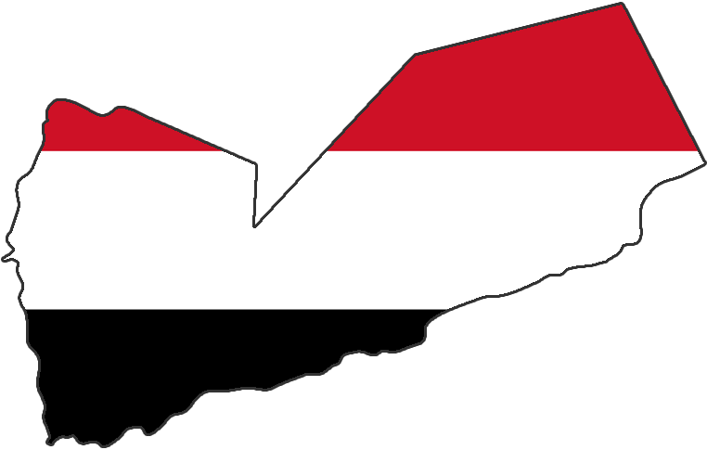
Yemen

Slide 2
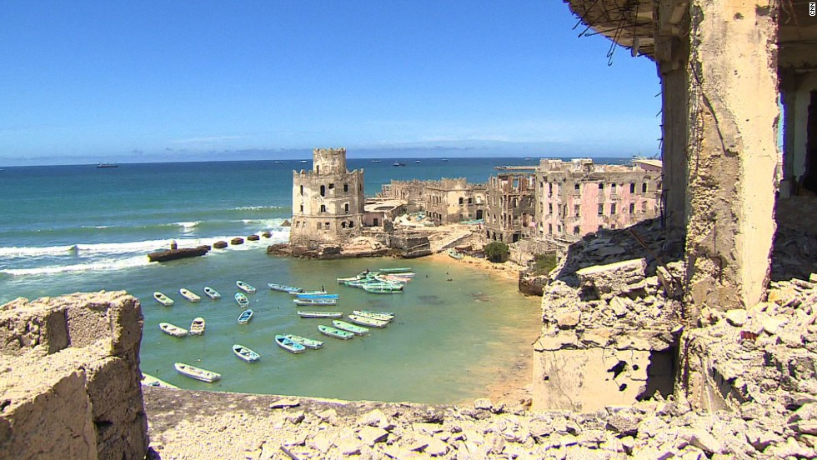
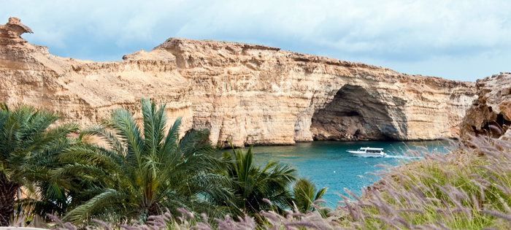
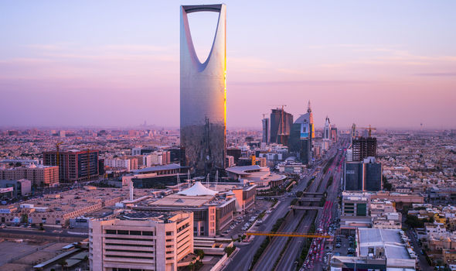
Yemen's neighbors
Somalia
Oman
Saudi Arabia

Slide 3
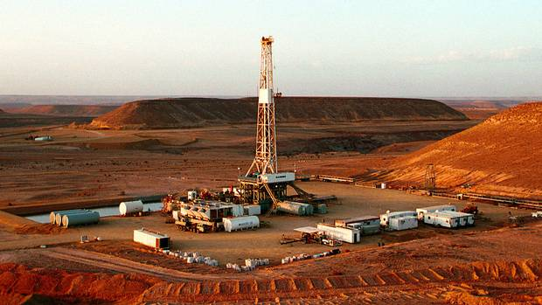
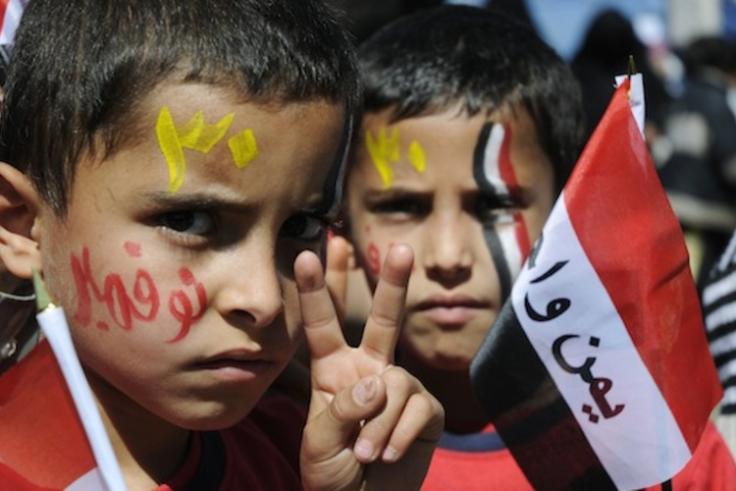
About Yemen
24.4 million
May 22, 1990
Oil
Batheri, Hobyot,
Razihl, Socotri

Slide 4
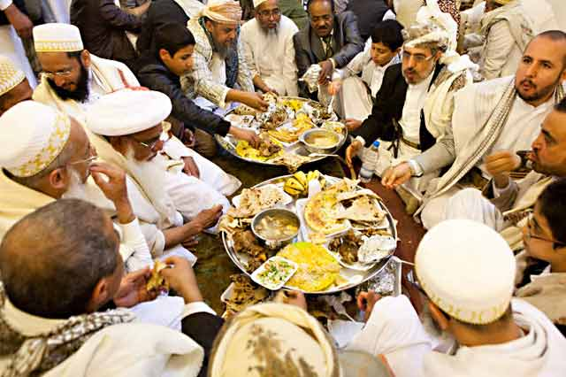
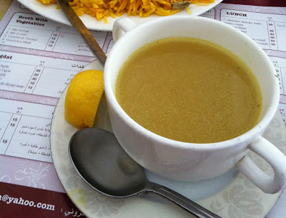
Yemeni Delicacies
فحسَة
مر ق
المندي‎

Slide 5
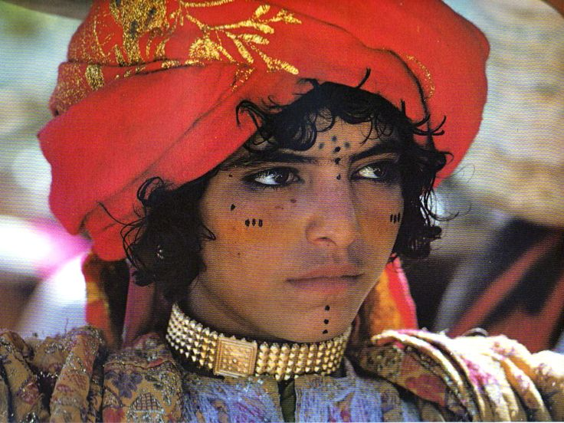
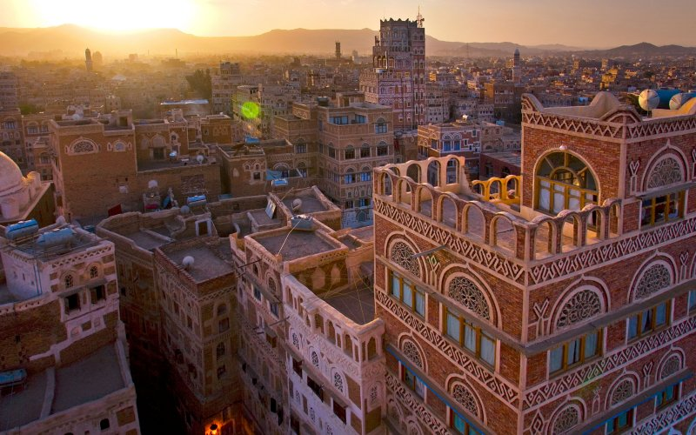
Arab Culture
Light brown skin, dark hair, dark eyes

Slide 6
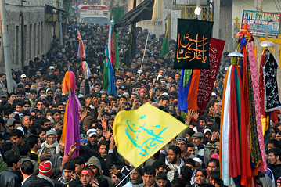
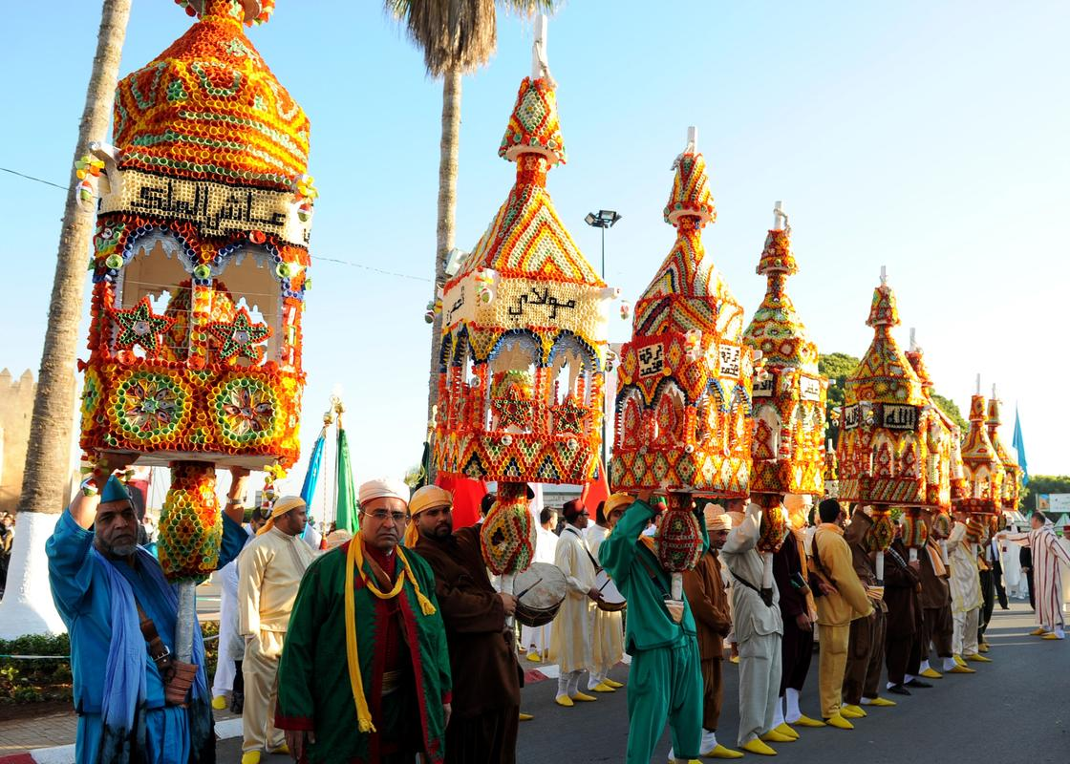
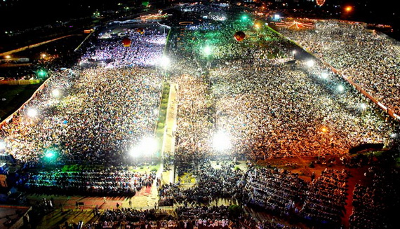
Major Islamic Holidays
Ramadan, Muharram, Mawlid al Nabi

Slide 7
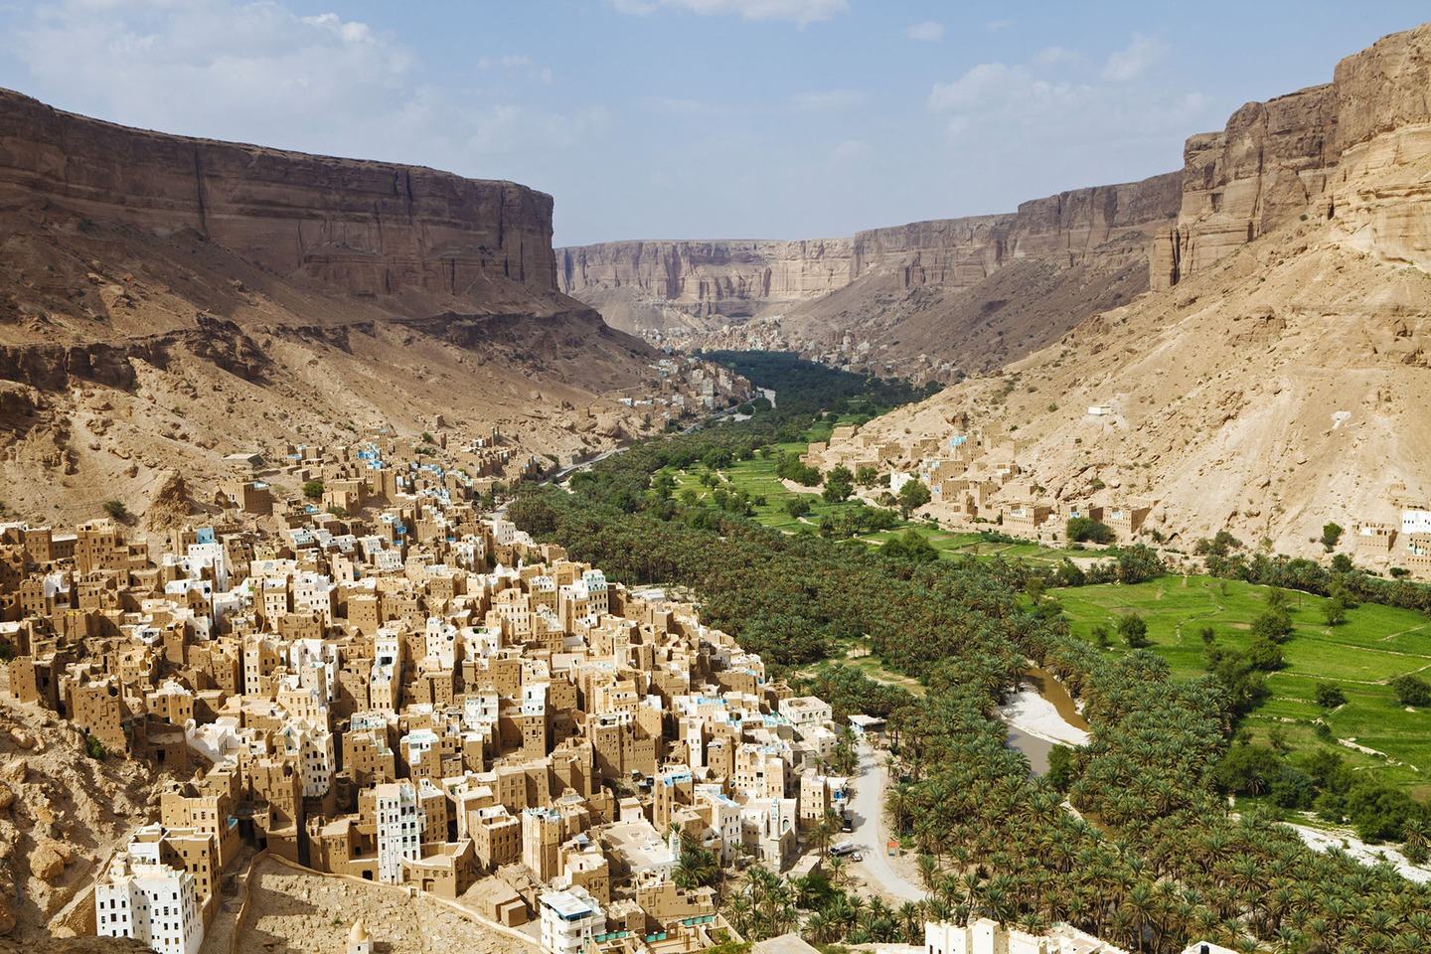
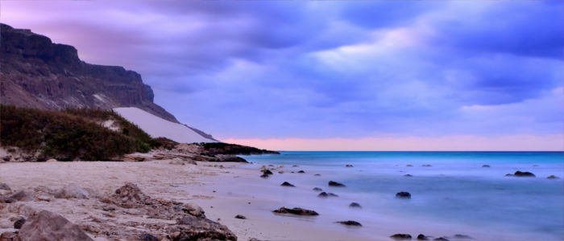
Climate
Subtropical
Dry, hot
Desert
Low Rainfall
High temperatures
in the
summer

Slide 8
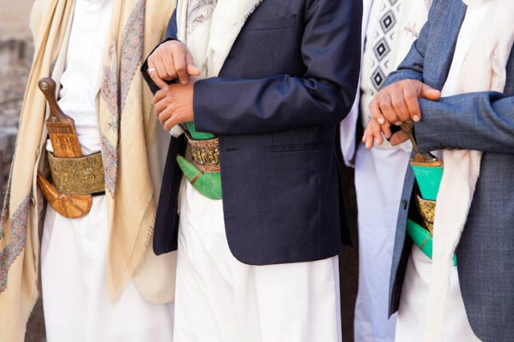
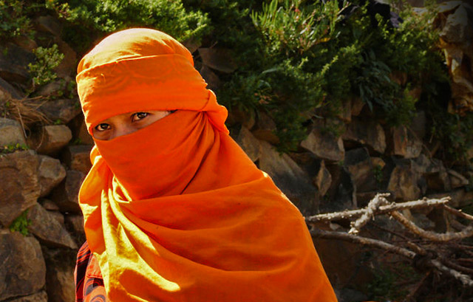
Clothing
(Traditional) Male
Light, flowing light colored linens, blazer, and head dress
(Modern) Male
Very similar to us
Female
Burqua, hijab, sitara ect. Usually covering most skin, though also light and flowing.

