Slide 1
Welcome to Arabic 2
Lesson 16

Slide 2
Review: Refer to your notes
List the days of the week starting with Sunday.

Slide 3
هناك سيارة وردية جديدة اما م قد يم بنك. أنا من نيو يو رق و أحب امر يكا. هنا ك ا لطا و لق بنية بجانب تلفا و ازرق. هناك ورَّقة و قلم بجا نب ما فدة.

Slide 4
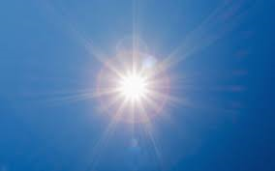
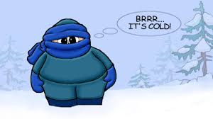
Vocabulary Builder
Translate the following:
Weather:
غائم
ماطر
صحو
بارد

Slide 5
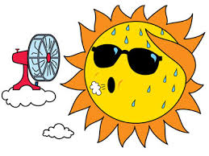
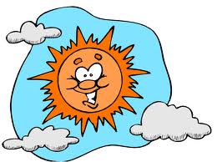
Vocabulary Builder Continue: Weather الطقس
حار/
دافئ

Slide 6
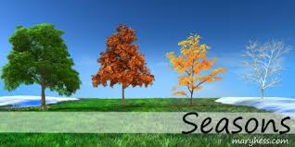
Write the translation to each: 1) There are four seasons in a year; 2) there are three months in winter, and 3 Months in spring, and 3 months in Autumn, and 3 months in summer. 3) Today, the weather is nice and warm
الفصول الاربعة

Slide 7
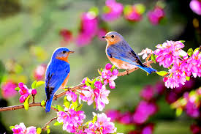
الربيع الطقس في الربيع…
Temperature:
Moderate:

Slide 8
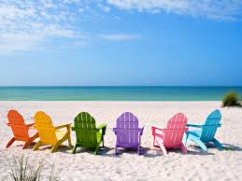
الصيف
In the Summer, the weather is sunny and the temperature is hot.

Slide 9
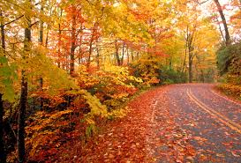
الخريف
In Autumn, the weather is windy cloudy

Slide 10
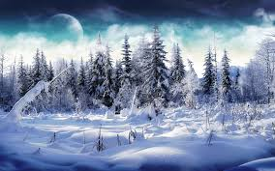
الشتاء
In the Winter, the weather is snowy and the temperature is very cold

Slide 11
Homework: Lesson 16
Translate the following vocabulary first then underline the word that does not belong in each set and explain your choice in English.
Tree Rose Green Snow
2) Weather moderate hot window
3) Rain hot desk cold
4) Week purple year month

