Slide 1
Welcome to Arabic 2

Slide 2
Letters

Slide 3
أُريدReview:
I’d like…..
I want

Slide 4
Greetings
Translate the following :
Hello, my name is:

Slide 5
Greetings
What is your name?: ( male)/female

Slide 6
Greetings
Good morning /R

Slide 7
Greetings
Good evening/R

Slide 8
Greetings
Where are you from?

Slide 9
Greetings
I am from…..

Slide 10
Family members

Slide 11
Asking about family members
Do you have a sister?

Slide 12
Asking about family members
Do you have a brother?

Slide 13
Family ___________
List your family members, their names and connect sentences with waw.

Slide 14
Thank you
Write it down several times & its response.

Slide 15
Broken-مَكْسٌور
The use of his, hers, and mine
 | Vocabulary Builder: Say in Arabic: I have a broken pen Say in Arabic: He has a broken pen Say in Arabic: She has a broken pen

Slide 16
Homework: 3
Constructing sentences.

Slide 17
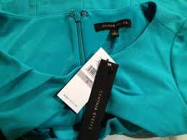
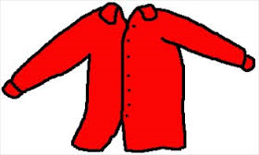
New-جَديد
1) Say in Arabic: I have a new shirt
2) Say in Arabic: He has a new shirt
3) Say in Arabic: She has a new shirt
4) Ask someone in Arabic if he/she has a new shirt
5) Ask someone in Arabic if he/her shirt is new.

