Slide 1
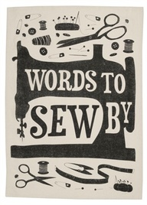
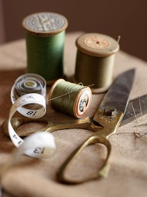
Accessory design

Slide 2
Examples:
Bags
Scarves
Hair accessories
Jewelry
Cell phone holders
Sunglass case
Etc!

Slide 3
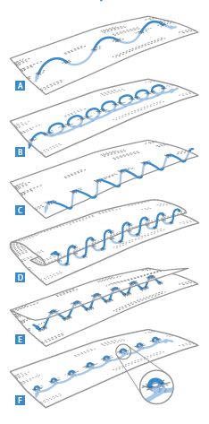
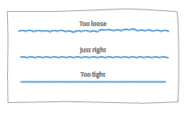
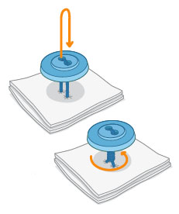
Sewing basics:
http://www.readymade.com/magazine/article/sew_far_sew_good

Slide 4
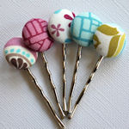
Projects from scrap fabric
http://tipnut.com/scrap-happy-fabric-scrap-ideas-free-patterns/

Slide 5
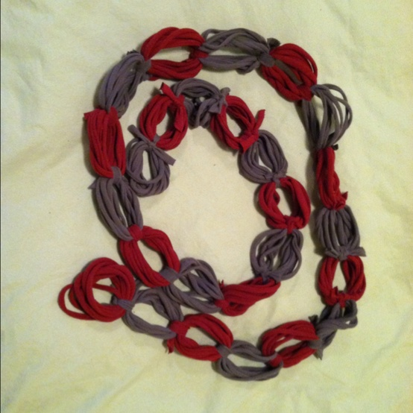
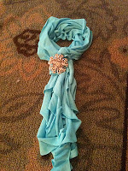
scarves
http://www.thismomsheart.com/2011/12/diy-t-shirt-scarf.html

Slide 6
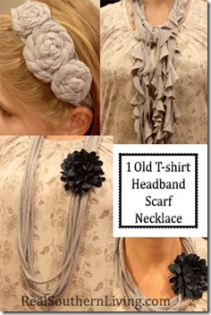
Headbands
http://realsouthernliving.blogspot.com/2012/01/1-old-t-shirt-headband-scarf-and.html

Slide 7
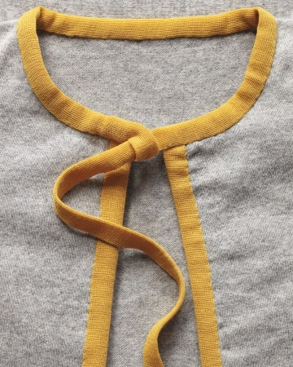

Slide 8
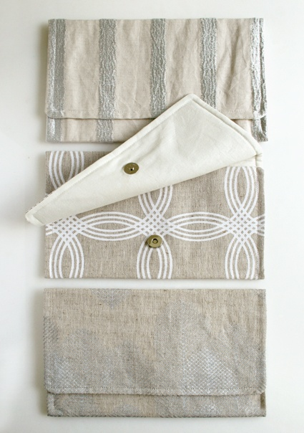
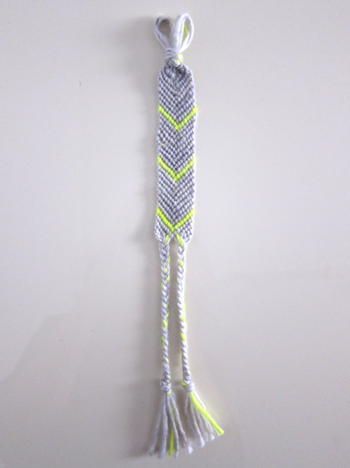

Slide 10
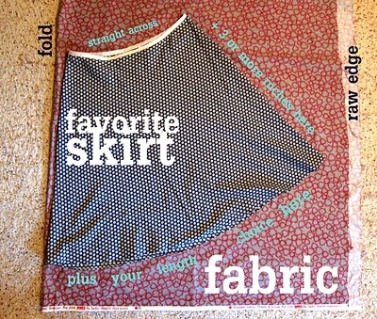

Slide 11
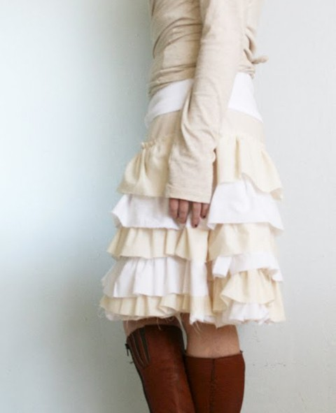
Skirts
http://coatsandclarksewingsecrets.blogspot.com/2012/06/10-super-easy-skirts.html

Slide 12
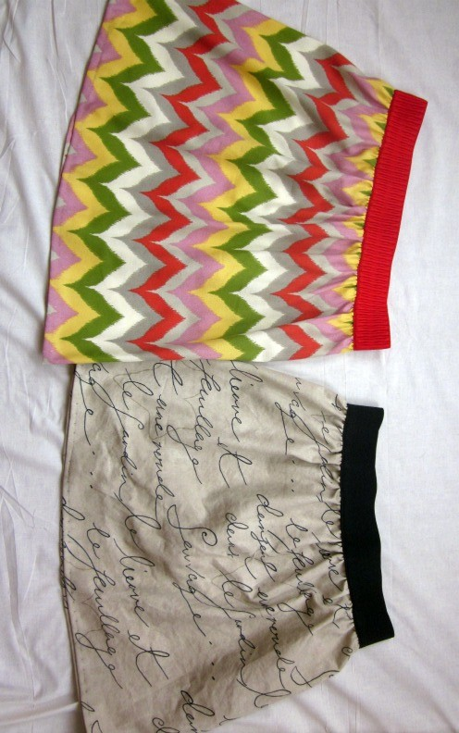
http://coatsandclarksewingsecrets.blogspot.com/2012/06/10-super-easy-skirts.html

Slide 13
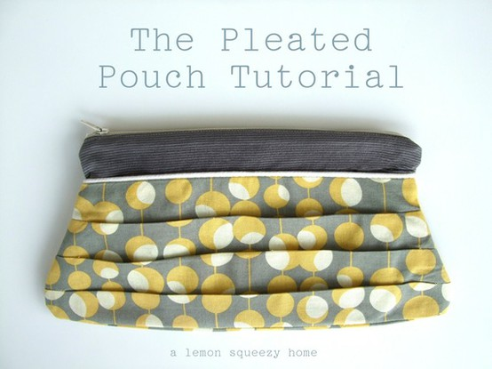
Bags
http://www.lemonsqueezyhome.com/2010/10/pleated-pouch-tutorial-with-pattern.html

Slide 14
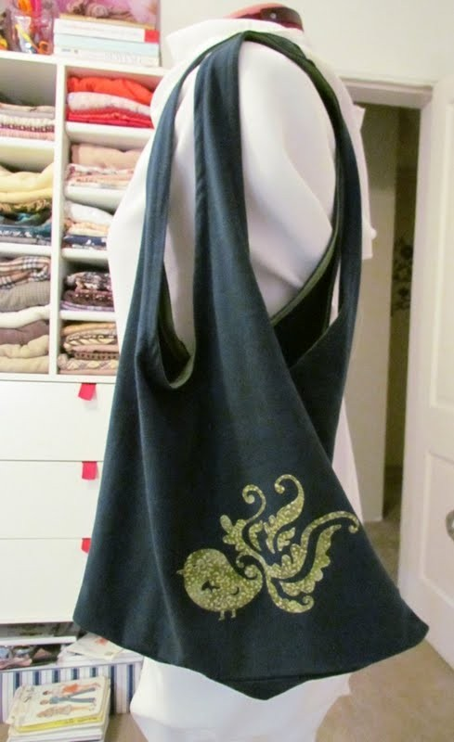
http://etcetorize.blogspot.ca/2011/08/t-shirt-tote-bag.html

Slide 15
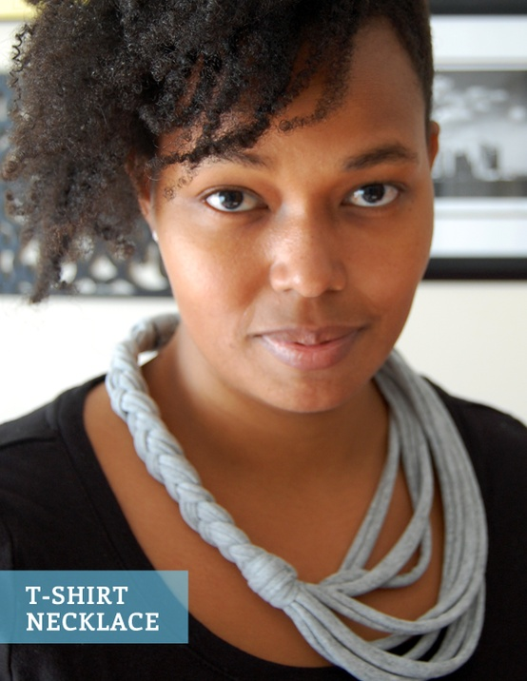
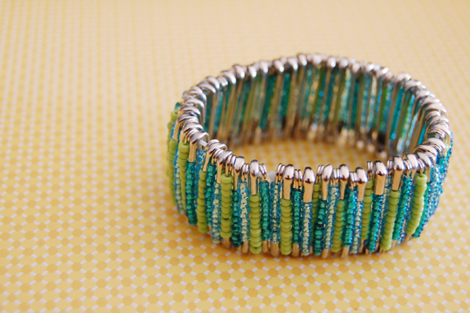
Jewelry
http://www.greenandgorgeous.net/2012/10/31/three-easy-diy-jewelry-tutorials-using-unexpected-materials/

Slide 16
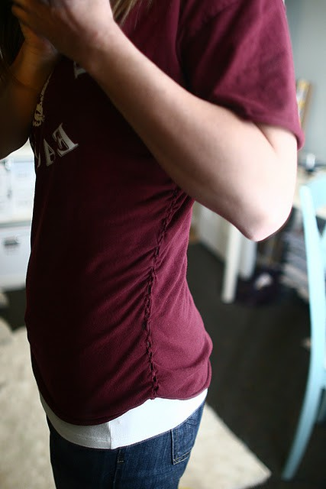
T shirt
http://connectthedotsons.blogspot.com/2011/03/diy-husbands-large-t-shirt-to-fitted.html

Slide 17
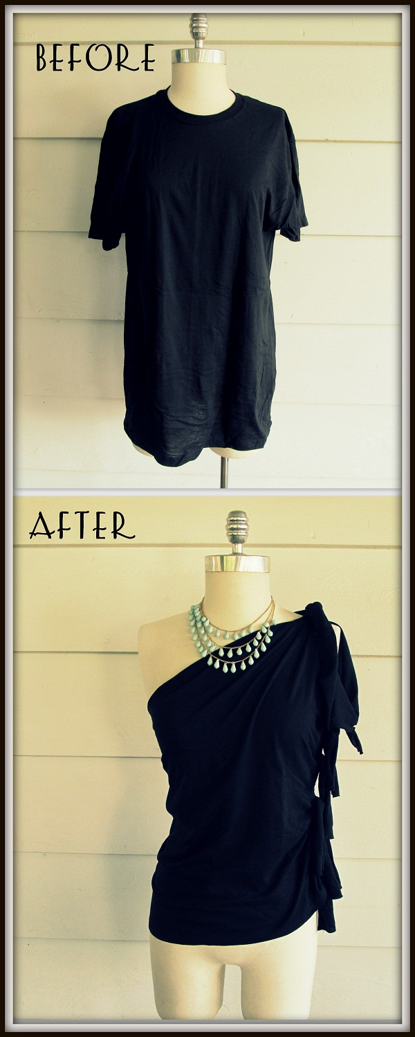
http://wobisobi.blogspot.com/2012/07/no-sew-one-shoulder-shirt-diy.html

Slide 18
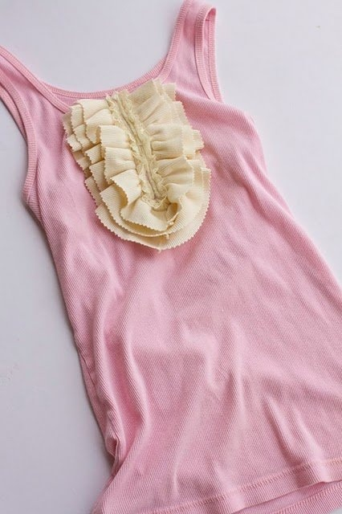

Slide 19
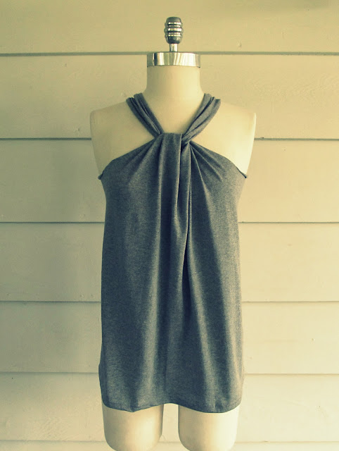
http://wobisobi.blogspot.com/2012/07/no-sew-halter-3-diy.html

Slide 20
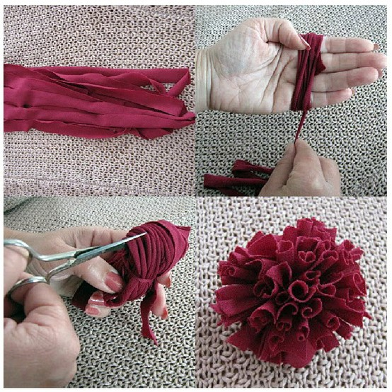
Flowers

Slide 21
http://realsouthernliving.blogspot.com/2012/01/1-old-t-shirt-headband-scarf-and.html
http://lookslikehomemade.com/10-no-sew-t-shirt-upcycle-projects/

Slide 22
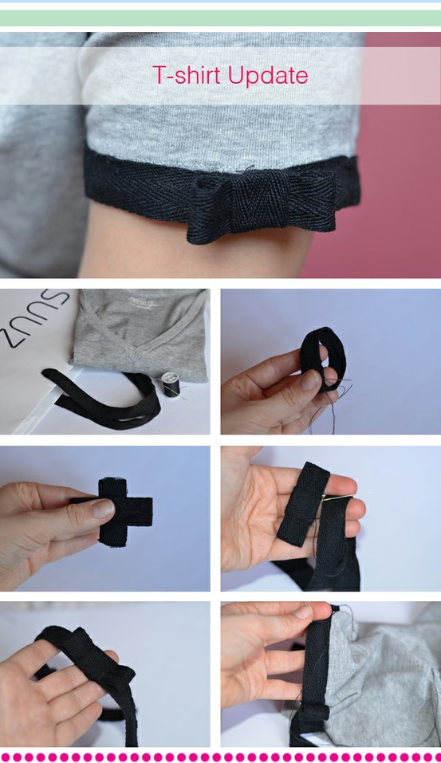
Bow
http://www.makeitandfakeit.com/2012/04/t-shirt-update-kate-spade-style.html

Slide 23
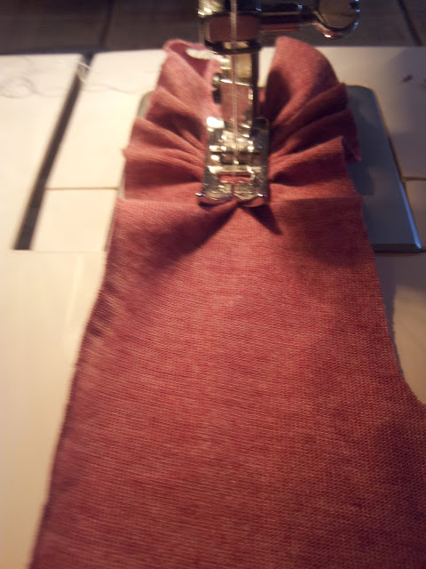
How to make a ruffle
http://www.twiggstudios.com/2012/02/chevron-ruffled-cushion.html

Slide 24
