Slide 1
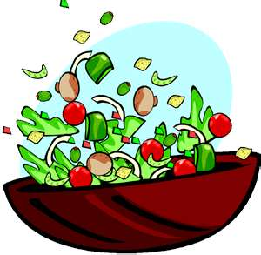
Salads, Salad Structure, Care for Greens and Dressings.

Slide 2
The Structure of Salad
There are 4 main parts of a salad:
1. The base – in a green salad, this is usually lettuce, romaine, or additional types of greens.
2. The body – in a green salad, this is usually a protein like chicken of ham.
3. The dressing – there are two types, a mayonnaise base or a vinaigrette.
4. The garnish – this is any product used to finish or enhance the salad, like parsley, basil, chives or olives.

Slide 3
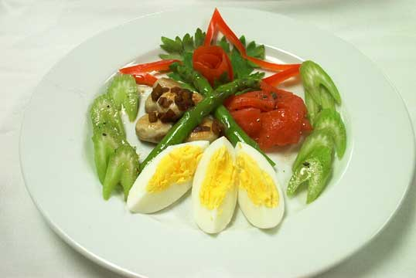
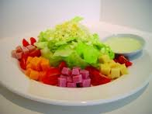
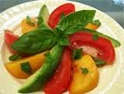
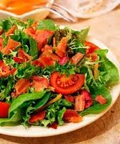
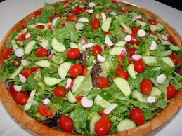
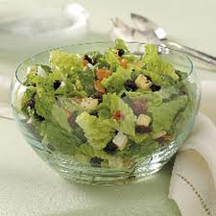
Tossed and Composed salads:
Composed salads are arranged – either in the serving container or layered.
Tossed salads are usually greens and small bite size vegetables.

Slide 4
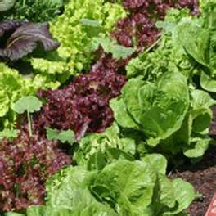
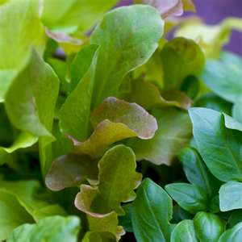
How to Care for Salad Green:
Crisp up greens by placing in ice water for a few hours before serving.
Drain thoroughly before serving.
Greens may be broken or shredded according to the purpose.
Do no over handle or greens become bruised and wilted.
Store in a plastic bag. Do not wash until you are ready to use, as the greens will rust.
Never freeze.

Slide 5
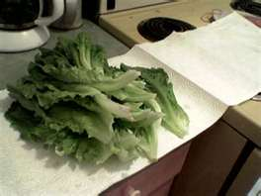
Tips:
Keep washed and drained greens wrapped in a dry paper towel and refrigerate in a plastic container or a large plastic bag.
To prevent browning after washing and serving, tear greens instead of using a metal knife. Tearing adds more texture.

Slide 6
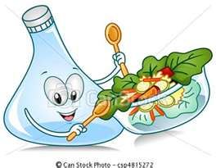
Salad Dressing:
Add flavor
Add color
Add fat
Add calories

Slide 7
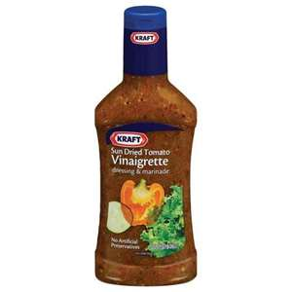
Two Different Types of Dressing: Vinaigrette
Vinaigrette – a mixture of oil, vinegar and seasoning.
Formula for a Vinaigrette = 3 to 1
3 oils to 1 vinegar
Example:
1/3 c. olive oil
2 T. white wine vinegar
1 t. Dijon mustard
Other examples:
Walnut oil red wine vinegar
Sunflower seed oil balsamic vinegar
Canola oil apple cider vinegar
Flavorings:
Herb, spices, citrus zest, and berries.

Slide 8
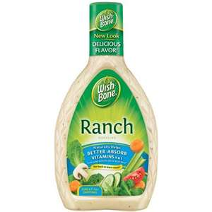
Mayonnaise Based
Mayonnaise Based = The base of the dressing is mayonnaise and seasonings are added. This dressing has a thicker consistency.
Types:
1. Ranch
2. Blue Cheese
3. Tomatillo (Café Rio)
4. Thousand Island

Slide 9
Which dressing should you serve?
The dressing should complement the other flavors in the salad.
Vinaigrette – a mixture of vegetable oil, vinegar, and seasonings.
Mayonnaise – a thick, creamy dressing that is an emulsion of oil, vinegar, egg yolk and seasoning.
Emulsion: A mixture of one liquid with another with which it cannot normally combine smoothly — oil and water being the classic example.

Slide 10
Principles of Salad Making:
#1 Rule – Do Not put the dressing on or salt a salad until just before serving.
Prepare salad dressing 2-3 hours before serving and chill.
Choose fresh, quality products and prepare salad just before serving.
Salads should look neat.

Slide 11
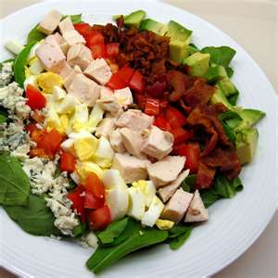
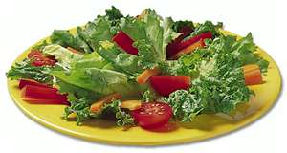
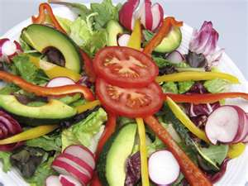
More Principles:
Handle greens as little as possible.
Avoid too much dressing.
Break or tear greens into bite size pieces.
Ingredient should be well – drained and dry.
Combine crisp textures with soft textures for contrast.
Toss with a fork to give a tossed rather than smashed appearance.

Slide 12
When preparing a salad the first question to ask . . . . What role will the salad play in the meal?????
There are 4 main types of salads:
Appetizer
Main Dish
Accompaniment Salad
Dessert Salad

Slide 13
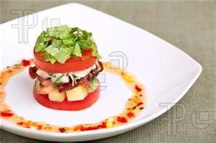
Appetizer Salad:
Small salad
Served before the main course
Conservative – some greens and 1 or 2 additional vegetables.
Role of the Appetizer Salad:
For a starter to stimulate the appetite and is served at the beginning of a meal.
Make with crisp greens, fruits or raw vegetables, and keep the servings small.

Slide 14
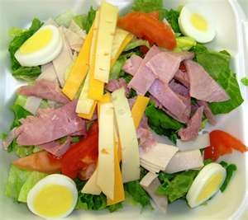
Main Dish Salad:
Large salad with lots of greens
Must contain 4 of the 6 nutrients
Must be filling, substantial and satisfying.
Role of the Main Dish Salad:
Make it with meat, fish, eggs, poultry, vegetable, fruit or a combination of fruit and cheese. This salad is served in a meal size portion and can be served hot.

Slide 15
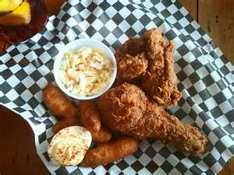
Accompaniment Salad:
Vary in size depending on the main dish
Usually served on the main dish plate
Could be a fruit, pasta, or green salad
Role of the Accompaniment Salad:
This salad should contrast well with the rest of the meal in color, flavor, and texture.
Use crisp greens, fruits, or vegetables whether raw or cooked.

Slide 16
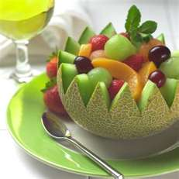
Dessert Salad:
This may be a sweetened, molded or frozen salad made of fruit gelatin or fruit mixture.
Whipped cream is usually added to the dressing.
This salad furnished the meal with a color, flavor and texture treat.

Slide 17
Nutrients in Salads:
Vitamins
Minerals
Fiber
Protein
Carbohydrates
Fats

Slide 18
Dressing Lab:
Each lab will make a dressing. Again this will be a buffet style lab.
All dressings will be placed on the supply table.
As you taste test the dressing you will as your lab group fill in a chart like the following one:

Slide 19
Salad Lab:
Each lab will make a specific type of salad and dressing. Again this will be a buffet style lab. So everyone will be taste testing each different salad and salad dressing

Slide 20
Dressing Evaluation:
Dressing | Did you like it or not? Explain why you like or disliked it! | List some of the flavors in the dressing you liked or disliked! | What would have made this dressing better?
#1
#2
#3
#4
#5
#6
#7

