Slide 1
Depth of Field

Slide 2
What the what?? Is Depth of Field

Slide 3
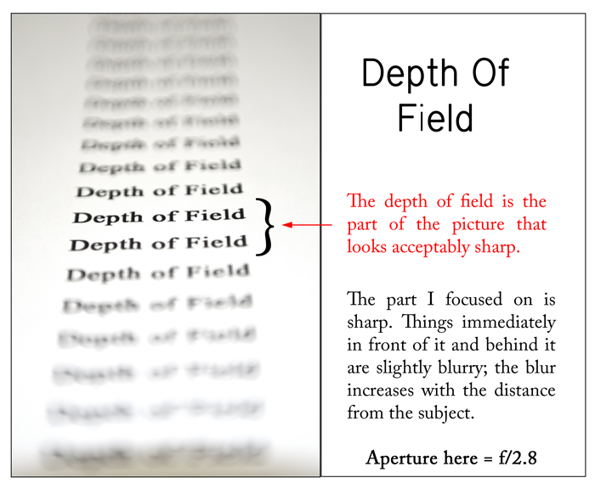

Slide 4
Two Types of Depth of Field (d.o.f.)
Shallow d.o.f. also called shallow focus - where only a select part of the image is in focus and the rest is blurry, creating circles of confusion.
Deep d.o.f. also called deep focus - where a large area of the image is in focus, from the foreground to the background.

Slide 5
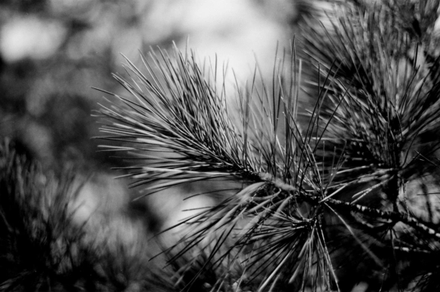
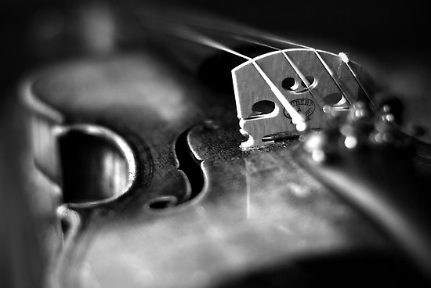
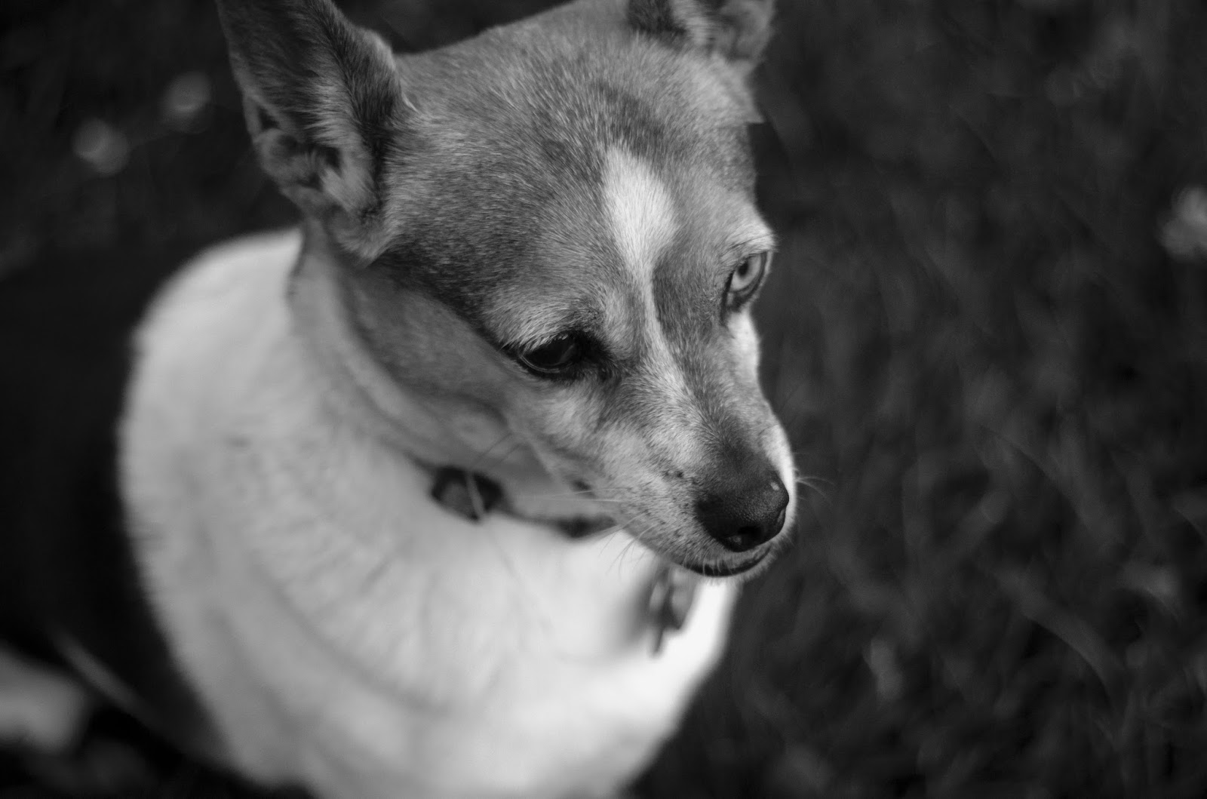
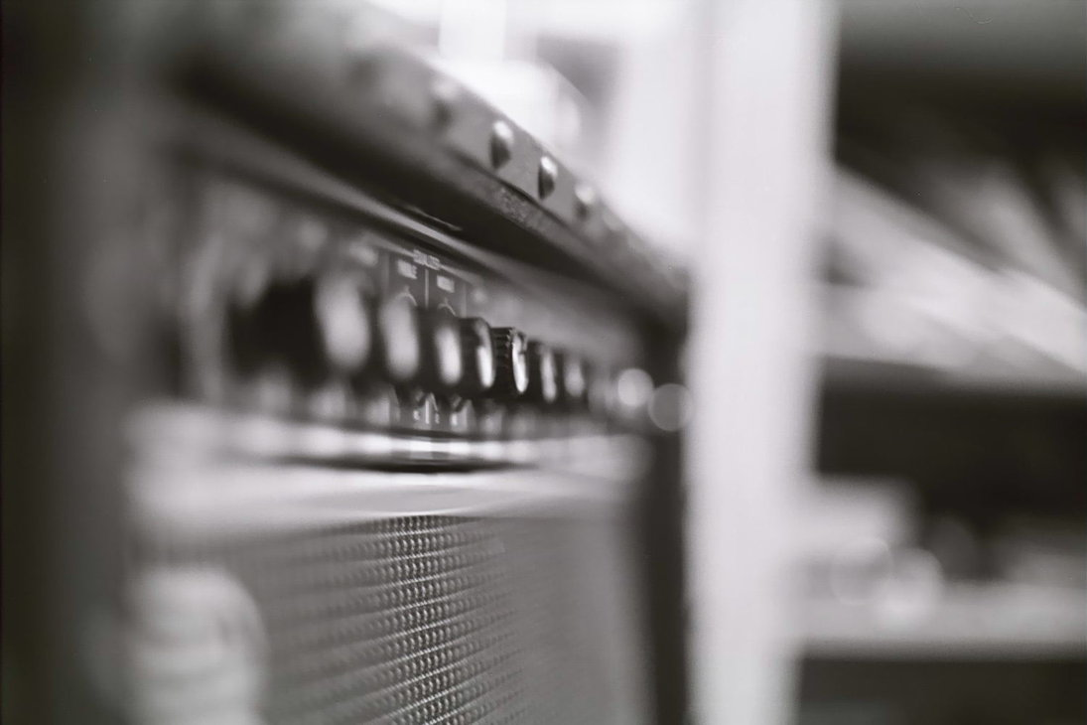
Examples of shallow d.o.f.

Slide 6
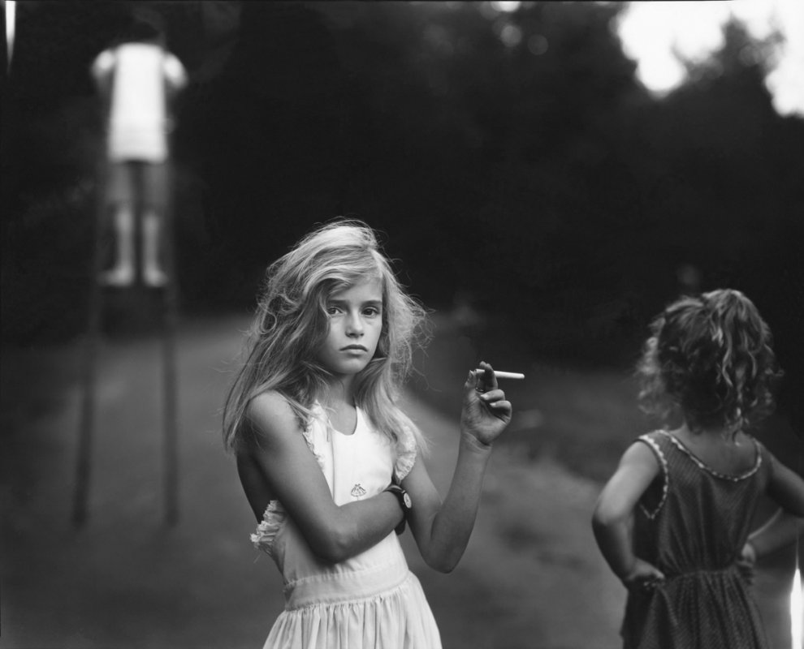
Sally Mann, Candy Cigarette, 1989

Slide 7
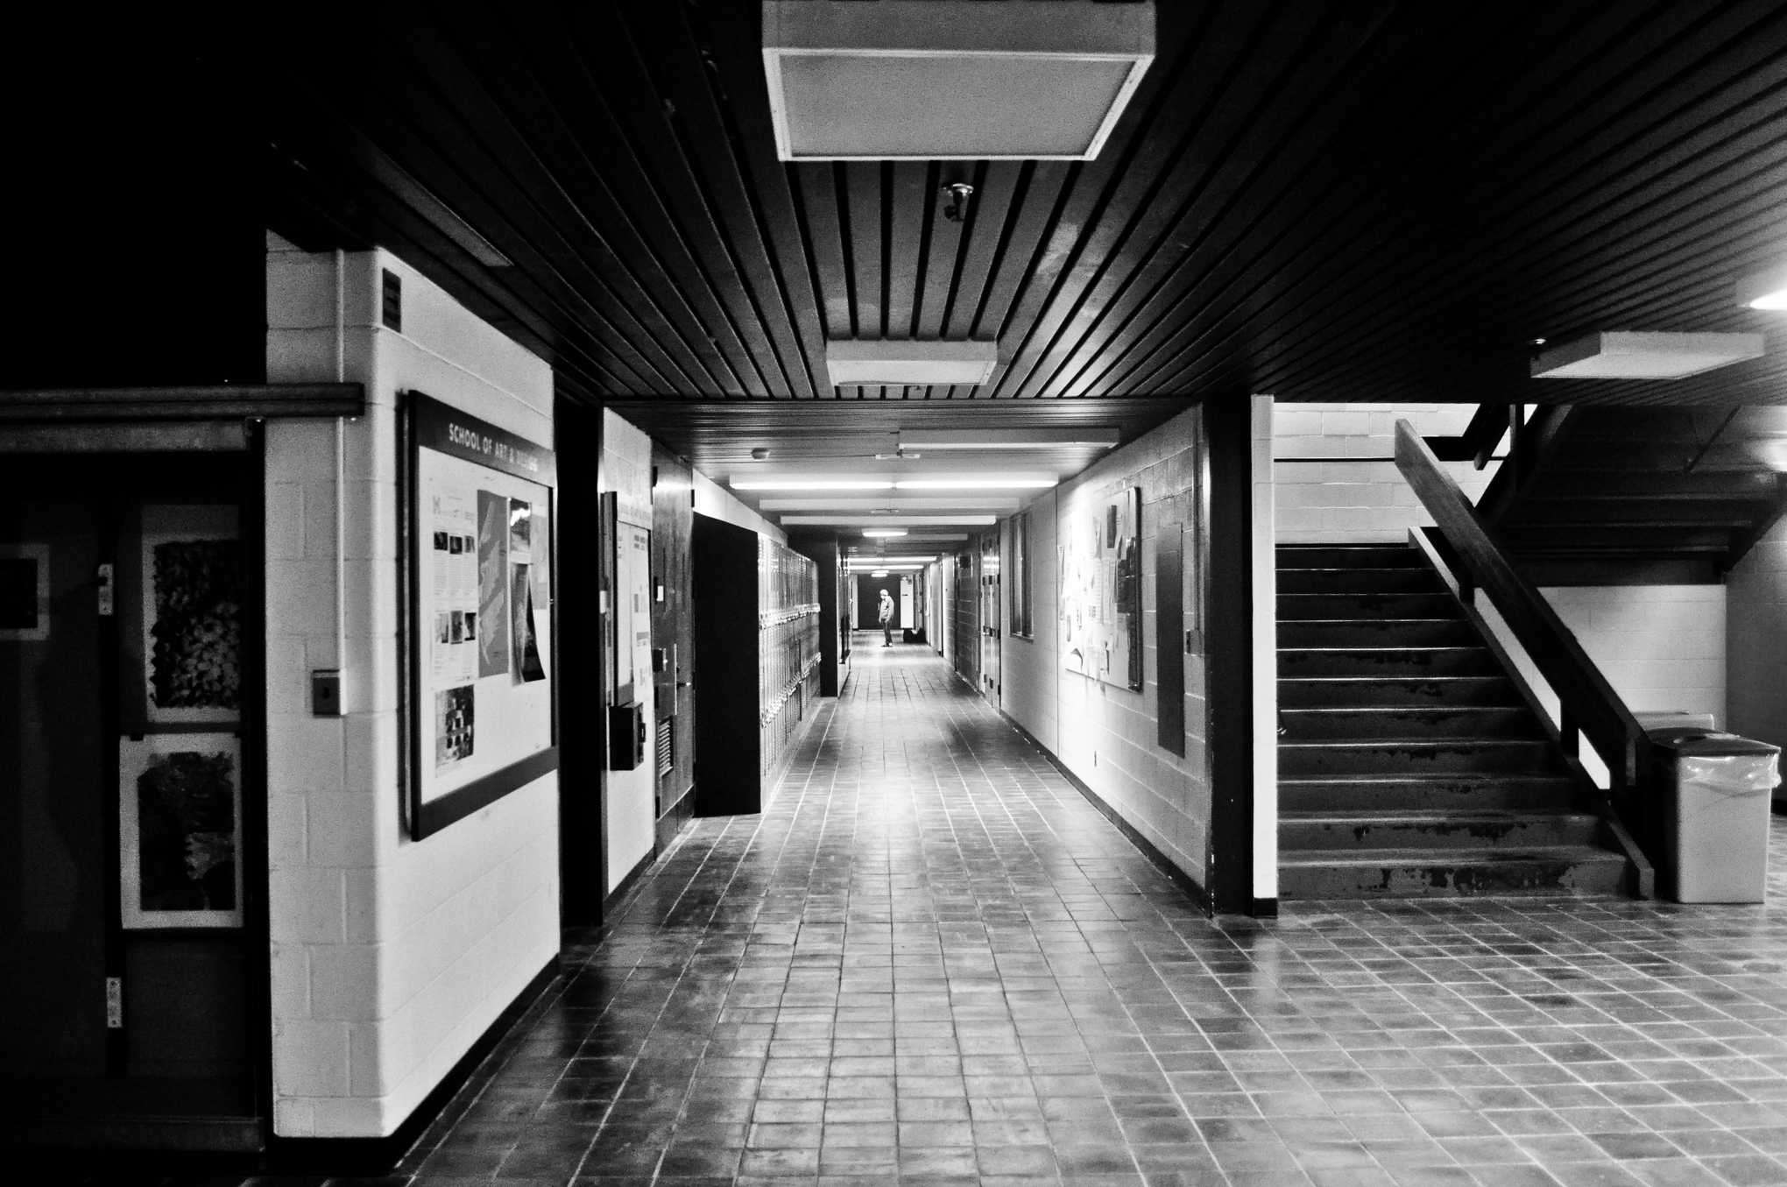
Examples of deep d.o.f.

Slide 8
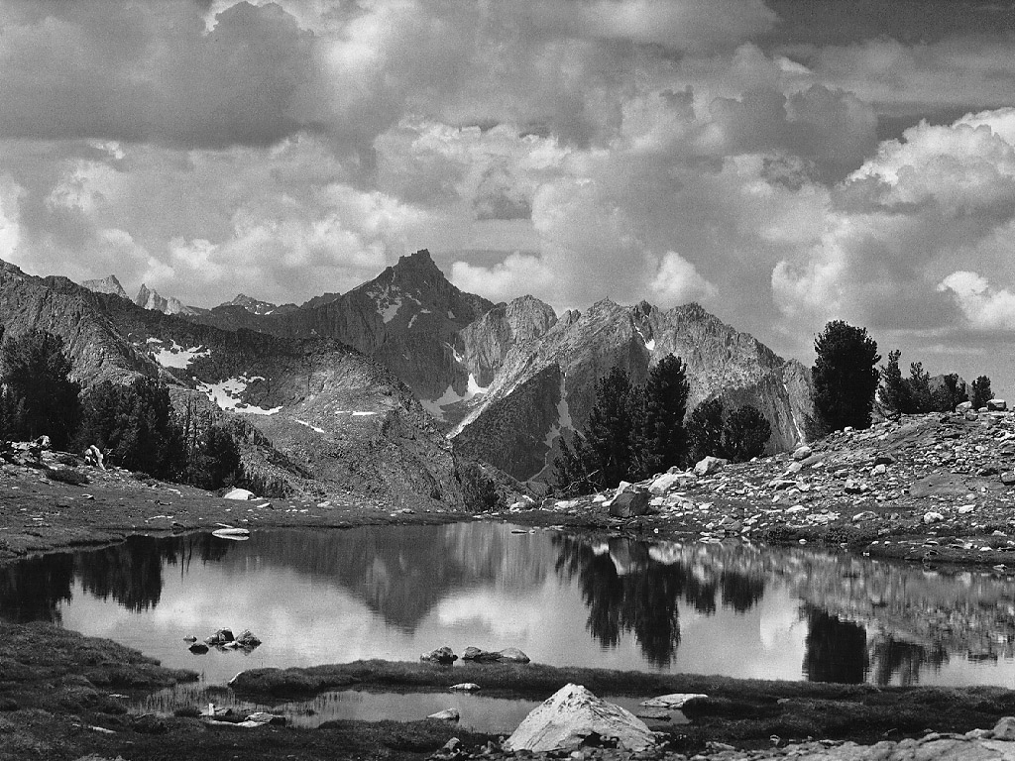

Slide 9
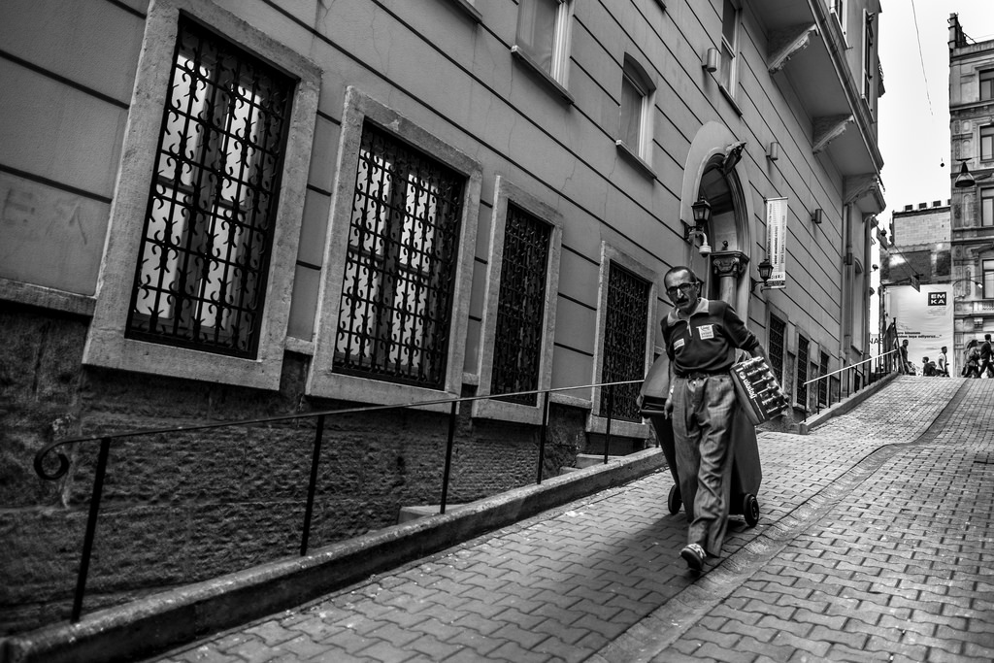

Slide 10
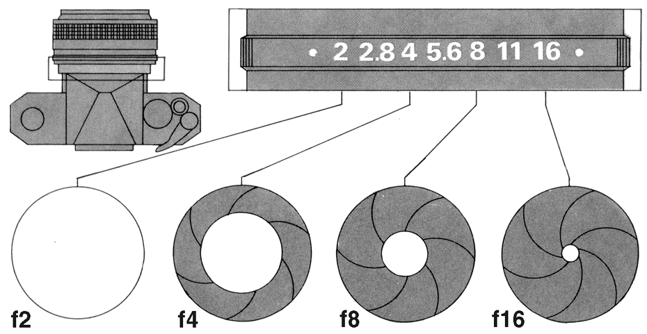
How do you control the depth of field?
(there are 3 ways)
1. Aperture

Slide 11
2. Focal Length
-usually represented in millimeters (mm), is the basic description of a photographic lens. It is a calculation of the optical distance from the point where light rays converge to form a sharp image of an object, to the digital sensor or 35mm film at the focal plane in the camera.

Slide 12
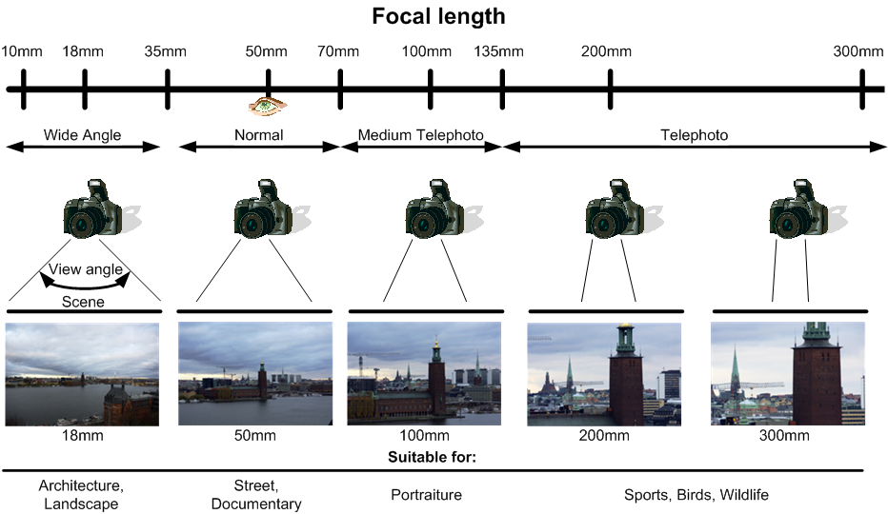

Slide 13
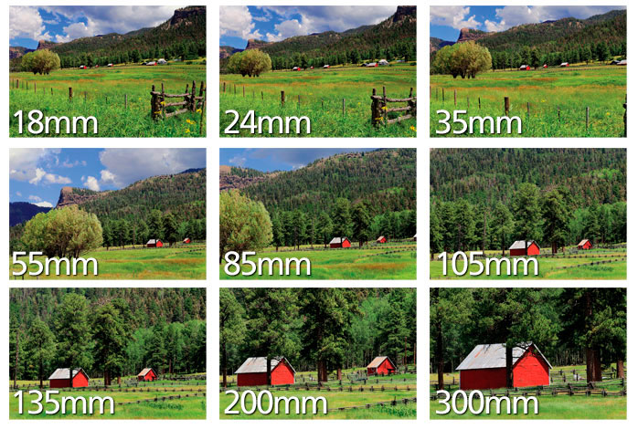
Focal Length

Slide 14
3. Distance from Subject
is exactly that, the distance between the camera (lens) and the main subject. The closer you are to your subject the shallower your depth of field will be. The farther you are to your subject, the greater your depth of field. If you're looking to create soft backgrounds, just get really close to your subject.

Slide 15
Circles of Confusion

Slide 16
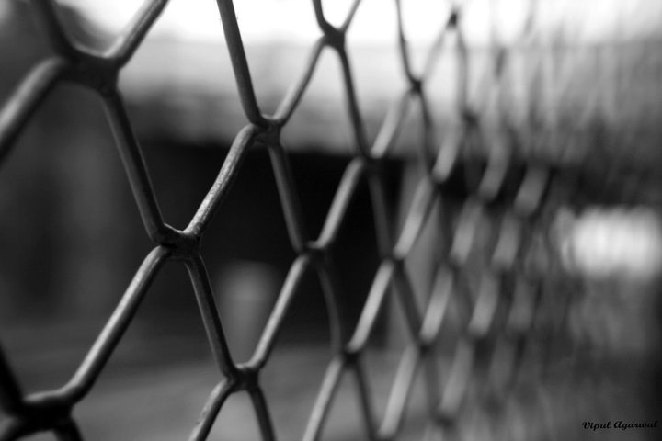

Slide 17
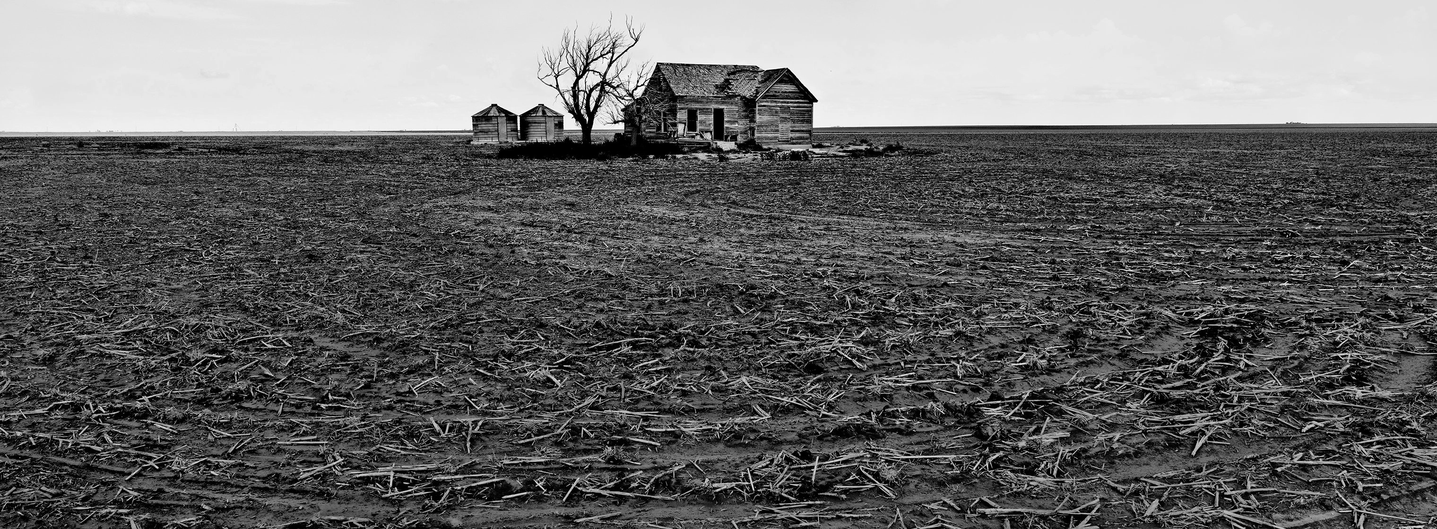

Slide 18


Slide 19
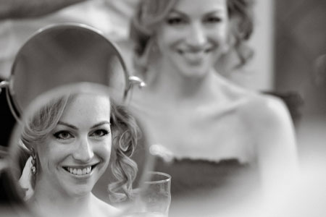

Slide 20
Shooting Assignment #2
Shoot one roll of film that exhibits control over depth of field.
Portraits - shallow depth of field - use a large aperture, low f-stop number for a soft/out of focus background that eliminates distractions. Create circles of confusion behind the subject. Get close. Use available light. Use the rule of thirds.
Landscapes - deep depth of field - use a small aperture, high f-stop number for a large area of focus. Set up foreground, middle and background in view finder and focus on the middle of subject area. Use the rule of thirds. Use available light.

