Slide 1
DOORS
photography exploration

Slide 2
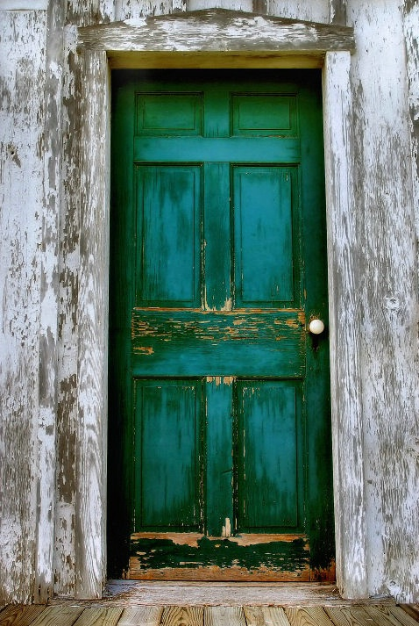
Doors and doorways have been symbolic across cultures for as long as history has been recorded.

Slide 3
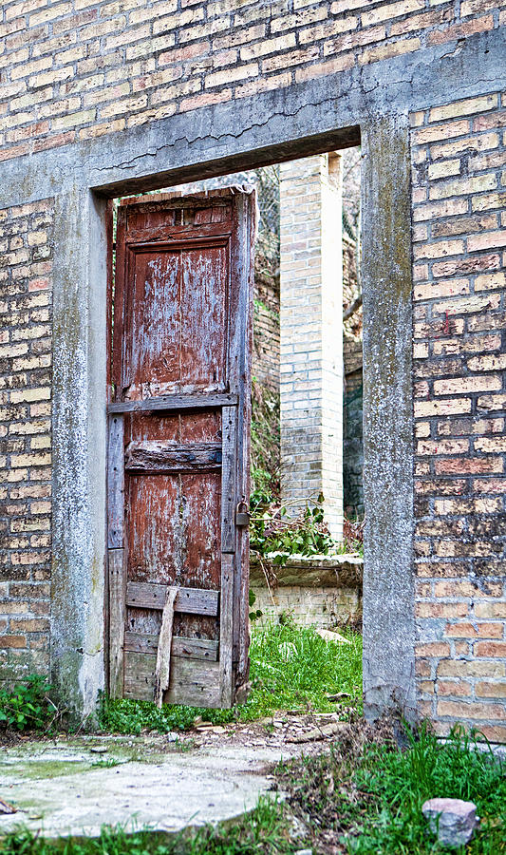
A door is both an entrance and an exit, so it has been associated with portals and passageways on many levels throughout history.

Slide 4

Skeletal Door, Ta Prohm, Cambodia - Stewart Smith

Slide 5
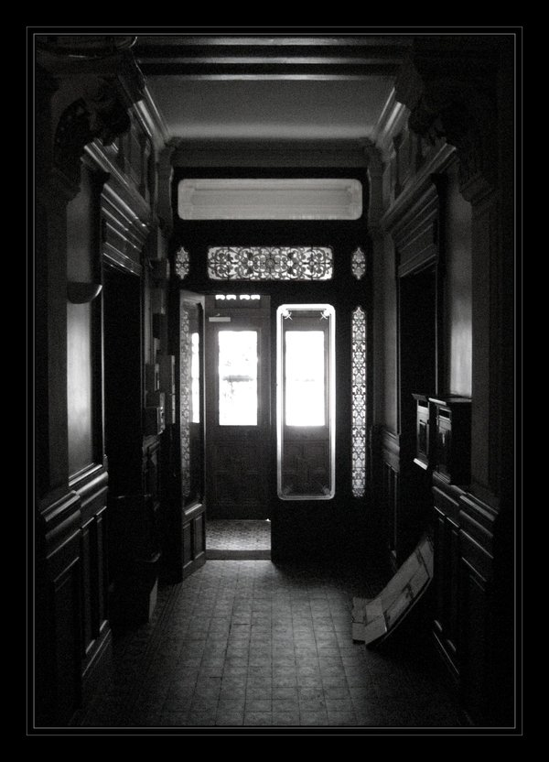
Doors are closely related to gates and thresholds because the three share some very similar symbolic features and sometimes work together to create passage.

Slide 6
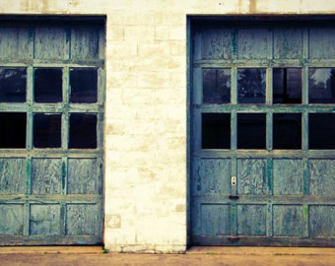

Slide 7
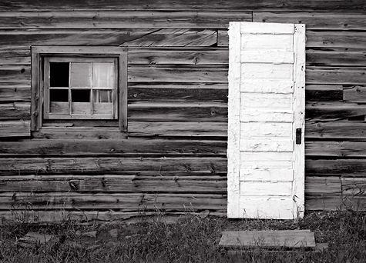
A door is first and foremost an entrance. On a literal level a door usually leads to the inside of something, be it a house, building, or other structure.

Slide 8
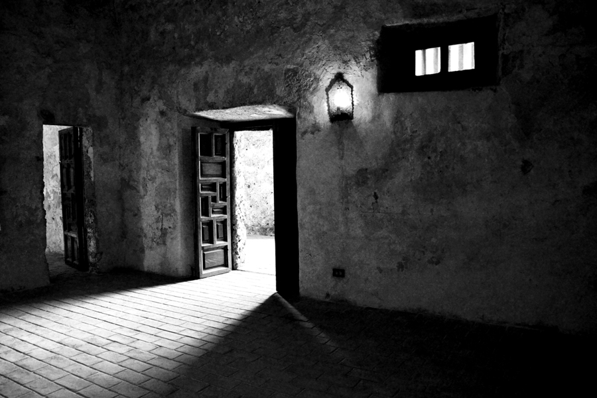
Within a structure itself a door serves as both an entrance and exit to other rooms, a passageway between rooms, and an exit from the structure.

Slide 9
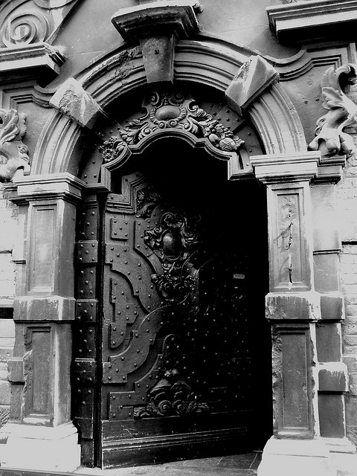
On a metaphorical level, a door can become an entrance to nearly anything, but it is most commonly used to symbolize the entrance to another world.

