Slide 1
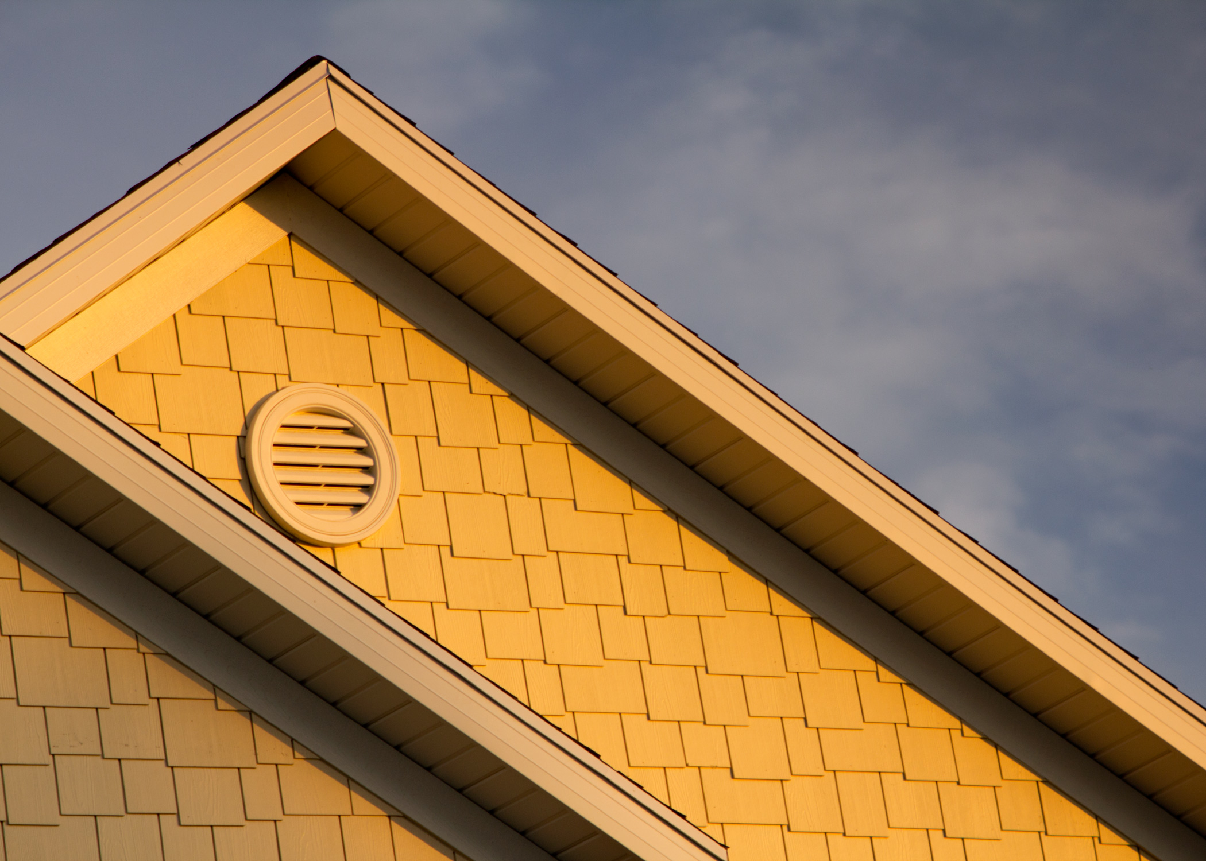

Slide 2
Do you know those photographs that seem to have a magic quality about them? There is just something about them that makes you feel good? Makes you feel warm and happy?

Slide 3
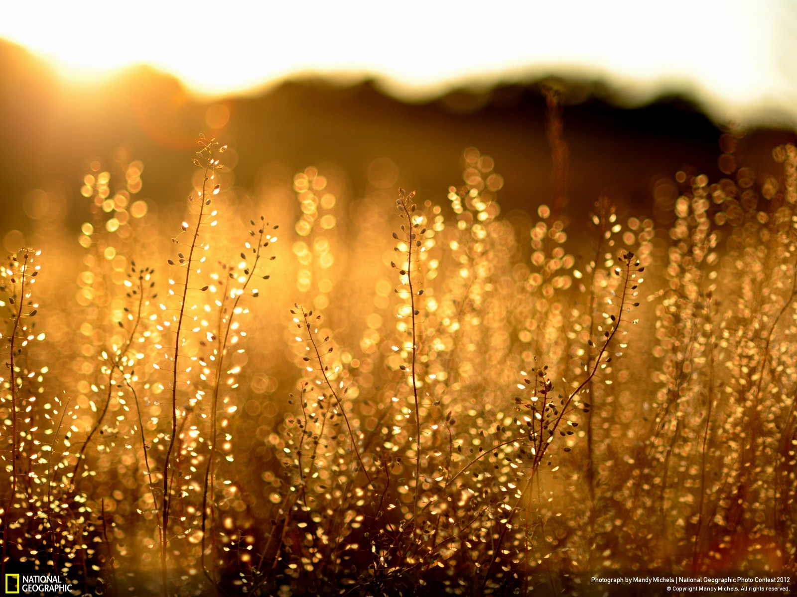

Slide 4
Sure you could spend hundreds to thousands of dollars to get introductory to top of the line lighting equipment that will help you capture beautifully stunning photographs.

Slide 5
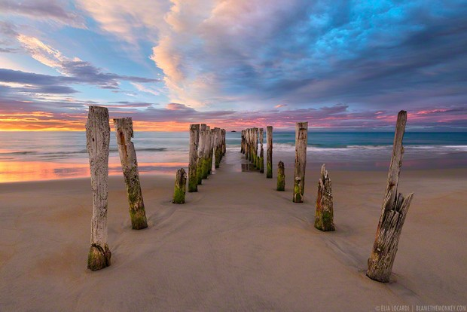
Most photographers will agree that there is one type of light that rules above all others…

Slide 6
…and it’s free:]

Slide 7
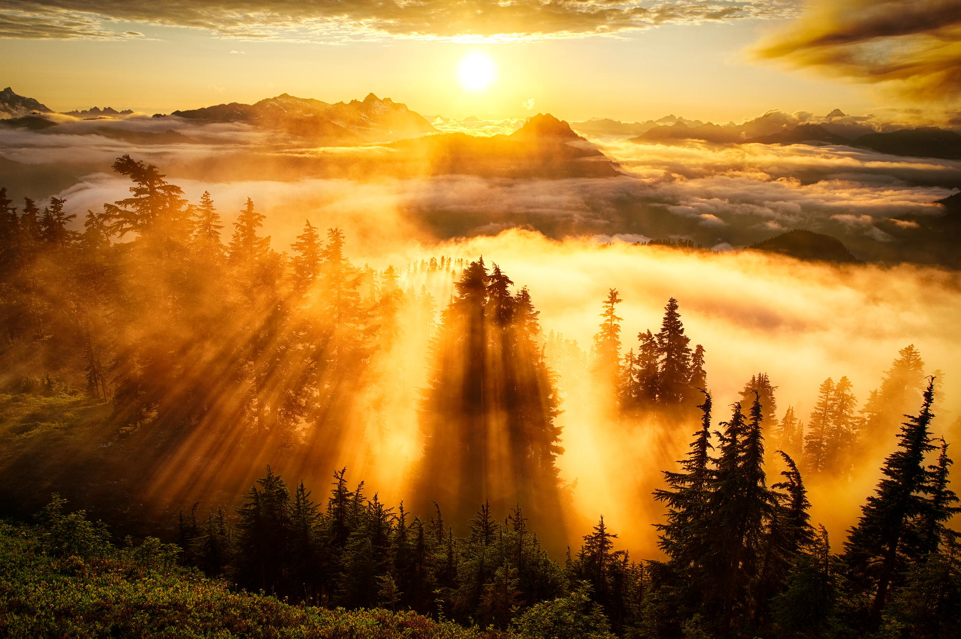

Slide 8
Golden Light
The light is soft, warm, dimensional and just flat-out magical.
It adds a type of quality to images that can not be replicated no matter how many actions, filters or textures you use.

Slide 9
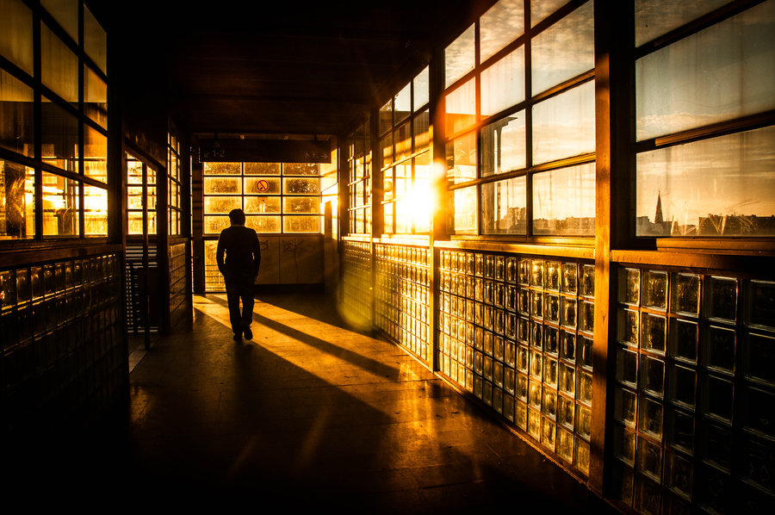

Slide 10
Golden Light is during the Golden Hour
Golden light shows up during golden hour, which is roughly an hour around sunrise, and an hour around sunset.
These aren’t exact times though, since it depends on where in the world you are. You might get more or less time for golden hour depending on where you are.

Slide 13
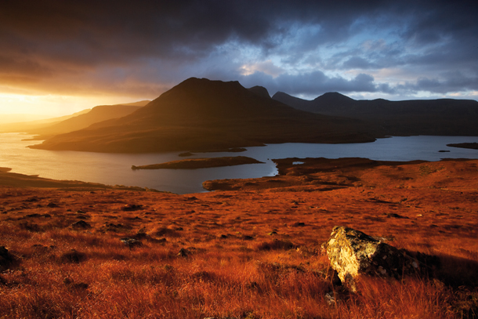

Slide 14
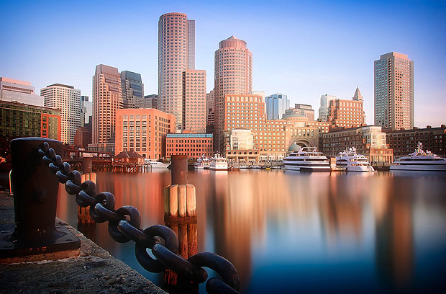

Slide 15
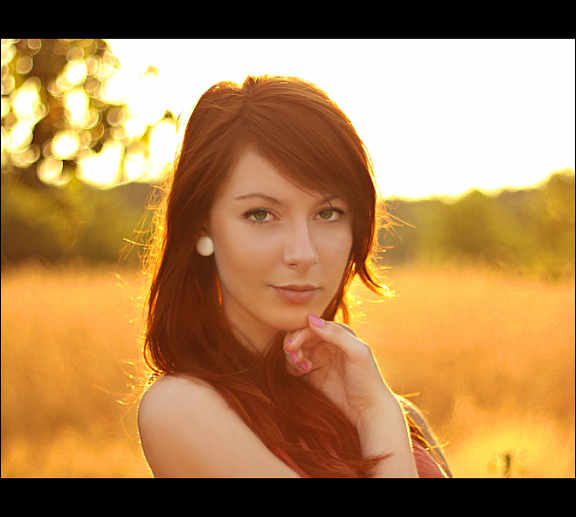

Slide 16
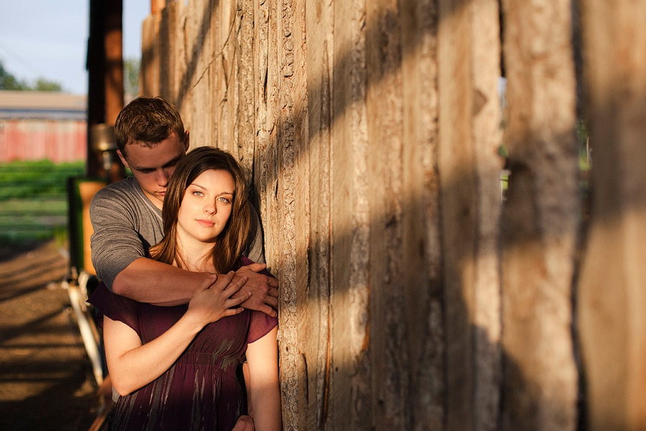

Slide 17
Calculate Your Golden Hour. You can help maximize your golden hour efficiency by planning ahead. Know your destination, have an idea of what subjects you want to shoot, and calculate precisely when the golden hour occurs where you live.
There is a free golden hour app, it is called Magic Hour. It lets you know when the best time to shoot is, morning and night.

Slide 18
Shoot Fast. Don’t be in so much of a rush that you fail to use good technique, but remember that you’ve got a relatively small window in which to take advantage of this gorgeous light.

Slide 19
Use a Wide Aperture. If you don’t typically shoot wide open, the golden hour presents a great opportunity to do so. You will be awed by the beautiful “points-of-light” bokeh created during these times of day.
BRACKET

Slide 20
Stay With It. Changes in lighting during the golden hour occur pretty fast; the landscape you shot when first arriving at your location will probably look significantly different 10 minutes later. So keep shooting for the whole hour and be sure to capture as many variations as possible.

Slide 21
Adjust White Balance. Auto white balance isn’t your best choice when shooting during the golden hour. Set your white balance to “cloudy,” otherwise you risk neutralizing the wonderful golden glow.

Slide 22
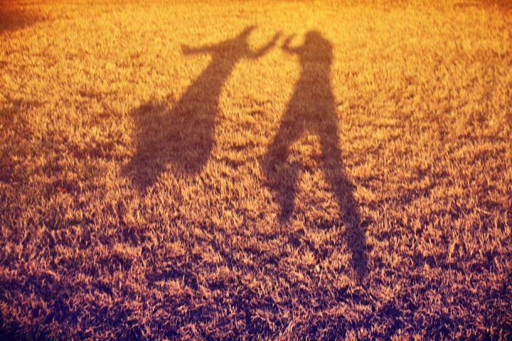

Slide 23
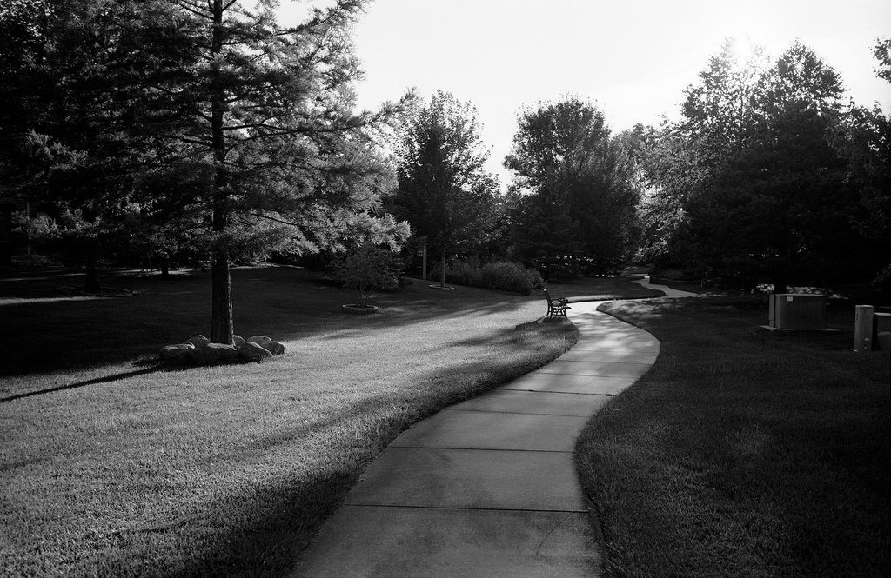

Slide 24
