Slide 1
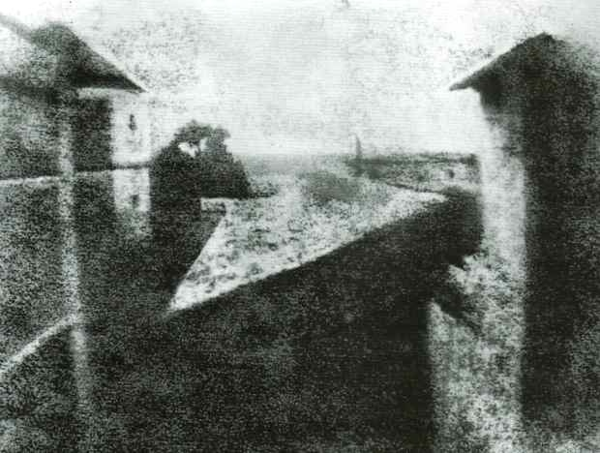
A History of Photography

Slide 2
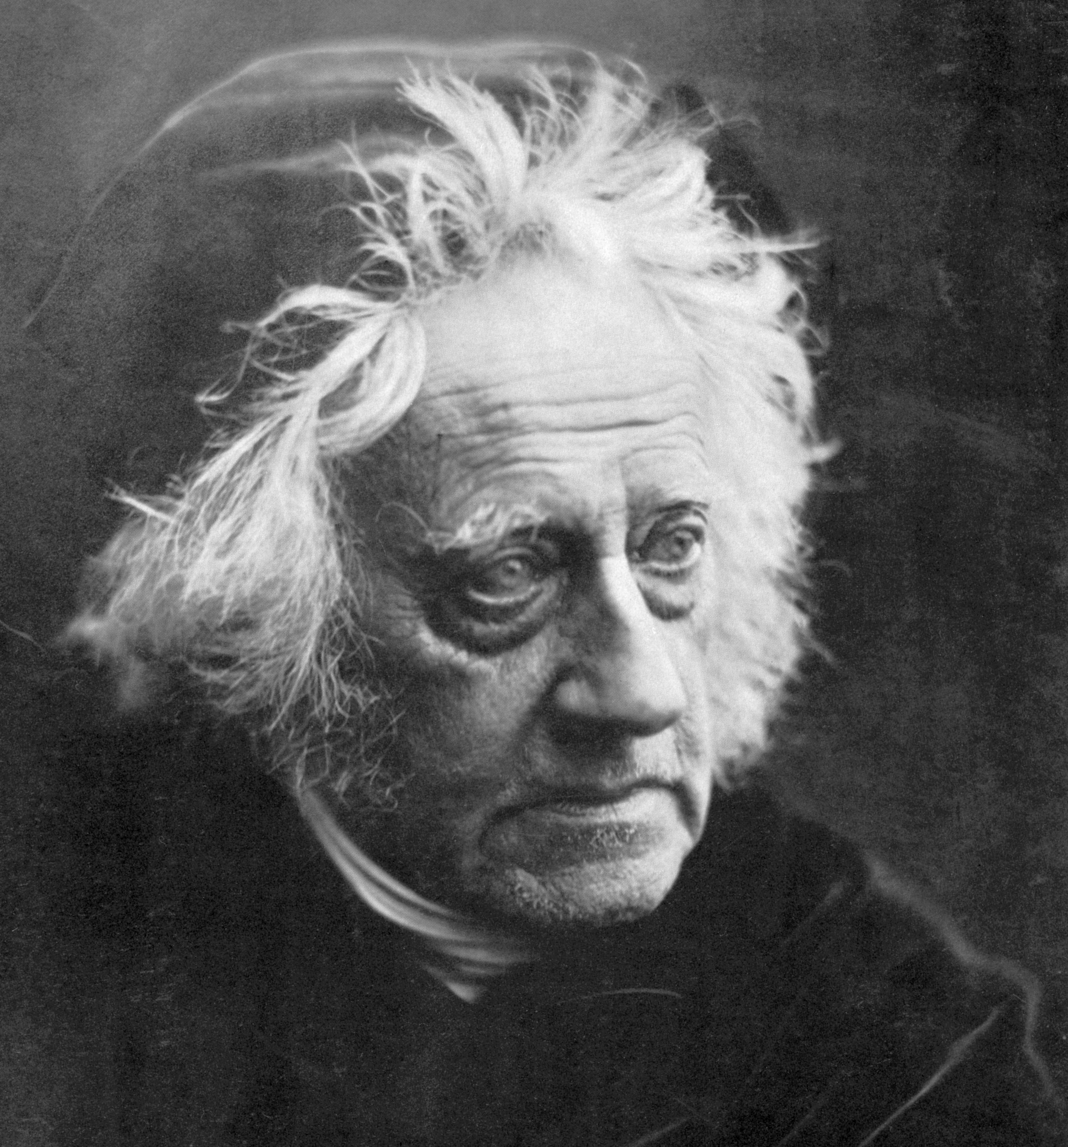
The word photography comes from the Greek words photos and graphos that mean ”light” and “drawing." The first time the word "photography" was used was in 1839 by Sir John Herschel, captured here by British photographer Julia Margaret Cameron, the year the invention of the photographic process was made public.

Slide 3
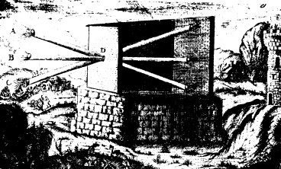
The Chinese were the first people that we know of to write about the precusor of the pinhole camera, the "camera obscura" (Latin words meaning "darkened room"). About 2,500 years ago (5th Century B.C.) they wrote about how an image was formed upside down on a wall from a pinhole on the opposite wall.

Slide 4
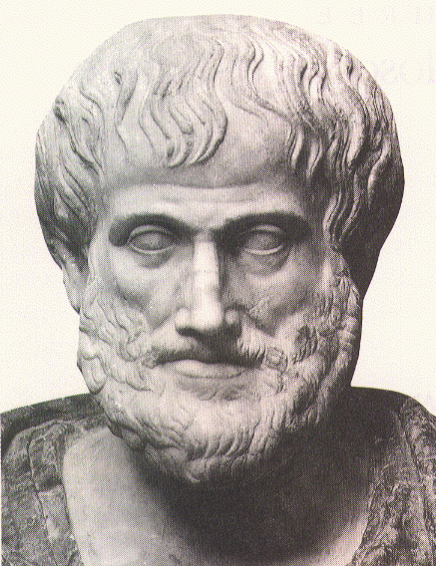
About 2,400 years ago (4th Century B.C.) the famous philosopher Aristotle talked about a pinhole image formation in his work. He wondered why "when light shines through a rectangular peep-hole, it appears circular in the form of a cone?" He didn't find an answer to his question and the problem wasn't answered until about 2,000 years later in the 1500’s. the 1500s

Slide 5
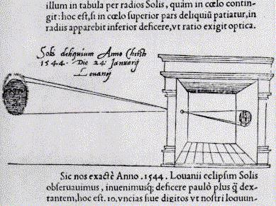
In the 1500s many artists, including Michelangelo and Leonardo da Vinci, used the "camera obscura" to help them draw pictures. A person or object would be outside the dark room and their image was reflected on a piece of paper and the artist would trace it.

Slide 6
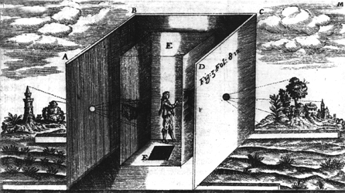
This is a drawing of a camera obscura done in 1646. This drawing shows an outer shell with lenses in the center of each wall and an inner shell with transparent paper for drawing. The artist needed to enter by a trap door in the bottom.

Slide 7
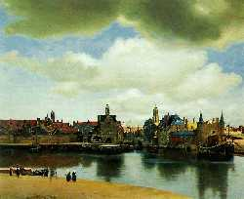
The camera obscura was used in the painting of this picture. It was painted about 1660 by Jan van der Meer van Delft (aka Jan Vermeer). His paintings are known for their "camera-like" detail and quality - but were painted 150 years before the invention of the camera.
"View of Delft"

Slide 8
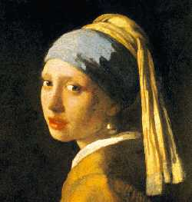
The camera obscura is believed to have been used in this painting by Jan Vermeer. He painted this in 1665. He was a great master who made paintings that to this day still amaze people with how much they look like a photograph.

Slide 9
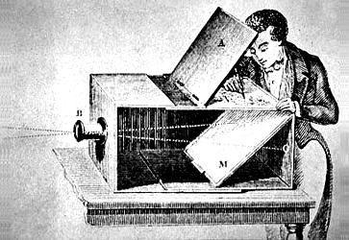
The camera obscura was made portable by the 1700s by putting it in a box with a pinhole on one side and a glass screen on the other. Light coming through this pinhole projected an image onto the glass screen, where the artist could easily trace it by hand. Artists soon discovered that they could obtain an even sharper image by using a small lens in place of the pinhole.

Slide 10
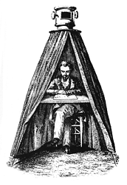
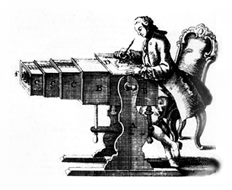
Two types of portable cameras obscura.
Drawing of "portable" camera obscura from 1769 (right).

Slide 11
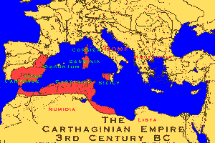
Extremely important to the invention of photography was knowledge of how sensitive to light certain materials were. More than 2,000 years before the invention of the camera obscura, the ancient Phoenicians (the first civilized nation in the world) knew that a certain snail left a yellow slime that turned purple in sunlight.
The Phoenicians came from the eastern shore of the Mediterranean Sea in land we now call Lebanon.

Slide 12
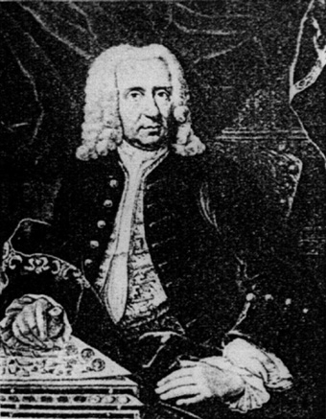
In 1727 a German professor, Johann Heinrich Schulze, observed that silver salts darkened when exposed to light. But the idea of making pictures using this information did not occur to him. That invention required the talents of a later generation of scientists.

Slide 13
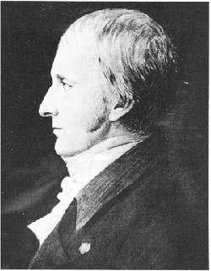
In 1800 a young English chemist, Thomas Wedgewood, was making "sun pictures" by placing leaves on leather that he had treated with silver salts, but he couldn't find a way to stop the darkening action of light and his leaf images faded into blackness.
For the birth of photography to happen two key discoveries were still needed: a way to combine light-sensitive material with the camera obscura device and a way to make an image permanent.

Slide 14
"View from the Window at Le Gras, France"
The birth of photography happened in 1826 when a French scientist, Joseph Nicephore Niepce, put a plate coated with bitumen (an asphalt used in ancient times as a cement or mortar) in a camera obscura. He put the camera obscura facing his house for eight hours and made a photograph. It is the earliest camera photograph that we still have today. Here is that first photograph.

Slide 15
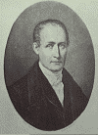
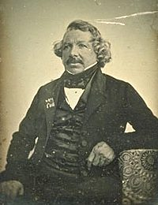
Niepce (left) began sharing his findings with Louis Jacques Mande Daguerre (right), an artist who owned a theatre in Paris. They became partners three years later. Daguerre's most important discovery came in 1835, two years after Niepce died.

Slide 16
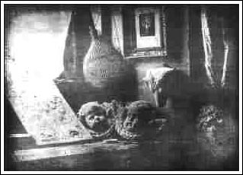
Daguerre found that the chemical compound silver iodide was much more sensitive to light than Niepce's bitumen. He put a copper plate coated with silver iodide in a camera obscura, exposed this plate to light for a short time, then to fumes of mercury and an image appeared! One problem remained, the image darkened over time. Two years later he solved this problem by washing away remaining silver iodide with a solution of warm water and table salt.
Daguerre
Still life,
1837

Slide 17
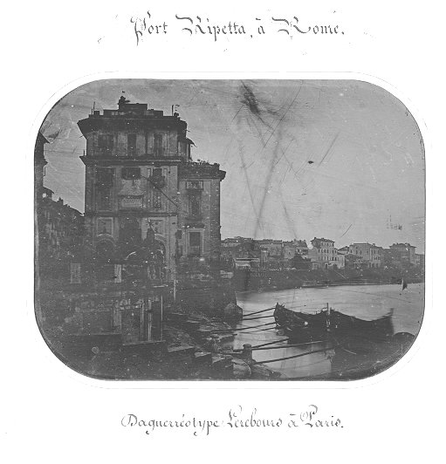
Daguerre's process, which he named the daguerreotype, was announced to the world on January 7, 1839. Half a year later the French government gave Daguerre and Niepce's son, Isidore, lifetime pensions in exchange for all rights to their invention. The daguerreotype was to become France's gift to the world.
Here is one of the first daguerreotypes that was taken in 1839. It is a picture of Port Ripetta, Rome in Italy.

Slide 18
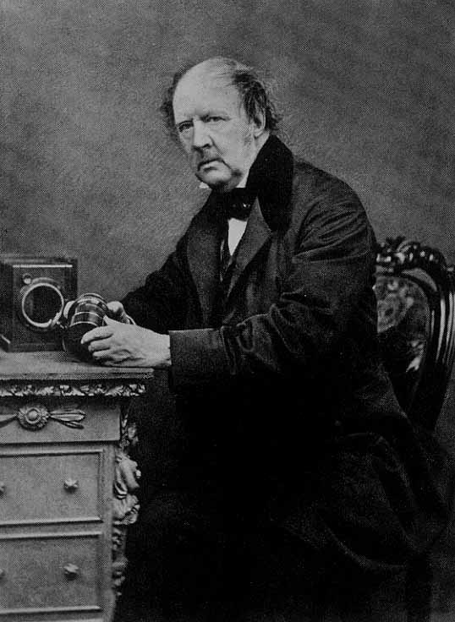
Three weeks after Daguerre's announcement an English amateur scientist, William Henry Fox Talbot, read about the daguerreotype and realized that this invention was a lot like his own unpublicized process that he called photogenic drawing. He quickly tried to claim priority over Daguerre and presented his process in a paper to the Royal Society in London, England.

Slide 19
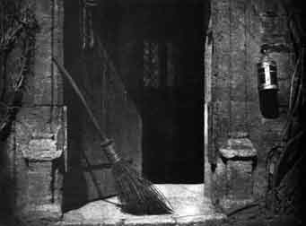
In Talbot's process he first coated a sheet of drawing paper with the chemical compound silver chloride, then he put it in a camera obscura where it produced an image with the tones reversed (a negative). He then placed the negative against another coated sheet of paper to produce a positive image. Talbot did not find a way to make the image permanent until a month after Daguerre's announcement, but his process, later improved and renamed the calotype, also known as the talbotype, is the basis for most modern film technology which relies on negatives to produce many positive prints.

Slide 20
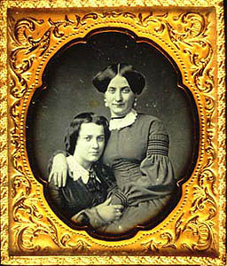
Because of a few problems of Talbot's process, the daguerreotype was the method of photography that first took the world by storm. With improvements the daguerreotype quickly proved a great way to make portraits of people. One year after the daguerreotype was invented, daguerreotype studios throughout Europe and America were producing detailed likenesses. People gazed in amazement at their own image in these "mirrors with a memory."

Slide 21
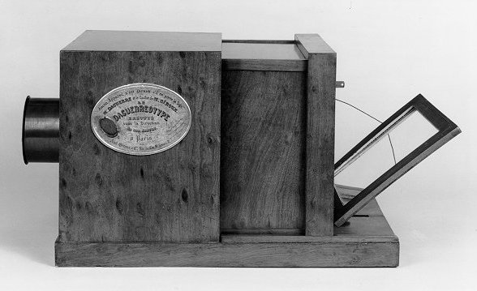
This is a picture of one of the first commercially made daguerreotype cameras that was made in 1839. It was designed by Mr. Daguerre, the inventor of the daguerreotype.

Slide 22
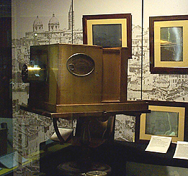
Another picture of a daguerreotype. Notice it is quite large.

Slide 23
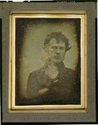
A daguerreotype portrait made the year the daguerreotype was invented.
Portrait of the photographer, Robert Cornelius

Slide 24
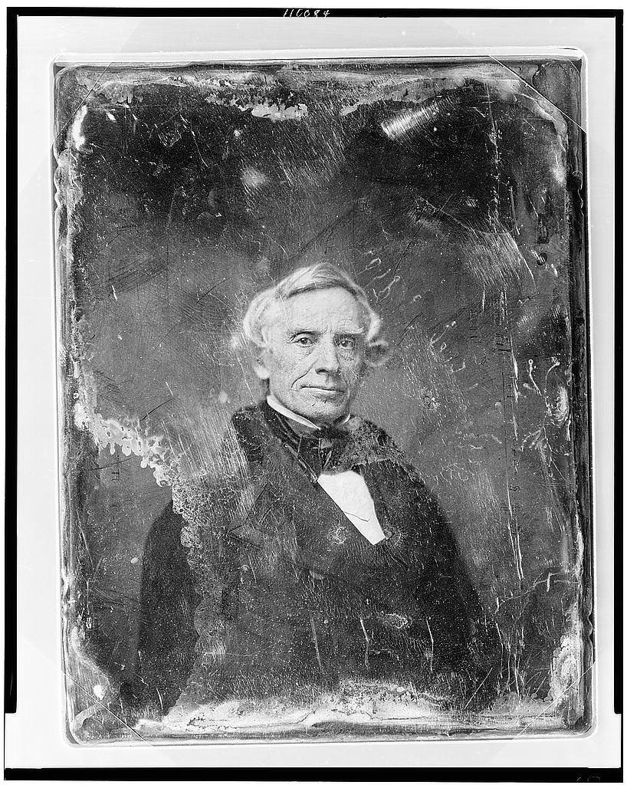
Photography arrived in America because the man who invented the telepgraph system, Samual F. B. Morse, was so excited about it. He saw a demonstration of the daguerreotype in Paris and returned to America and spread the news. Daguerreotypes remained popular in America into the 1850's, long after European photographers had switched to the improved process developed from Talbot's positive/negative method.
Daguerreotype of Samuel Morse

Slide 25
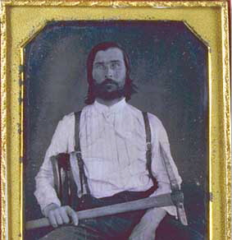
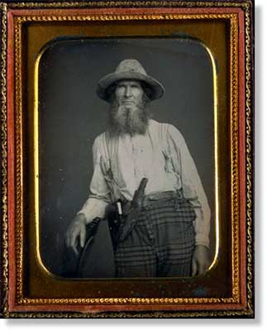
Most pictures of the California Gold Rush of 1849 are daguerreotypes.

Slide 26
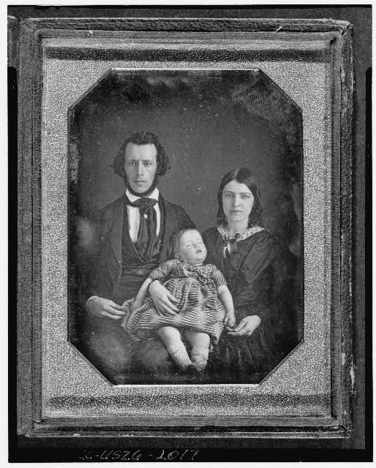
Portraits of people were the most popular type of photographs taken in the 1800's. Photographic portraits were much less expensive than painted ones, they took less time and were more accurate. People who painted people’s portraits quickly went out of business or became daguerreotypists themselves.

Slide 27
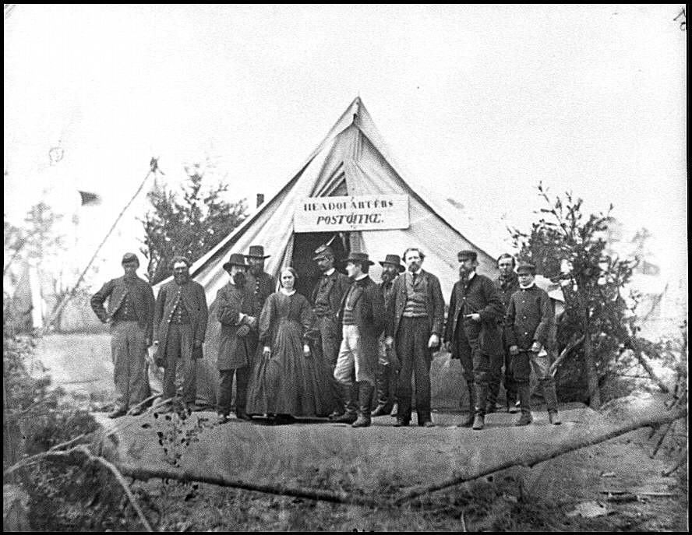
In 1851 English photographer Frederick Scott Archer invented a wet-plate process called collodion. This was like Talbot's process but the negatives were made of smooth glass instead of paper. This produced sharper images and lasted longer than paper so it was easier to produce many paper prints from one glass negative.
Army Post Office tent in Virginia during the Civil War. Collodian picture taken April 1863 by Timothy O'Sullivan.

Slide 28
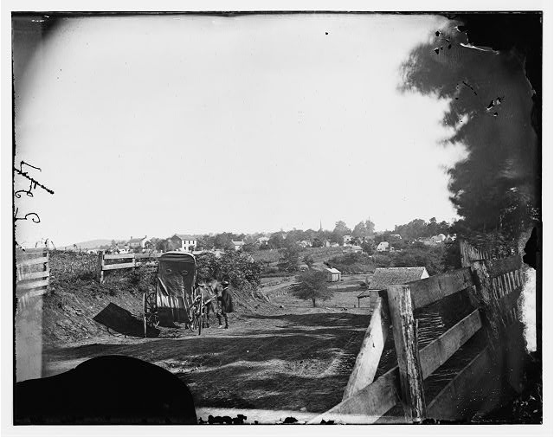
A less expensive process was the tintype which used an iron plate instead of a glass plate. During the Civil War tintypes were the type of photography that was used the most. Tintype photographers often worked from the back of horse-drawn wagons photographing pioneer families and Union soldiers.
Picture of a photographer's wagon during the Civil War in 1863 in Virginia. Timothy O'Sullivan took this photograph.

Slide 29
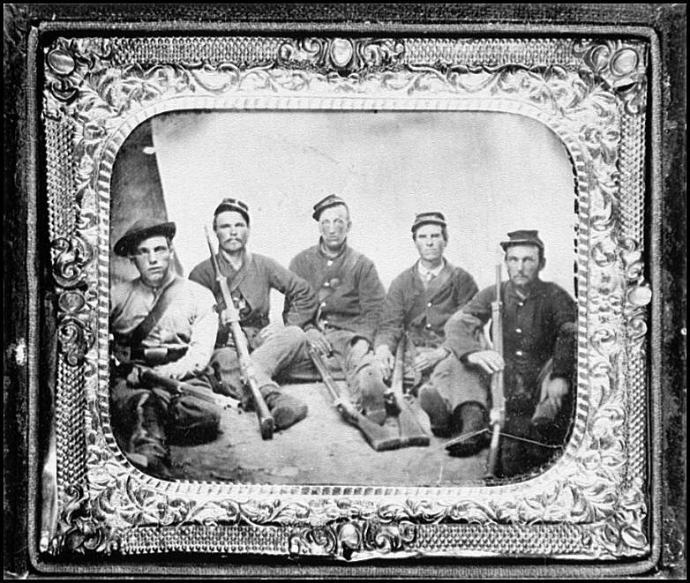
Tintype of civil war soldiers.

Slide 30
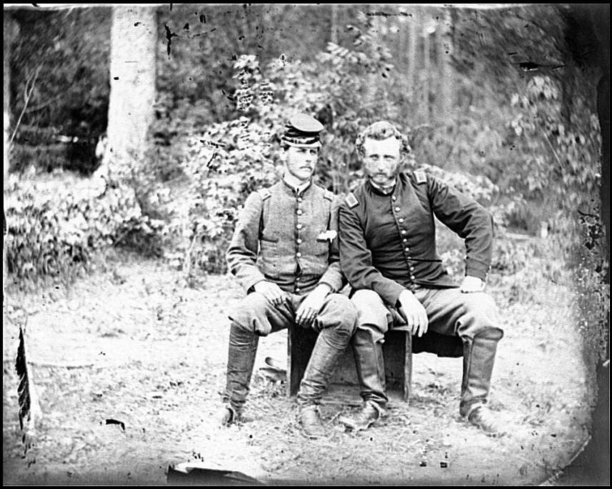
The Civil War in America was the first war to be thoroughly recorded by photography. American photographer Mathew Brady saw the importance of documenting the conflict at its beginning and organized a team of photographers to cover different battlefronts. They took 7,000 pictures!
Photograph of George Armstrong Custer (on right) and a Confederate prisoner during the Civil War.

Slide 31
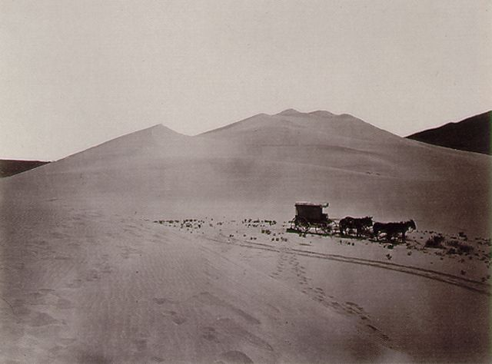
Two of Mathew Brady's employees went on to become two of the best-known photographers of the American West, Timothy O'Sullivan and Andrew J. Russell. They produced large prints of spectacular land forms and people of the west.
Timothy O'Sullivan

Slide 32
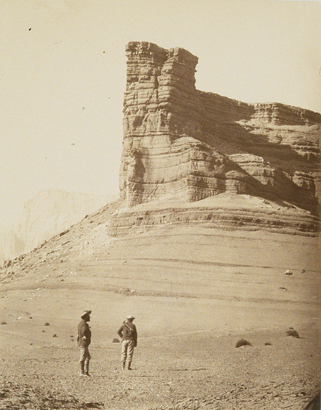
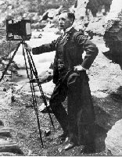
Other well known photographers are William Bell, John Hillers and William Henry Jackson.
William Bell
William Henry Jackson

Slide 33
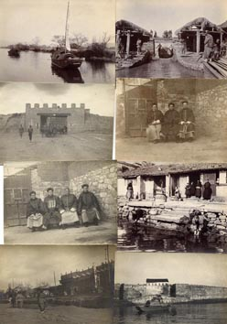
Photographers hauled their large cameras, tripods and portable darkrooms all over the world. They photographed India, China and Japan. People were eager to see what these far off countries looked like.

Slide 34
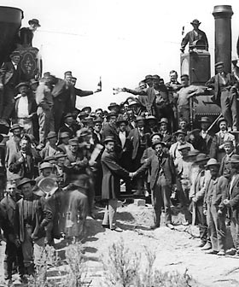
In the 1800's industries hired photographers to photograph the great things they did like building ships, railroads, buildings and bridges. In Utah the completion of the transcontinental railroad in 1869 was celebrated with a photograph of the two steam locomotives facing each other. This photograph was taken by Andrew J. Russell who had worked for Mathew Brady during the Civil War.
Driving of the golden spike

Slide 35
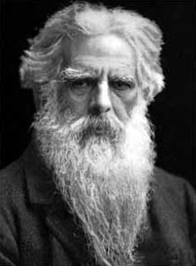
Birth of “motion” pictures
Leland Stanford unwittingly started a chain of events that contributed to the development of motion pictures. To settle a wager regarding the position of a trotting horse's legs, he sent for Eadweard Muybridge, a British photographer who had recently been acclaimed for his photographs of Yosemite.

Slide 36
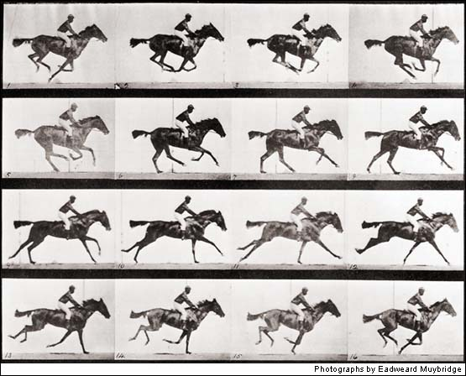
Although Muybridge initially considered the task impossible, he made history when he arranged 12 cameras alongside a race track. Each was fitted with a shutter working at a speed he claimed to be "less than the two-thousandth part of a second." Strings attached to electric switches were stretched across the track; the horse, rushing past, breasted the strings and broke them, one after the other; the shutters were released by an electromagnetic control, and a series of negatives made.

Slide 37
Though the photographs were hardly more than silhouettes, they clearly showed that the feet of the horse were all off the ground at one phase of the gallop. Moreover, to the surprise of the world, the feet were bunched together under the belly. None of the horses photographed showed the "hobbyhorse attitude" - front legs stretched forward and hind legs backward -so traditional in painting. The photos were widely published in America and Europe.

Slide 38
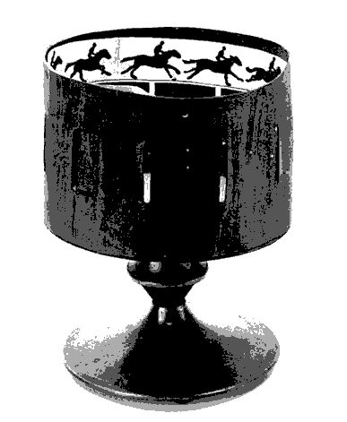
The Scientific American printed eighteen drawings from Muybridge's photographs on the first page of its October 19, 1878 issue. Readers were invited to paste the pictures on strips and to view them in the popular toy known as the zoetrope, a precursor of motion pictures. It was an open drum with slits in its side, mounted horizontally on a spindle so it could be twirled. Drawings showing successive phases of action placed inside the drum and viewed through the slits were seen one after the other, so quickly that the images merged in the mind to produce the illusion of motion.

Slide 39
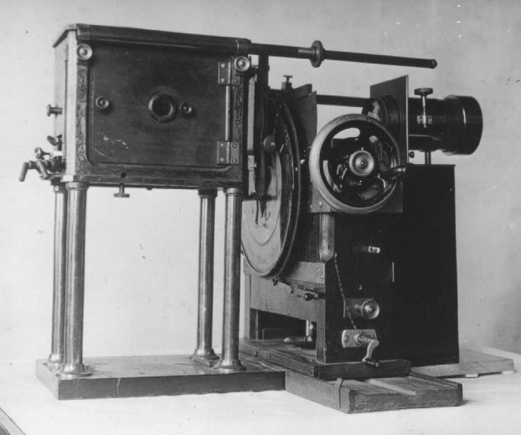
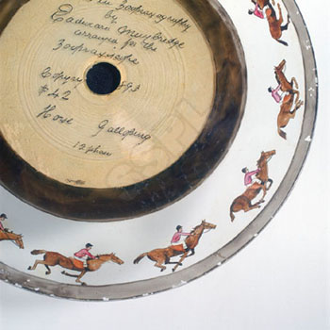
In 1880, using a similar technique with a device he named the zoogyroscope, or zoopraxiscope, Muybridge projected his pictures on a screen at the California School of Fine Arts, San Francisco.
Motion pictures were born.

Slide 40
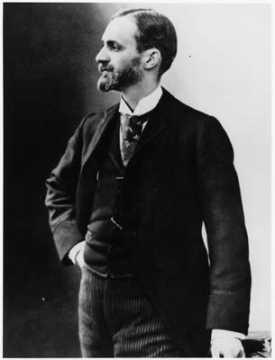
Kodak Cameras
George Eastman, was only 24 years old when he set up his Eastman Dry Plate Company in New York in 1880 and the first half-tone photograph appeared in a daily newspaper. In 1888 he introduced the first Kodak camera that cost $25.00 (a great deal of money then). It had a 20 foot roll of paper, (enough for 100 pictures) already put in it. To get the film developed you had to return the camera to the Eastman Dry Plate Company in Rochester, New York. For $10.00 they would develop the photographs, put more film in your camera and mail everything back to you. One year later an improved Kodak camera with a roll of film instead of a 20 foot roll of paper appeared.

Slide 41
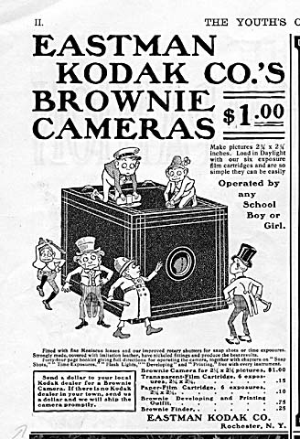
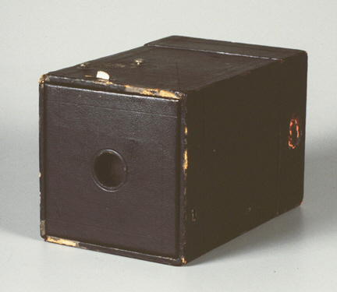
Mr. Eastman wanted everybody to be able to take photographs. He worked hard to develop a camera that everybody could afford to buy. He did it in 1900. It was the Kodak Brownie box roll-film camera. It cost $1.00. Now everyone could take photographs, not just professional photographers.

Slide 42
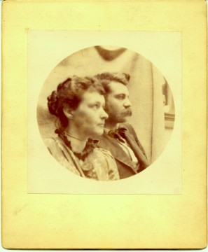
Photograph taken with a Brownie camera. Notice how the photograph is round, just like the opening in the camera.

Slide 43
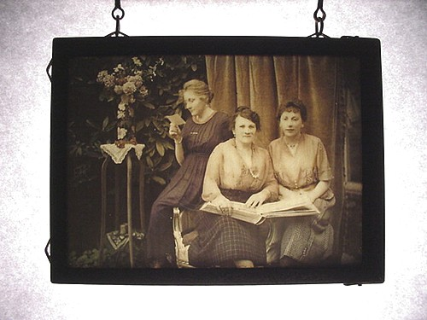
Color Photographs
People had tried to make color photographs since 1860. It wasn't until 1906 that a film sensitive to all colors called "panchromatic film" was produced. You had to take three separate negatives and then use a special viewer so you could see all three slides layered on top of each other.
The first color plates were invented in 1907 by Auguste and Louis Lumiere. They named it Autochrome. The colors appeared in delicate pastel.

Slide 44
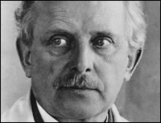
The cameras that we have now use film with "sprockets" (holes along both sides of film). This film was developed in 1914 by Oscar Barnack.
Oscar Barnack, the inventor of the world-renowned Leicca camera was the first to utilize the new 35mm format with the production of the Ur-Leica in 1924.

Slide 45
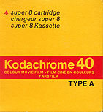
You've heard of Kodachrome? It was the first color film that had more than one layer of film - it had many layers of film. Now you didn't need to take three separate photographs and put them on top of each other to get one color photograph, you could just take one photograph! Kodachrome was developed in 1936.

Slide 46

The first instant color film is developed in 1963 by Polaroid.

Slide 47
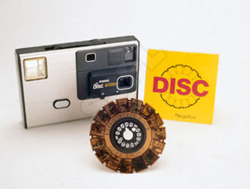
The disk camera was introduced in 1983 by Kodak.

