Slide 1
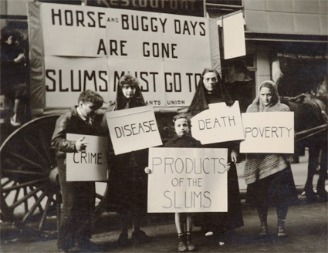
Social Comment
Joe Schwartz, "Slums Must Go! May Day Parade, New York" 1936

Slide 2
Social Commentary
is the act of using language effectively to provide commentary on issues in a society.
What language is used depends on the author.

Slide 3
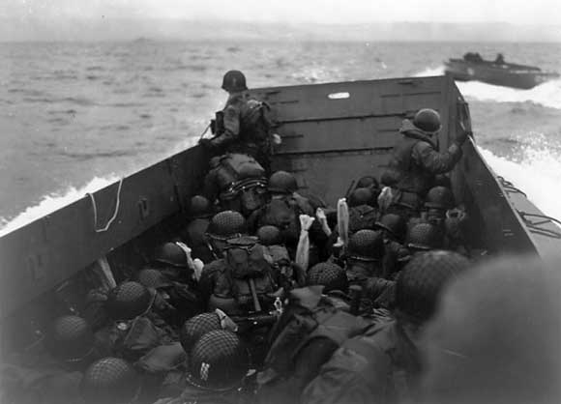
Robert Capa

Slide 4
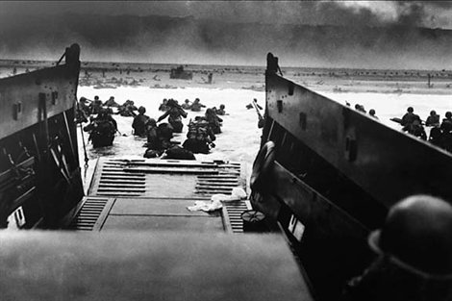

Slide 5
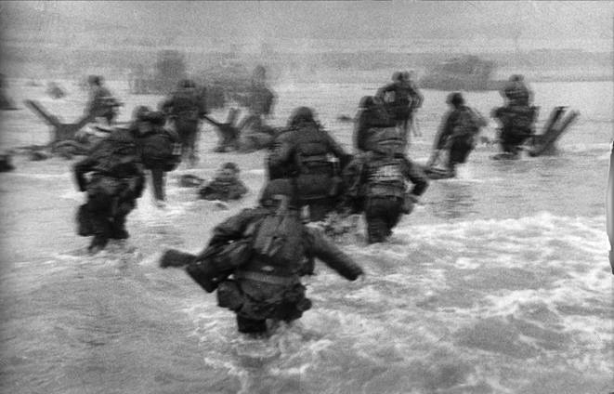

Slide 6
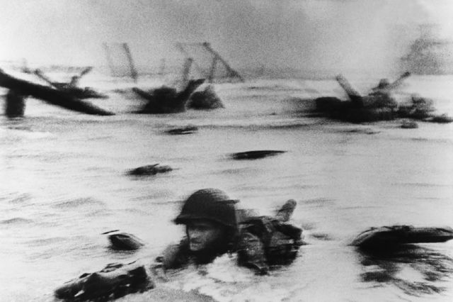

Slide 7
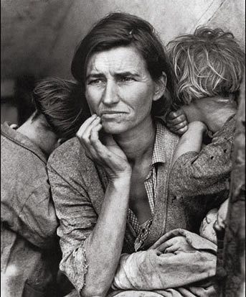
Dorothea Lange
Migrant Mother, Destitute peapickers in California. Mother of seven children.
Age thirty-two. Nipomo, California. 1936 March.

Slide 8
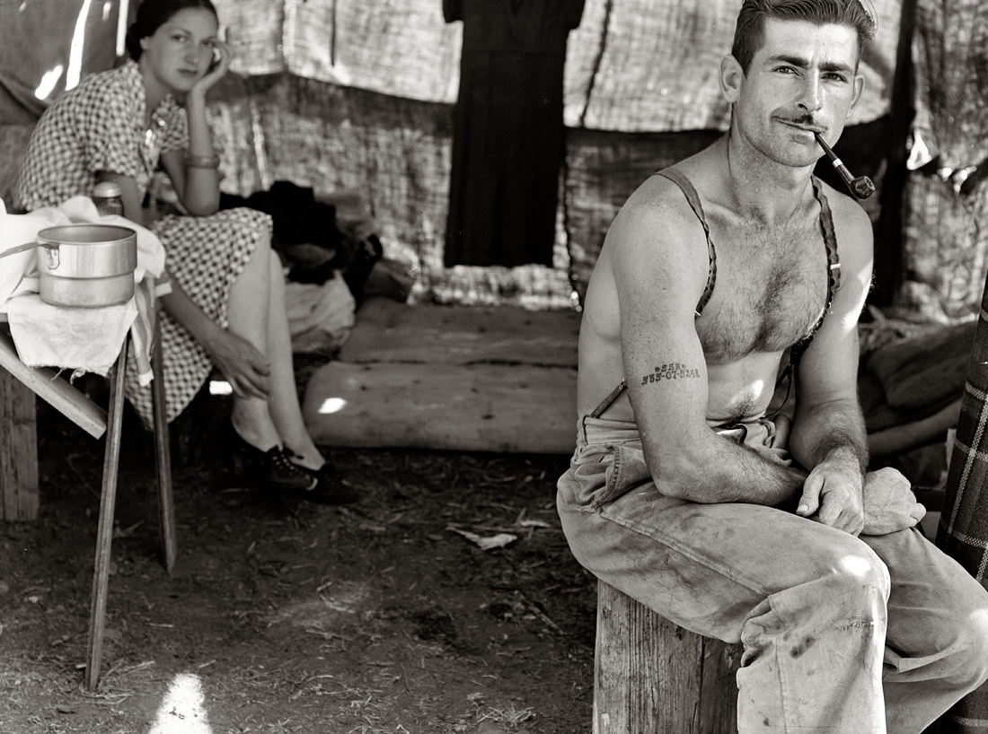
535-07-5248 and Wife, Oregon, August 1939

Slide 9
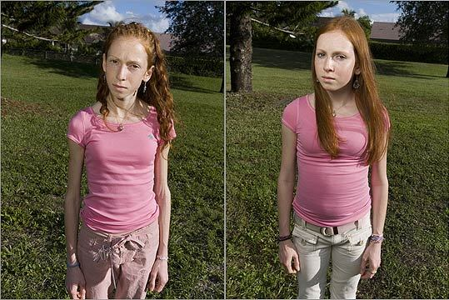
Lauren Greenfield
Aiva, 16, on her first day (left) and after 10 weeks.

Slide 10

Danielle gets measured as Michelle waits for final weigh-in
on their last day of weight-loss camp, Catskills, New York

Slide 11
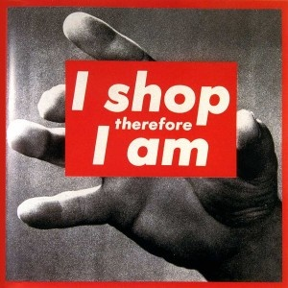
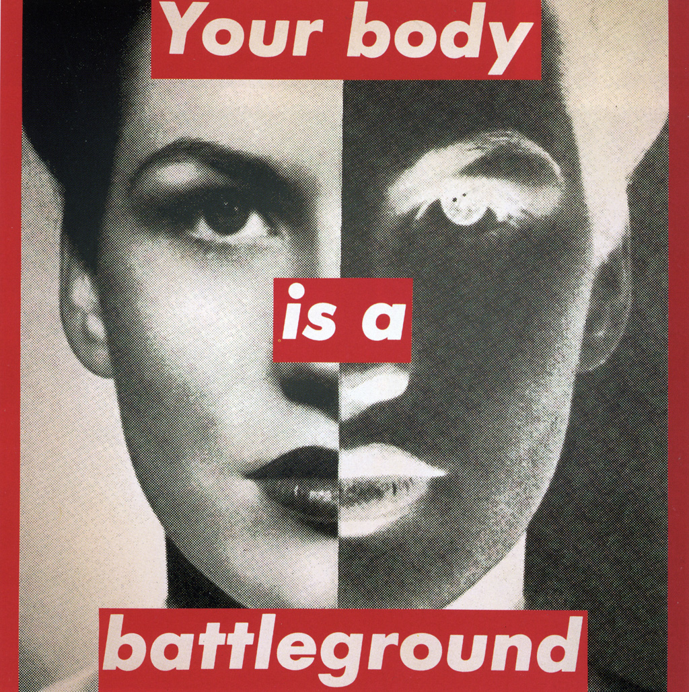

Barbara Kruger

Slide 12
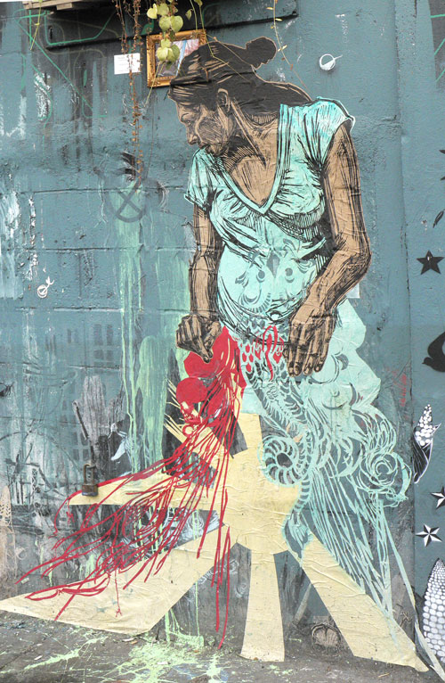
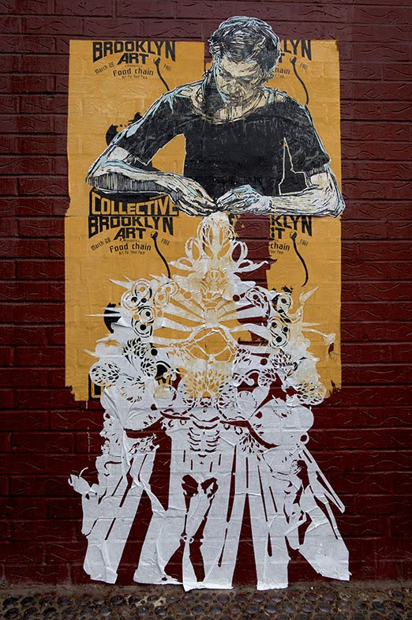
Swoon

Slide 13

Blu

Slide 14
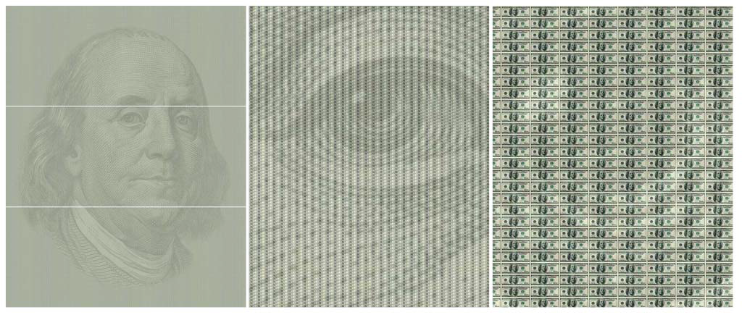
Chris Jordan
125,000 one hundred dollar bills, $12.5 billion , represents the amount of
money the United States spent every hour on the war in Iraq.

Slide 15
What social issues can you give voice to?

