Slide 1
Our two brains!

Slide 2
Recording Brain Activity

Slide 3
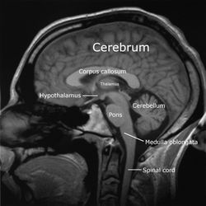
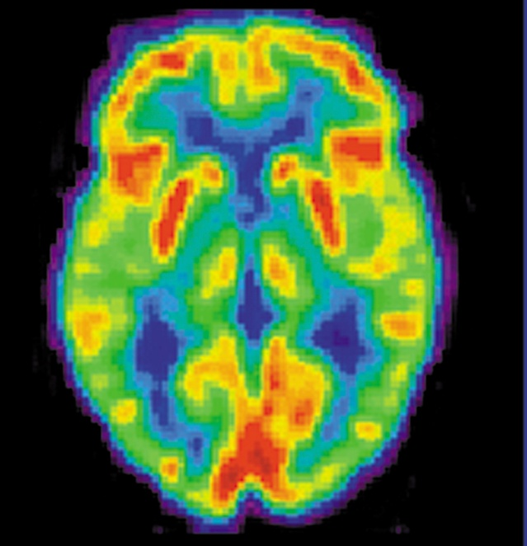
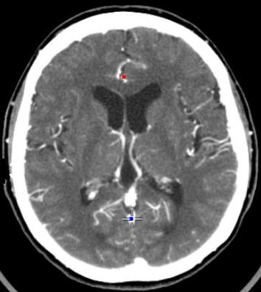
Images of the Brain
MRI Scan-
uses magnetic fields, radio waves, computers to map brain structures
PET Scan-
examines brain function and chemical activity
CT Scan-
Computer enhanced topography/ x-ray of structures

Slide 4
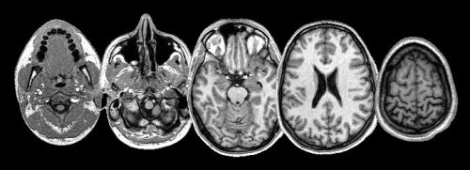
MRI vs fMRI
MRI | FMRI
Focused on anatomical structure | Focused on metabolic processes (using blood flow)
Shows processes as they happen in space | Shows processes as they happen in time
Being widely used | Being used sparingly Source: http://theydiffer.com/difference-between-mri-and-fmri/

Slide 5
Which face looks happier?

Slide 6
A

Slide 7
B

Slide 8
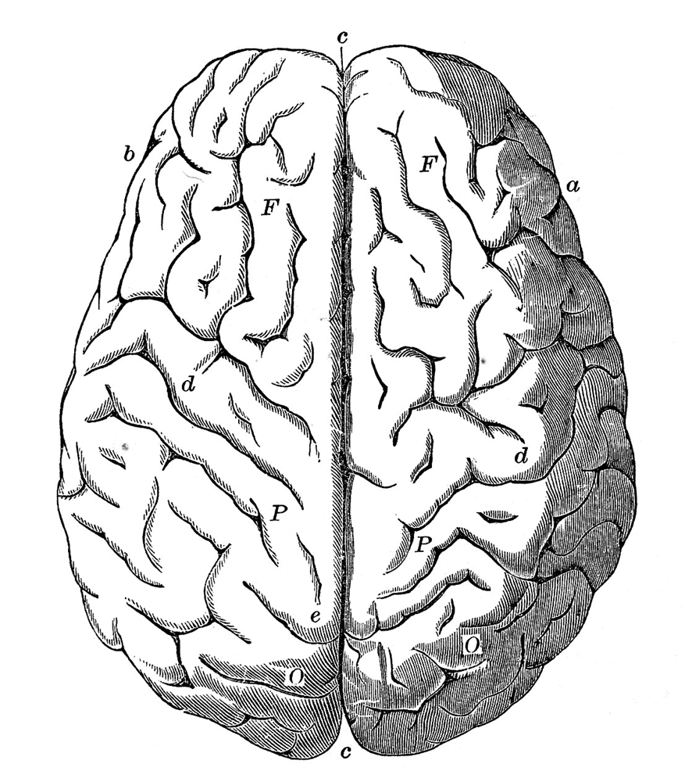

Slide 9
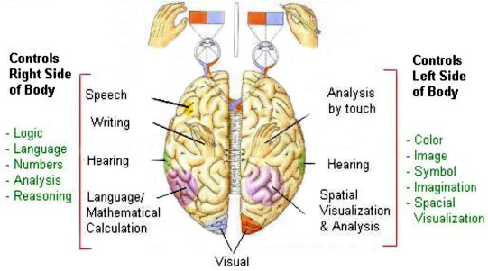
Specialization in the Brain’s Hemispheres

Slide 10
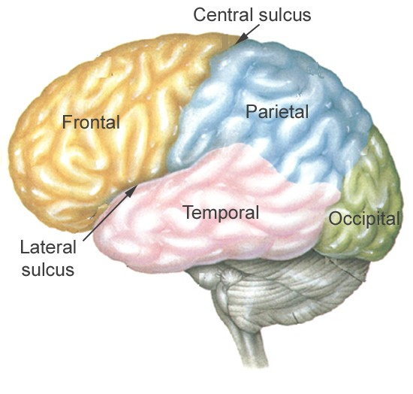
Lobes of the Brain

Slide 11
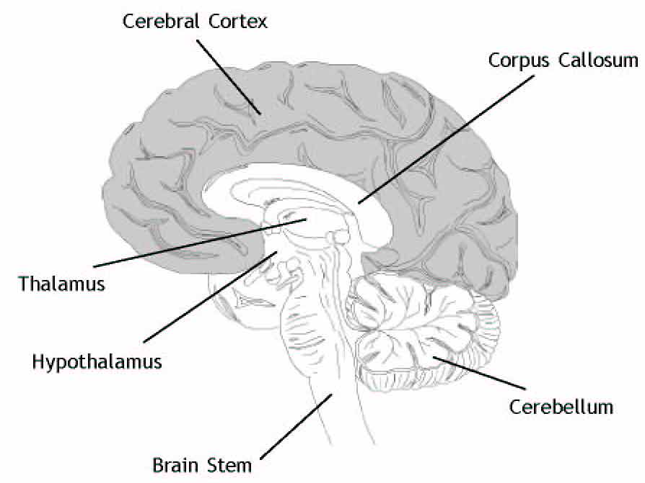
The Brain

Slide 12
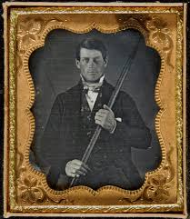
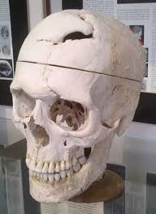
Phineas Gage

Slide 13
Splitting the Corpus Callosum

Slide 14
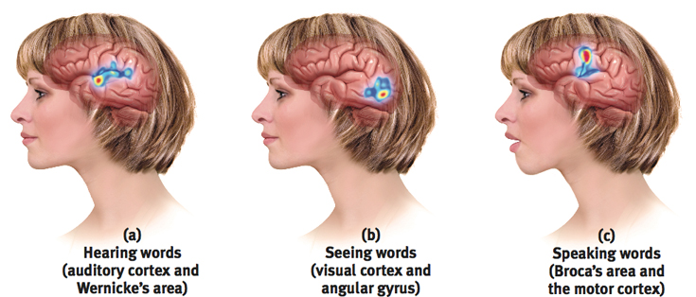

Slide 15
Which face looks happier?

Slide 16
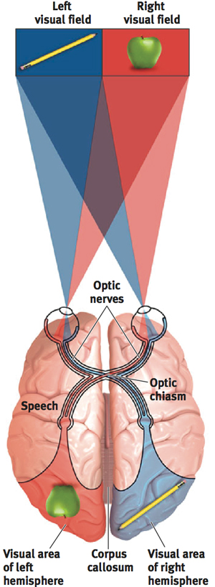

Slide 17
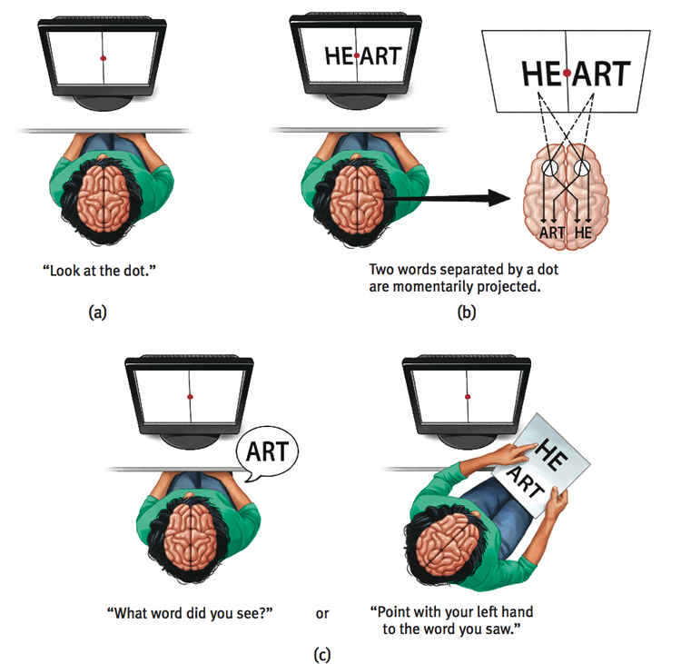

Slide 18
Problem
If we flash the picture of a cat to the right hemisphere of a split brain patient ..
Would each hemisphere observe the cat?
Would the person be able to say the word cat?
What would the person verbally report seeing?
How could the person correctly identify what was shown?

Slide 20
Wernicke's Aphasia
Broca’s Aphasia

Slide 21
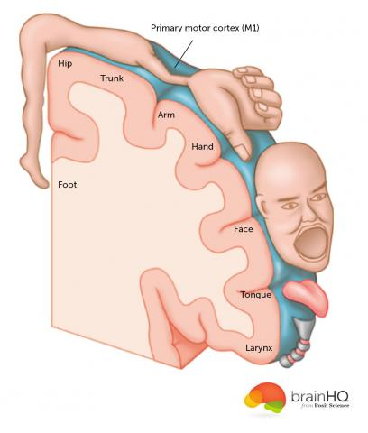
Homonculus

Slide 23
Brain Plasticity
Hemispherectomy and brain plasticity
Mirror therapy for Phantom limbs part 1
Part 2

Slide 24
The Nervous System(s)
CNS = Spinal cord (reflex) and brain (higher order responses)
Central Nervous System (CNS) | Peripheral Nervous System (PNS)
Brain (Higher order processing) | Somatic (SNS) - Sensory and motor neurons - voluntary | Autonomic (ANS) - Involuntary movement (like breathing)
Spinal Cord (reflexes)
 |  | Sympathetic – fight or flight, emergency center | Parasympathetic – calms down after emergency
Sensory vs motor neurons Sensory go to the CNS Motor go from the CNS to muscles

Slide 26
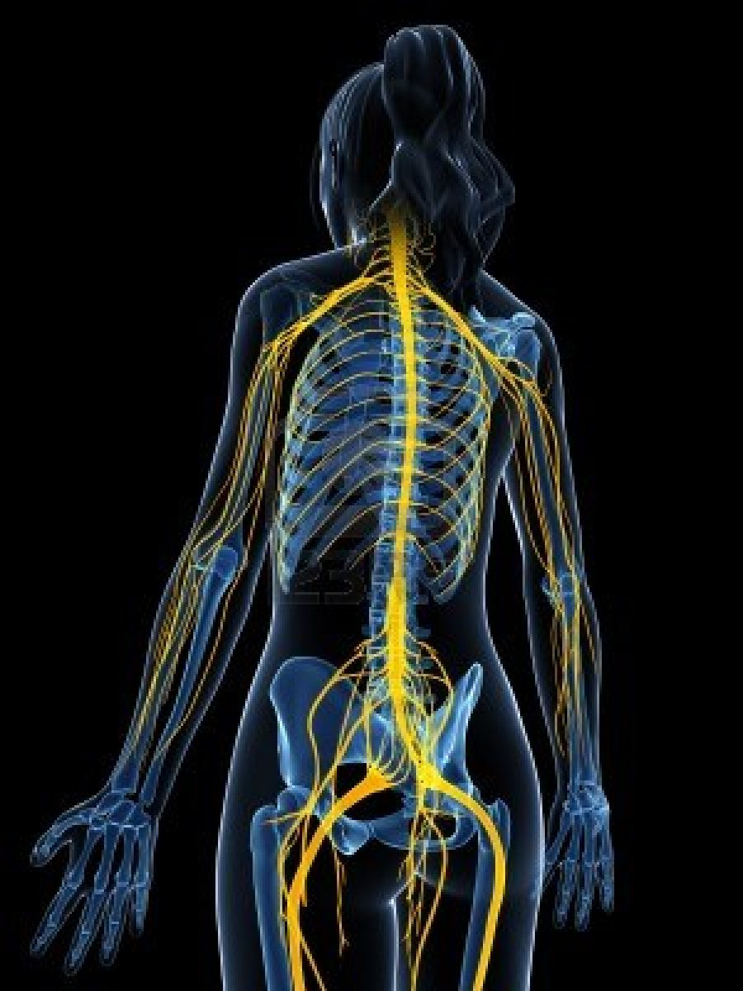

Slide 27
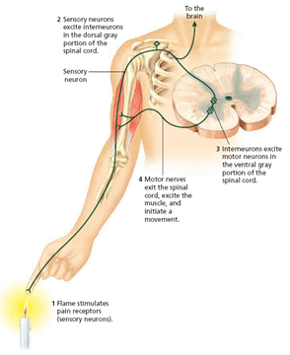
Afferent –Sensory Interneurons Efferent - Motor

Slide 28
Peripheral nervous system (PNS) - all nerves and neurons that that run through the body itself
Somatic nervous system - nerves that carry information from the senses to the CNS and from the CNS to the voluntary muscles of the body.
Autonomic nervous system - nerves that carry information to all of the involuntary muscles, organs, from the CNS
Sympathetic division (fight-or-flight system) - part of the ANS responsible for reacting to stressful events and bodily arousal (excite)
Parasympathetic division - part of the ANS that restores the body to normal functioning after arousal and is responsible for the day-to-day functioning of the organs and glands (slow back down)

Slide 29
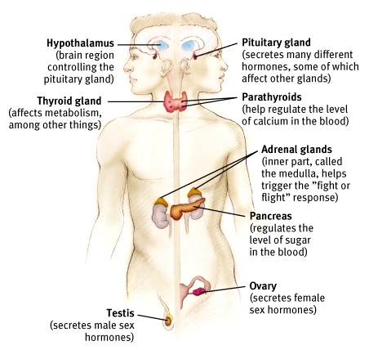
The Endocrine System
The Endocrine System is the body’s “slow” chemical communication system. Communication is carried out by hormones synthesized by a set of glands.
Notes:
OBJECTIVE 10| Describe the nature and functions of the endocrine system and its interaction with the nervous system.

Slide 30
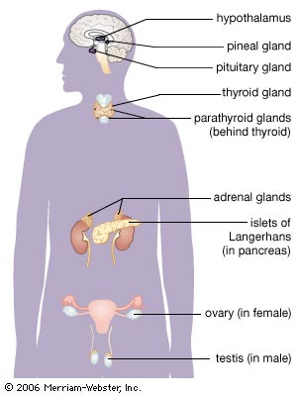
The Endocrine System
Glands - secrete chemicals into bloodstream - help control bodily functioning
- Hormones: chemical substances released by the glands (30 different) act like neurotransmitters
- Hypothalamus: controls eating, linked to emotion & reward center, controls the endocrine system.
- Pituitary Gland: “Master Gland” – regulates growth and controls other glands

