Slide 1
Developmental Psych

Slide 2
Questions for Developmental Psychologists
Nature vs Nurture?
Continuity vs Stages?
Stability vs. Change?

Slide 3
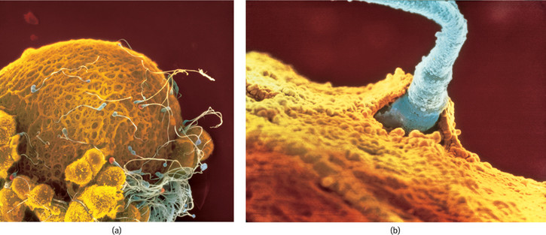
200,000,000 sperm vs. 1 egg
Less than ½ of zygotes survive 1st 3 weeks!

Slide 4
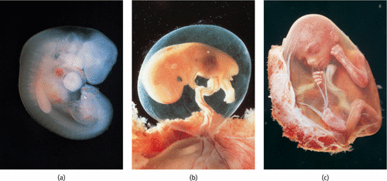
Embryo to Fetal Stage
teratogens – chemicals and viruses from the mother than can cause harm and disrupt development
Example – Alcohol can lead to Fetal Alcohol Syndrome
1 in 800 infants
Smaller head
Lifelong brain abnormalities

Slide 5
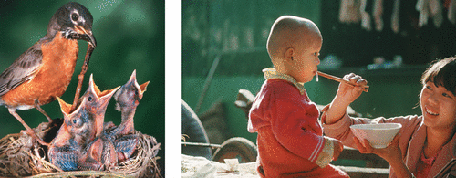
“Preprogramming”
We are predisposed as humans to respond to cries for nourishment
Babies predisposed to receive it (rooting reflex).

Slide 6
Reflexes

Slide 8
Can babies learn?
They can gaze
What interests them?
New information?
Habituation studies
Babies stare at new material, once they start to look away sooner (the information is no longer novel) it’s a sign that they have incorporated the stimulus into their understanding (learning)

Slide 9
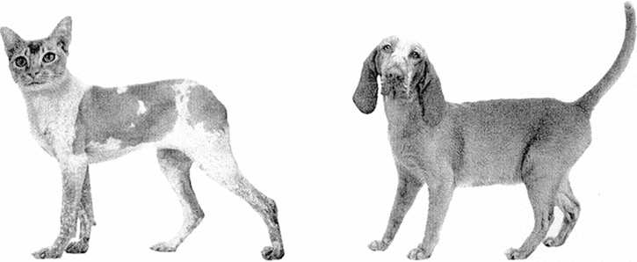
Are we predisposed to notice certain things?
A B

Slide 10
A B

Slide 11
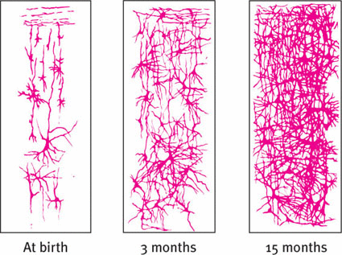
Neural network scan of infants

Slide 12
Maturation
Orderly biological growth process –its inborn
Frontal lobes 1st
Crawling then Walking
Hippocampus develops later → infantile amnesia?

Slide 13
Critical periods
Windows during which exposure to certain stimuli or experiences will produce proper development

Slide 14
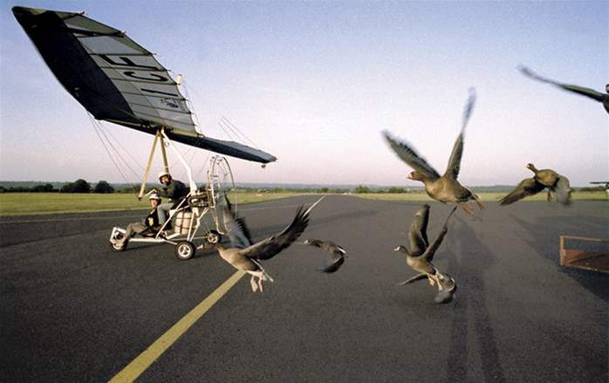
In animals - “Imprinting” – Konrad Lorenz

Slide 15
In humans – “Attachment”
The emotional tie we share with another person shown in young children through closeness to caregiver and distress at separation.

Slide 16
Original Theory: we become attached to those that satisfy our need for nourishment
Hypothesis???
A baby, if given the choice between a mother that provides nourishment and a mother that provides comfort will become attached to the mother that provides nourishment

Slide 17
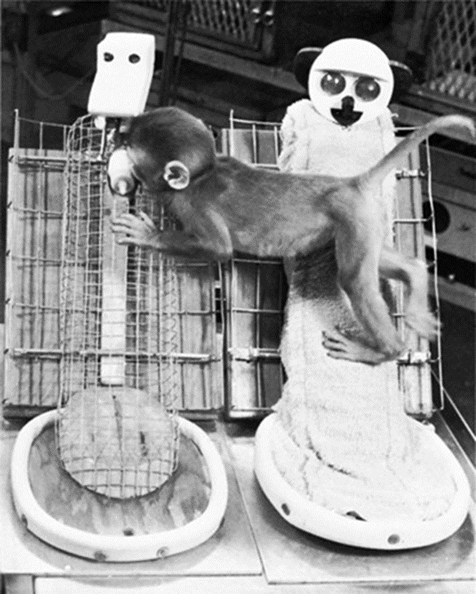
The experiment
As you watch, make note of the behaviors of the monkey’s. What does their behavior suggest about attachment and the effects of attachment? Ethical concerns?
Cloth mother vs Wire Mother
Harlow’s revised theory: We become attached to those that provide us with contact comfort
Conclusion: The cloth mother becomes a “safe haven” or base from which to explore. Comfort, contact & familiarity are the keys to attachment, not nourishment.

Slide 18
Types of attachment – Mary Ainsworth
“Strange situation” scenario
Secure, Ambivalent or Avoidant
For the following clip make note of the characteristics of what researchers refer to as “secure attachment” and “insecure attachment”
Strange Situation
Attachment study

Slide 19
 | Secure Attachment | Ambivalent Attachment | Avoidant Attachment
Separation Anxiety | Distressed when mother leaves. | Infant shows signs of intense distress when mother leaves. | Infant shows no sign of distress when mother leaves.
Stranger Anxiety | Avoidant of stranger when alone, but friendly when mother present. | Infant avoids the stranger - shows fear of stranger. | Infant is okay with the stranger and plays normally when the stranger is present.
Reunion behavior | Positive and happy when mother returns. | Child approaches mother, but resists contact, may even push her away. | Infant shows little interest when mother returns.
Other | Will use the mother as a safe base to explore their environment. | Infant cries more and explores less than the other 2 types. | Mother and stranger are able to comfort the infant equally well.
% of infants | 70 | 15 | 15

Slide 20
Critical Periods
Imprinting in animals – within 1st 24 hours
Attachment in children – 1st year is critical.
What happens when children are separated?
Reunion

Slide 21
Up to 3 months of age - Indiscriminate attachments. The newborn is predisposed to attach to any human. Most babies respond equally to any caregiver.
After 4 months - Preference for certain people. Infants they learn to distinguish primary and secondary caregivers but accept care from anyone;
After 7 months - Special preference for a single attachment figure. The baby looks to particular people for security, comfort and protection. It shows fear of strangers (stranger fear) and unhappiness when separated from a special person (separation anxiety). Some babies show stranger fear and separation anxiety much more frequently and intensely than others, but nevertheless they are seen as evidence that the baby has formed an attachment. This has usually developed by one year of age.
After 9 months - Multiple attachments. The baby becomes increasingly independent and forms several attachments.

Slide 22
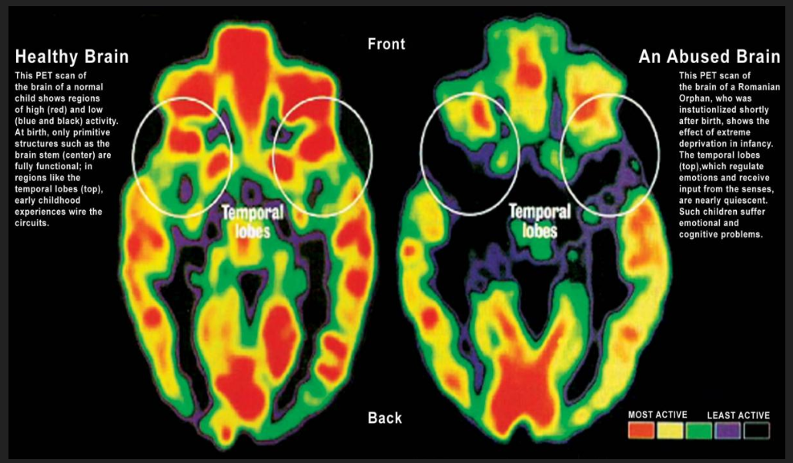
Critical periods for brain development

Slide 23
What if you are denied the needed stimuli in the “critical period?”
The fate of “Practice Babies?”

Slide 24
More Critical periods & Development
Watch the story of “Genie.” and respond in a reaction page (typed).
Why were language researchers interested in her case?
What might her case-study suggest about the idea of a critical period?
What other factors (confounds) make it difficult to determine the existence of a critical period from her case?

