Slide 1
From Darwin to Social Darwinism

Slide 2
Charles Darwin
1831 – HMS Beagle Galapagos Islands
1859 – On the origin of Species by Means of Natural Selection
In struggle for survival some animals may have chance “variations” which enable them an advantage to survival
These will survive over others and pass on these variations to their offspring
New species eventually emerge from compounding variations over time

Slide 3
1871 – The Descent of Man
“man is the co-descendant with other mammals of a common progentior.”

Slide 4
Social Darwinism
Herbert Spencer

Slide 5
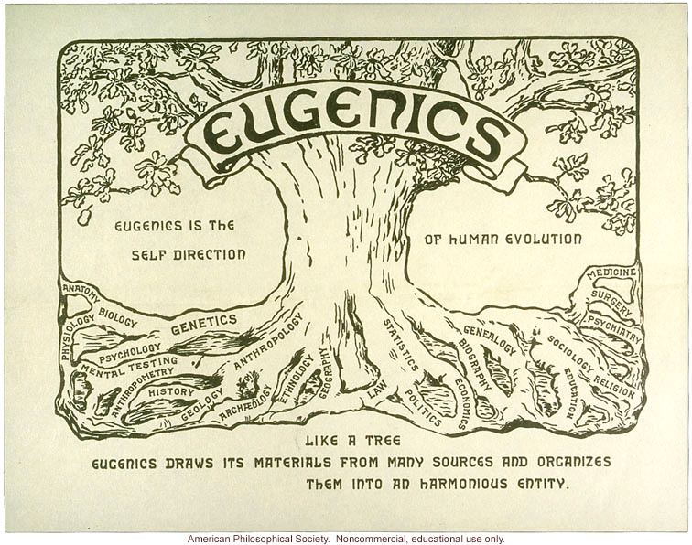

Slide 6
Britain - Eugenics –Sir Francis Galton 1883

Slide 7
Eugenics Creed
Sir Francis Galton, the founder of Eugenics and Darwin's half-cousin, dismissed the environmental factors that Darwin insisted were critical to natural selection in favor of an agricultural approach, based primarily on conjecture. When Charles Davenport brought Eugenics in the United States, he delineated the Eugenics Creed as follows:
- I believe in striving to raise the human race to the highest plane of social organization, of cooperative work and of effective endeavor.
- I believe that I am the trustee of the germ plasm that I carry; that this has been passed on to me through thousands of generations before me; and that I betray the trust if (that germ plasm being good) I so act as to jeopardize it, with its excellent possibilities, or, from motives of personal convenience, to unduly limit offspring.
- I believe that, having made our choice in marriage carefully, we, the married pair, should seek to have 4 to 6 children in order that our carefully selected germ plasm shall be reproduced in adequate degree and that this preferred stock shall not be swamped by that less carefully selected.
- I believe in such a selection of immigrants as shall not tend to adulterate our national germ plasm with socially unfit traits.
- I believe in repressing my instincts when to follow them would injure the next generation

Slide 8
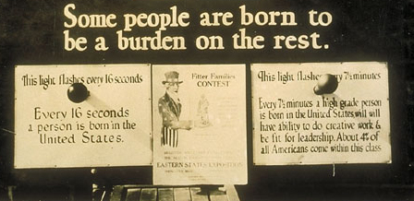

Slide 9
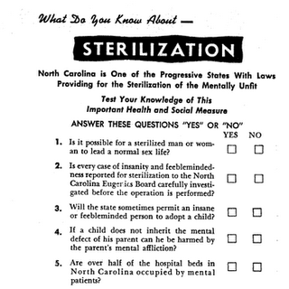

Slide 10
Eugenics in the US
Eugenics and California

