Slide 1
The Legacy of the Enlightenment?
The democratic revolutions begun in America in 1776 and continued in Amsterdam, Brussels, and especially in Paris in the late 1780s, put every Western government on the defensive.
Reform, democracy, and republicanism had been placed irrevocably on the Western agenda.

Slide 2
The Legacy of the Enlightenment?
New forms of civil society arose –-- clubs, salons, fraternals, private academies, lending libraries, and professional/scientific organizations.
4. Theoretically endowed with full civil and legal rights, the individual had come into existence as a political and social force to be reckoned with.
5. Established the concept of separation of church and state and the idea of deism as opposed to formal traditional religion

Slide 3
The War of Austrian Succession (p. 514) 1740 – 1748
Why:
Charles VI of Austria (HRE) bargains with the nations of Europe to recognize his daughter Maria Theresa as the rightful heir to the Austrian throne (the Austrian Pragmatic Sanction)
Upon his death several nations ignore the agreement and take advantage of the new ruler → the War of Austrian Succession
What:
Prussia’s Frederick the Great invades Silesia (Aus)
Great Britain aids Austria, France aids Prussia
French took Madras from GB, GB took Louisburg in America from French
French took Austrian Netherlands from Austria
Result:
Peace of Aix la Chapelle in 1748 → return of all territories to original powers EXCEPT Silesia
Prussia | Vs | Austria
France |  | Britain

Slide 4
The Seven Years War 1756 - 1763
“Diplomatic Revolution” – Old rivalries are demolished in favor of new alliances based on the changing world stage
Austrian Hapsburgs – want Silesia back and to limit Prussian power, team up with French Bourbons (traditional enemies) and later Russia
Great Britain who wants to stop French domination teams up with Prussia
The theater of operations:
Europe
Americas (French and Indian War / aka “Great War for Empire”)
India (Great War for Empire – GB vs. FR)
Result → GB becomes the greatest colonial power
French alliance with Austria later cemented with a royal wedding – Louis XVI to Marie Antoinette
Prussia | Vs | Austria
England |  | France

Slide 5
The Old Regime – France
Notion of Privilege in govt.
27 million
3 Estates

Slide 6
1st Estate – Clergy
130,000 /27 mil.
10% land
Exempt from taxes

Slide 7
2nd Estate – Nobility
400,000 / 27 mil.
25-30% land
Control industry
Highest govt. positions (military / law / church)
Exempt from taille and most other taxes
Nobility of Robe & Nobility of Sword

Slide 8
3rd Estate - Commoners
Peasants alone =75-80% of pop about
35-40% of land
Over ½ own no land and still owe feudal dues
Skilled artisans and craftspeople
Bourgeoisie – 2.3 million
20-25% of land
Merchants / bankers / industrialists /doctors / public office/ lawyers etc.
Excluded from social and political privileges enjoyed by nobles

Slide 9
Salons
Bourgeois and nobles mix and discuss Enlightenment ideas
Bourgeois and Aristocracy compete for power in govt.

Slide 10
18th Century Problems

Slide 11
1. Prices and Unemployment
Prices rise faster than wages (65% - 22%)
Rents rise 140%
Bread prices rise – ½ salary (3/4 of diet)
Bad harvests
Manufacturing depression
Unemployment in cities
1/3 of population is below poverty level
Lords try to revive long forgotten taxes on peasants

Slide 12
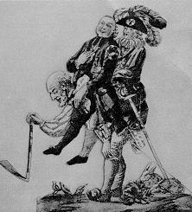
2. Ideas of noble privileged and absolutism face harsh criticism (philosophes) and American War veterans (Enlightenment Influence)

Slide 13
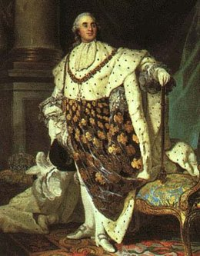
3. French Governments Debts
Wars – Louis XIV’s → American Revolution aid
Extravagance (parties/ luxuries)
Loans → huge interest payments (1/2 govt. spending)
25% pays army

Slide 14
Calonne – director of finances – urges Louis XVI to reform tax system
-dismissed
Jacques Necker – urged paring down spending on extravagances - dismissed
Parlements (Provincial Bodies) and Assembly of Notables (Nobles / Magistrates) refuse to cooperate with govt.s attempts at tax reform unless an Estates General is called

Slide 15
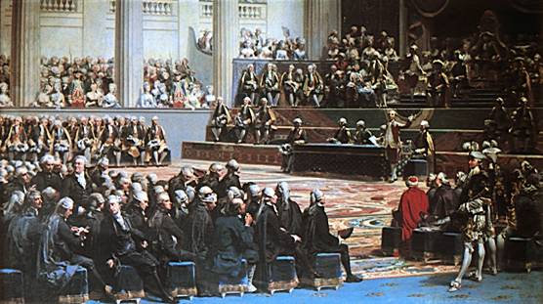
1789 - The Estates General
Last meeting 1614
Each Estate has one collective vote
1st – 300 delegates
2nd – 300 delegates
3rd – 600 delegates

Slide 16
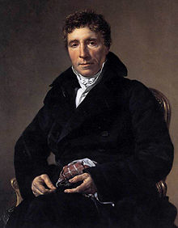
May 5th 1789
3rd Estate demands a vote by head not by order
Lovers of Liberty
Society of 30
Lower clergy
1st and 2nd Estates declare voting by estate
A few members from each join the 3rd estate
Abbe Sieyes – “What is the 3rd Estate?”

Slide 17
What is the Third Estate?
For each of the 4 classes of the nation write down in your own words what occupations they are charged with according to Abbe’ Sieyes?
What does Sieyès say (ha-ha!) about the “privileged order’s” role in government?
How does he characterize the relationship between the privileged order and the “Nation”?
Summarize in three sentences Sieyès' argument.

