Slide 1
Class notes 3/4/20
Personality – Psychoanalytic Perspective
Freud’s Psychosexual Stages
Carl Jung’s view of the psyche
***These notes go with the handout from class

Slide 2
Personality

Slide 3
Personality
Characteristic patterns of thinking, feeling and acting

Slide 5
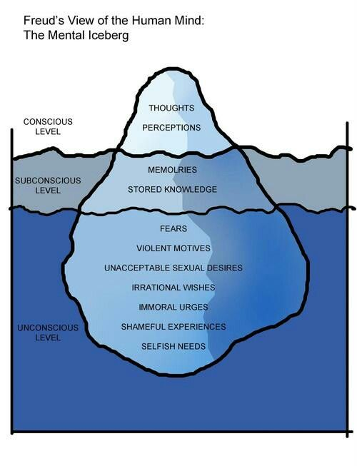

Slide 6
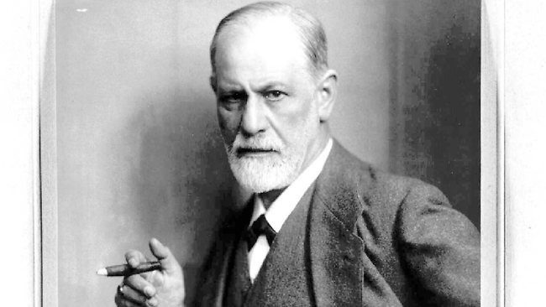
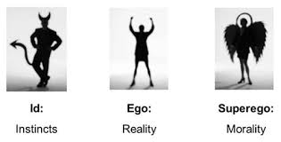
Psychoanalytic Perspective
Based on Freud – id / superego / ego battle
Unconscious is a repository of unacceptable desires → influence of our behaviors and patterns of thought
Case study – Little Hans

Slide 7
Freud’s “Psychosexual Stages of Development” (1915)
Stage | Focus
Oral (0 – 18 months) | Pleasure centers on the mouth – biting chewing, sucking – everything goes in the mouth
Anal (18 – 36 months) | Pleasure focuses on bowel and bladder elimination; coping with demands for control of those parts by adults
Phallic (3 – 6 years) | Pleasure zone is the genitals; coping with incestuous feelings and hatred toward rival for those feelings (Oedipus complex / Electra Complex) Repression of feelings and later identification with the rival begins
Latency (6 – puberty) | A phase of dormant sexual feelings
Genital (puberty onward) | Maturation of sexual interests

Slide 8
Methodological problems with the case study
Hans’ father did the observing
Hans’ father did the reporting to Freud
Father was a physician, aware of the evolving theory, and reputation of Freud
Freud published only a sample of the letters he received from Hans’ father
We are not given the details of what happened in Hans’ therapy
Freud’s theory came first and the Hans study seemed to “prove it” – aka prone to “confirmation bias”

Slide 10
Defense Mechanisms
The ego’s protective method of reducing anxiety about truths we don’t want to face by unconsciously distorting reality.
Repression
Regression
Reaction formation
Projection
Rationalization
Displacement
Sublimation

Slide 11
Sublimation examples
You feel an urge to be unfaithful to your partner. Rather than act on these unacceptable urges, you channel your feelings into doing projects around the yard.
You become distraught at the end of a relationship. In order to deal with these negative emotions, you begin writing poetry. You are able to transfer your heartbreak and emotional upset into a creative activity.
You are reprimanded by your manager at work. You feel fearful that you might lose your job, but you decide to walk home from work in order to think and release your frustrations. This activity not only gives you time to cool off and reflect; it also benefits your physical health.
https://www.verywellmind.com/what-is-sublimation-in-psychology-4172222

